Slide 1
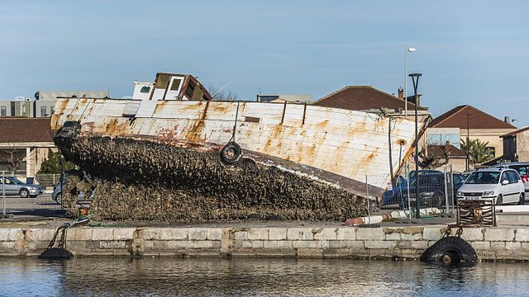

Yale-UNIDO Train-the-Facilitator Workshop in Green Chemistry
Accidents and Unintended Consequences
CENTER for GREEN CHEMISTRY
and GREEN ENGINEERING at YALE
Image: Wikimedia Commons, Quai Paul Riquet (embankment) in Sète, Hérault, France, Author: Christian Ferrer

Slide 2
Topics To Be Covered
Chemical and Industrial Accidents
  Union Carbide, 1984
  Cuyahoga River, 1969
  Port of Tianjin, 2015
  Kolontar, 2008
  Anything else!
Unintended Consequences
Green Chemistry is Everybody’s Job
Perspective and Context
Green Chemistry – Where do we go from here?

Slide 3
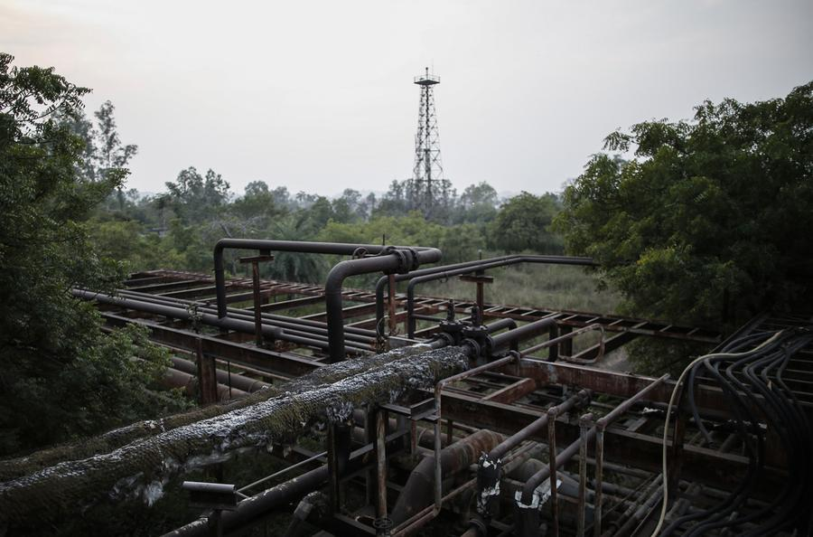
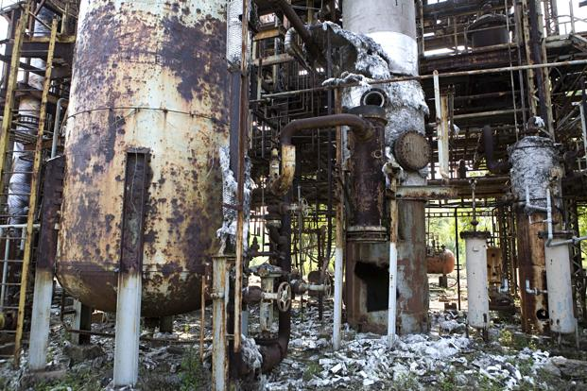
Industrial and Chemical Accidents
What do you see?
What do you think happened?
Aftermath of infrastructure damage
https://www.theatlantic.com/photo/2014/12/bhopal-the-worlds-worst-industrial-disaster-30-years-later/100864/

Slide 4
Union Carbide, 1984
Poison gas leaked from a Union Carbide factory (Bhopal, India), killing thousands of people instantaneously, and injuring many more (many of whom died later of exposure). Up to 20,000 people have died as a result of exposure (3-8,000 immediately after). More than 120,000 still suffer from ailments caused by exposure.
How did this happen?
Methyl isocyanate – used to make pesticides was being stored in large quantities on-site at the plant.
Methyl isocyanate is a highly reactive molecule, undergoing an exothermic process with water
Most safety systems either failed, were inoperative or ignored by employees
Water was released into the tank holding the methyl isocyanate.
The reaction occurred and the methyl isocyanate rapidly boiled, producing large quantities of toxic gas, released into the surrounding region

Slide 5
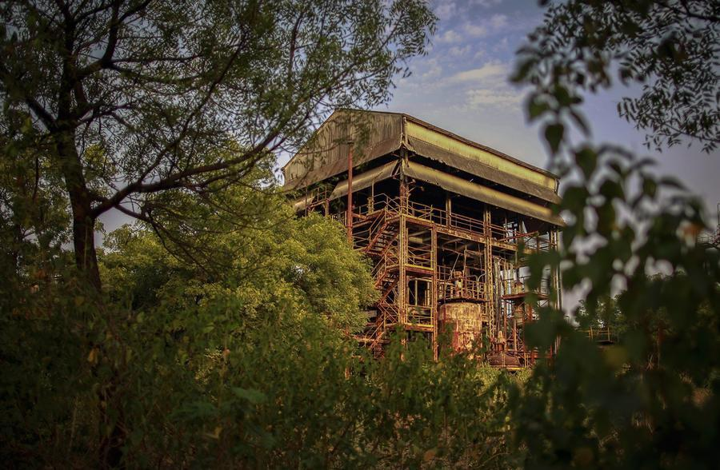
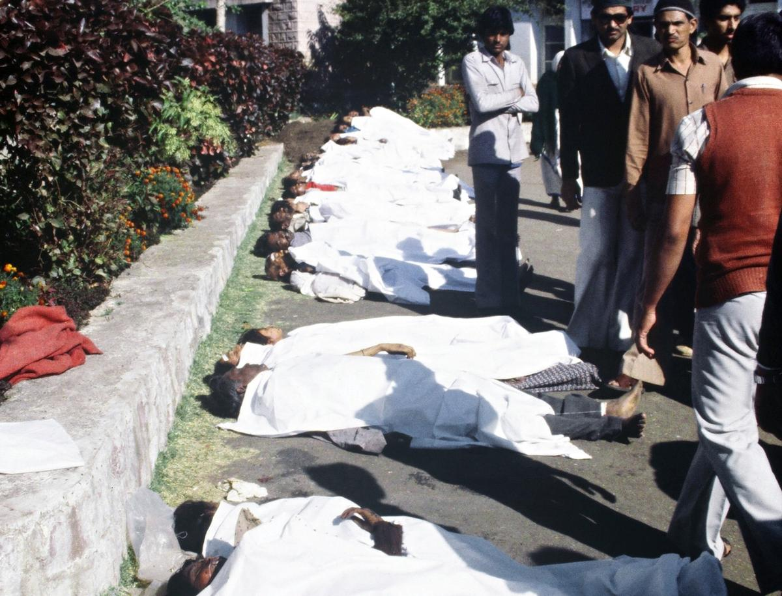
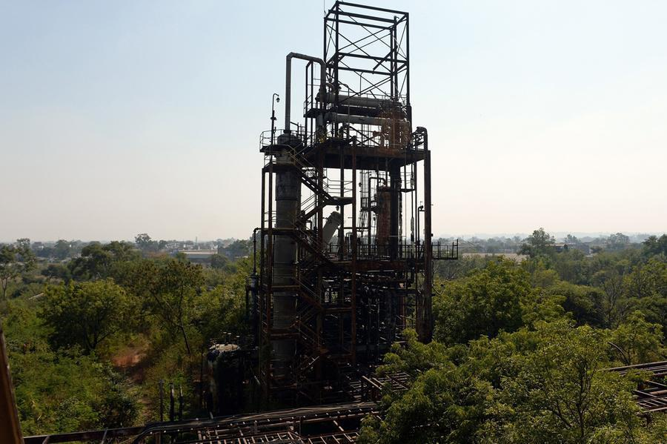
Union Carbide, 1984
Flare tower where toxic methyl isocyanate gas was released into the air.
What is left of the abandoned
Union Carbide plant.
Bodies of victims following the 1984 pison gas leak.
https://www.theatlantic.com/photo/2014/12/bhopal-the-worlds-worst-industrial-disaster-30-years-later/100864/

Slide 6
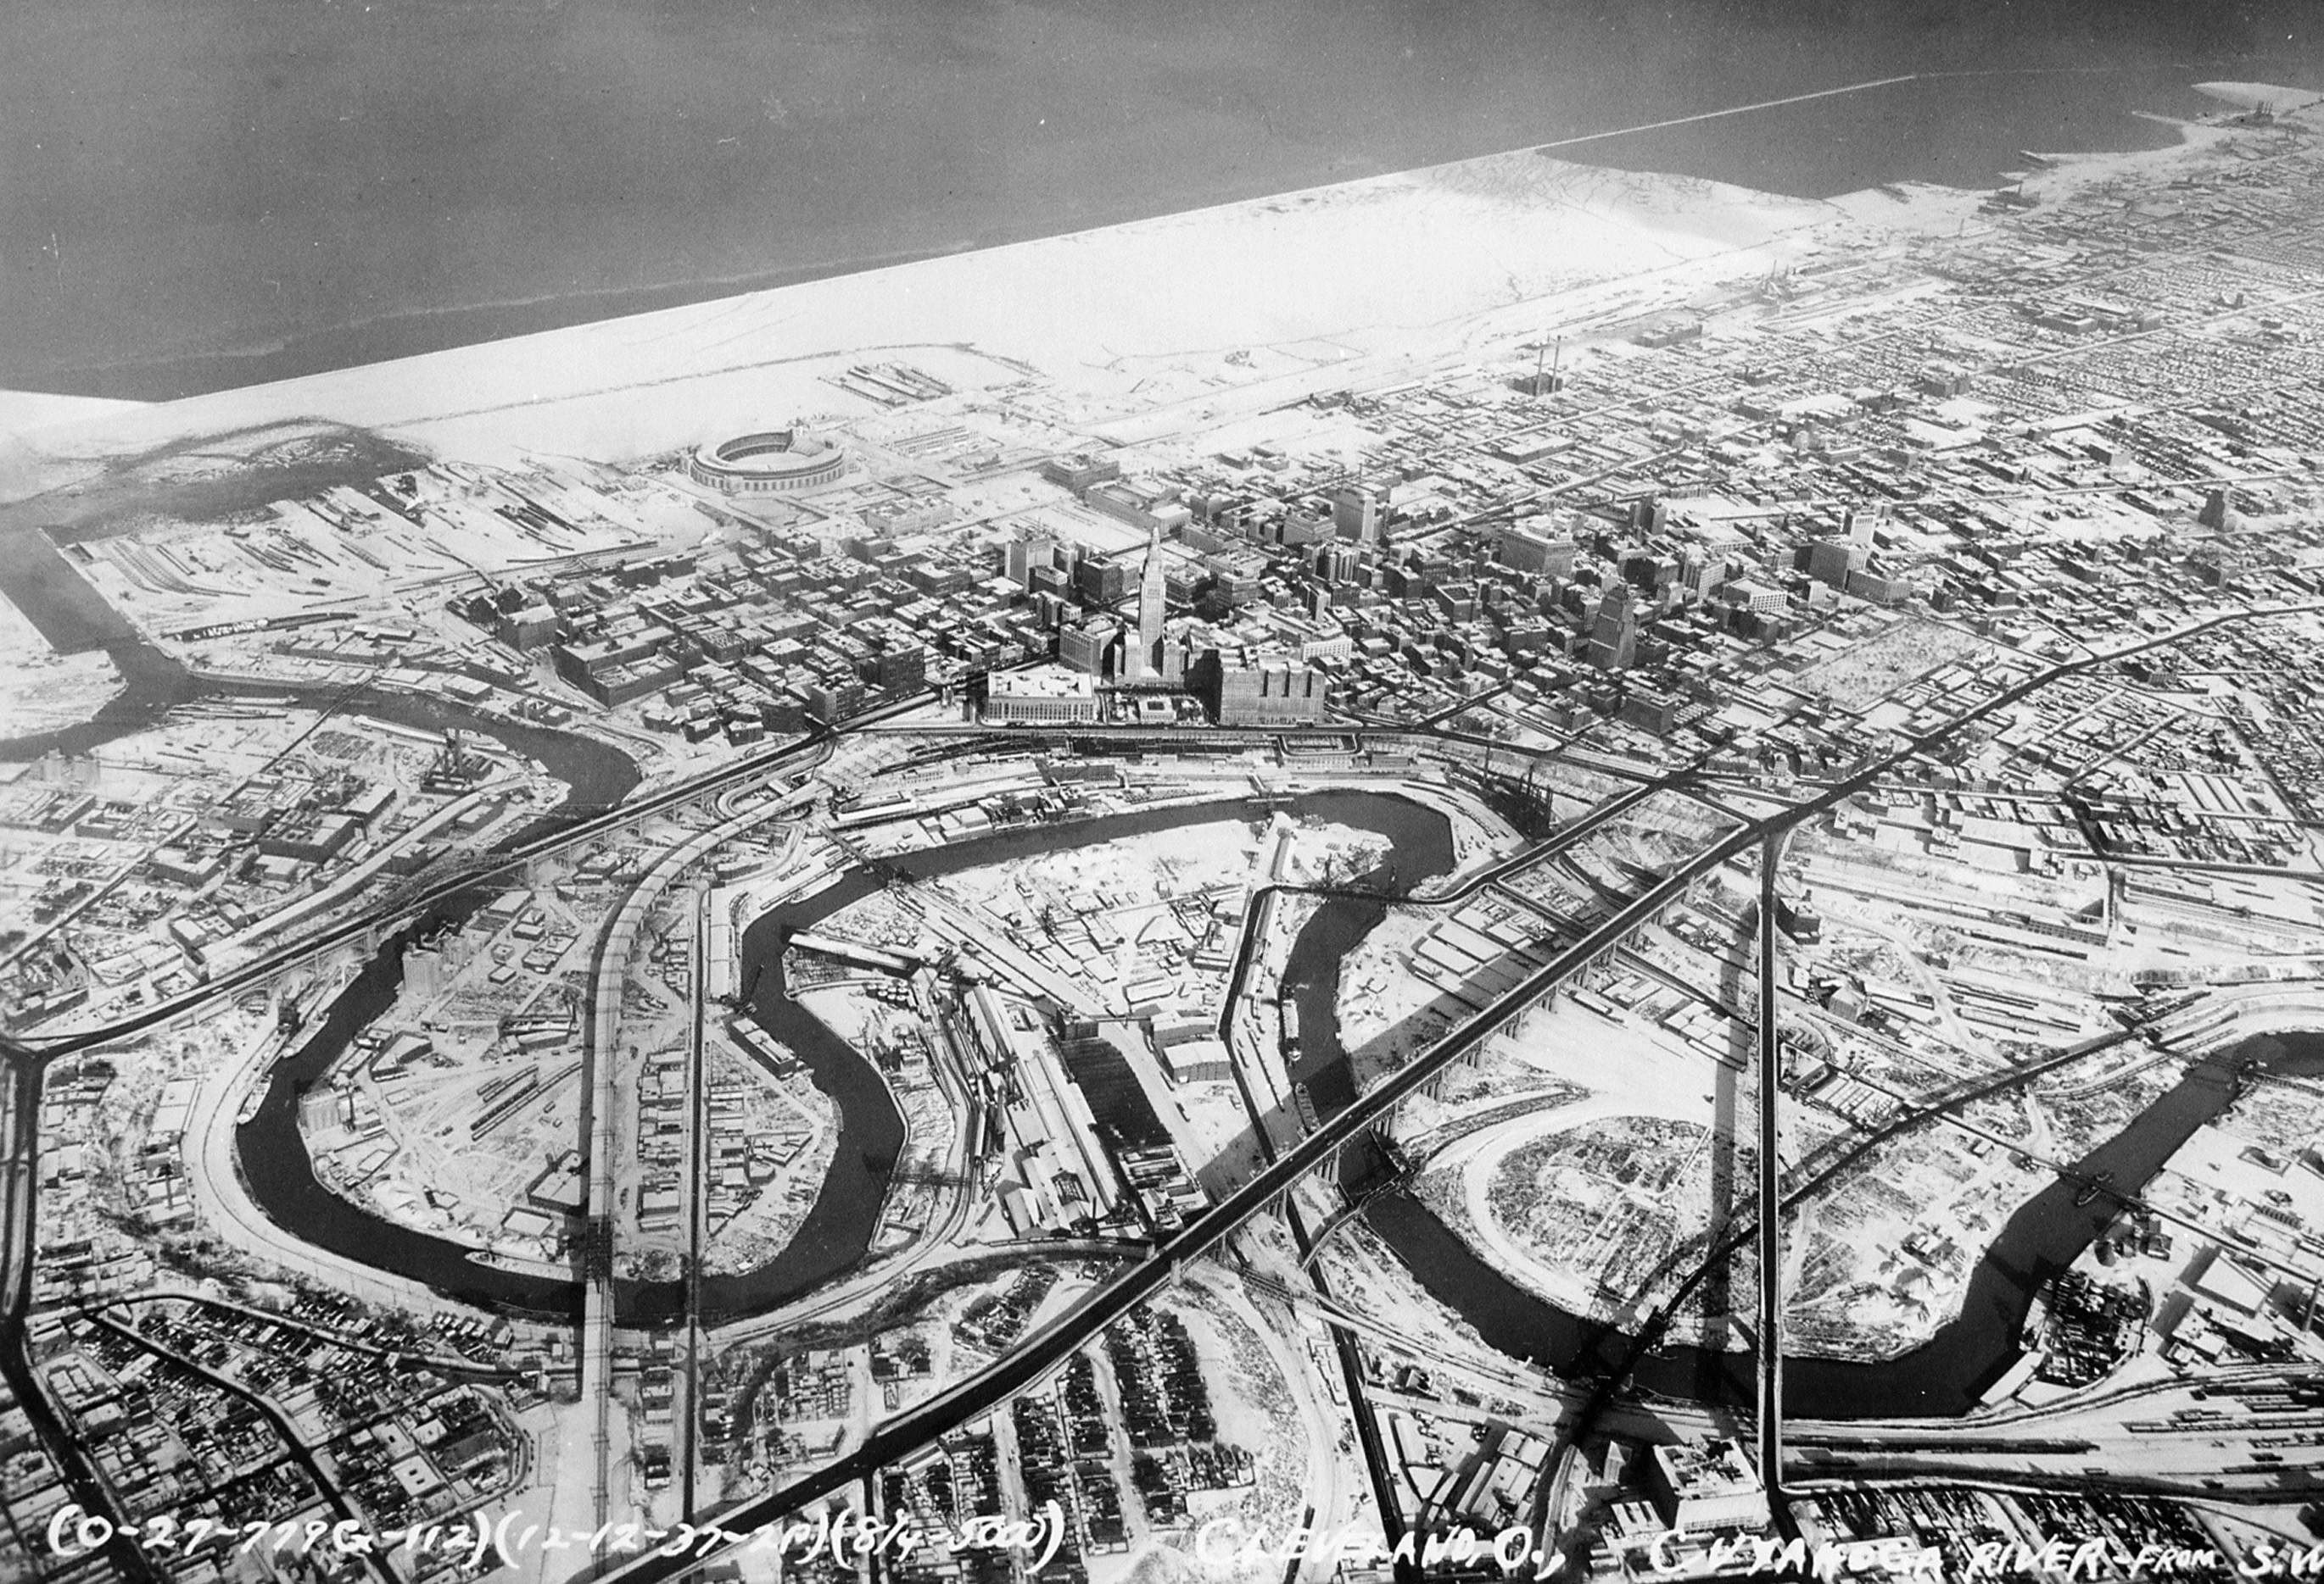
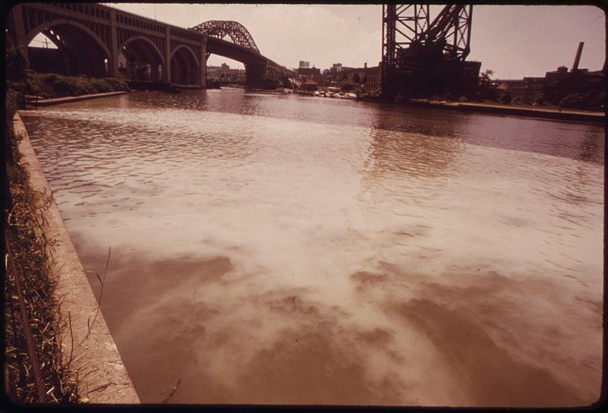
Cuyahoga River – Cleveland, Ohio, 1969
  There were many things being dumped in the river such as: gasoline, oil, paint, and metals. The river was called "a rainbow of many different colors."
  Fires erupted on the river several times before June 22, 1969, when a river fire captured national attention when Time Magazine reported it.
  Some river! Chocolate-brown, oily, bubbling with subsurface gases, it oozes rather than flows. "Anyone who falls into the Cuyahoga does not drown," Cleveland's citizens joke grimly. "He decays."
  - Time Magazine, August 1969

Slide 7
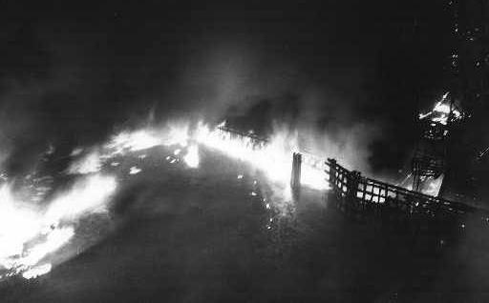
Cuyahoga River – Cleveland, Ohio, 1969
Images Courtesy of The Cleveland Press Collection, Cleveland State University Library; Author: Fred Bottomer, and James Thomas

Slide 8
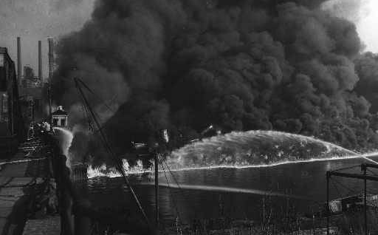
Cuyahoga River – Cleveland, Ohio, 1969
Images Courtesy of The Cleveland Press Collection, Cleveland State University Library; Author: Fred Bottomer, and James Thomas

Slide 9
Port of Tianjin, 2015
A series of explosions killed 173 people and injured hundreds of others at a container storage station.
The first two explosions occurred within 30 seconds of each other at the facility. The second explosion was far larger and involved the detonation of about 800 tons of ammonium nitrate. Fires caused by the initial explosions continued to burn uncontrolled throughout the weekend, repeatedly causing eight additional secondary explosions.
The facility stored large quantities of sodium cyanide and calcium carbide, as well as 800 tons of ammonium nitrate, which is principally used in manufacturing fertilizer.
In total, 304 buildings, 12,428 cars, and 7,533 intermodal containers were damaged.
The cost of damage was estimated at $9 billion.

Slide 10
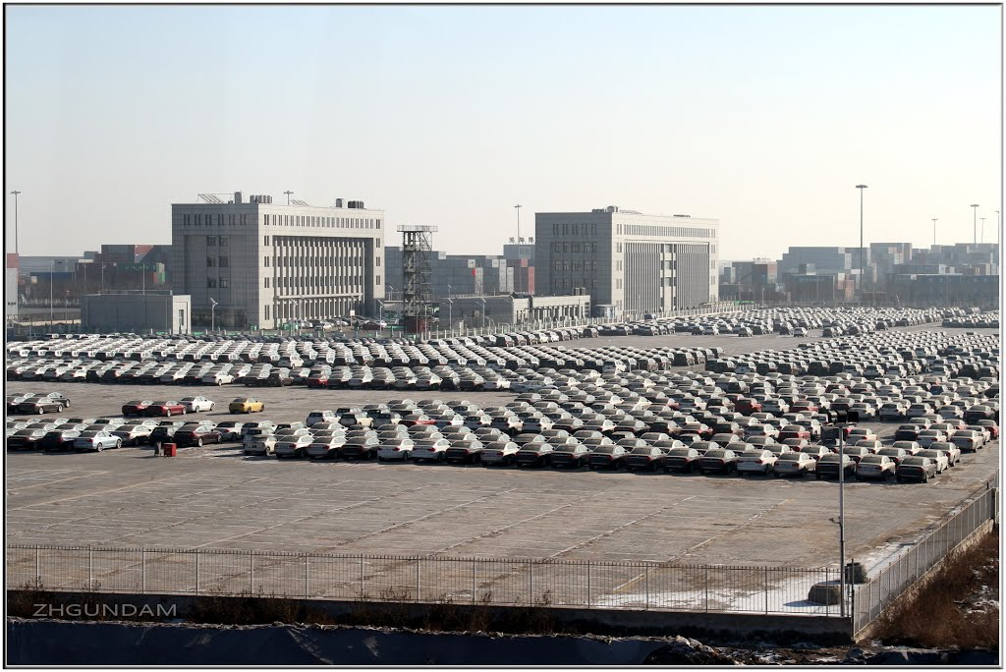
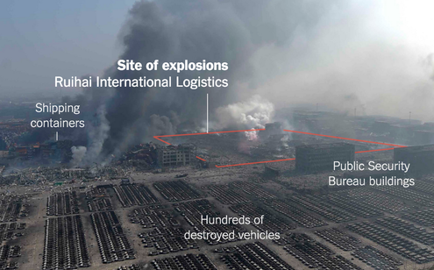
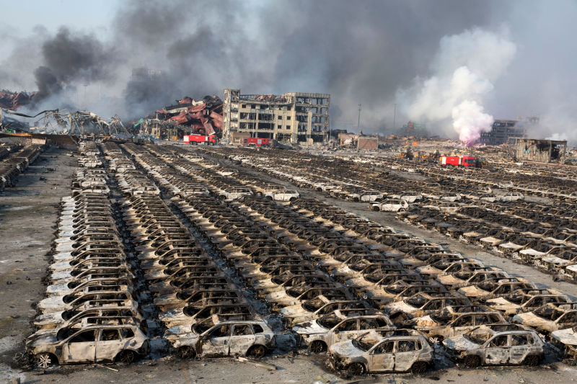
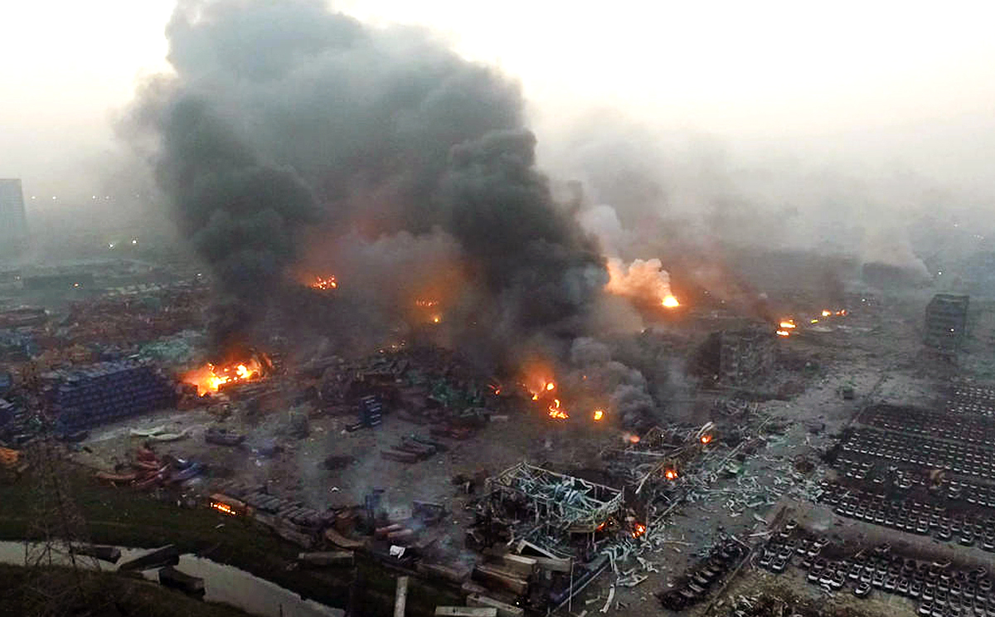
before
after
https://sploid.gizmodo.com/photos-from-the-devastating-aftermath-of-the-tianjin-ex-1723899654
https://www.nytimes.com/2015/08/21/world/asia/cyanide-levels-tianjin-china-explosion.html
http://www.radionacional.com.pe/sites/default/files/noticias/explosion%20tianjin.jpg

Slide 11
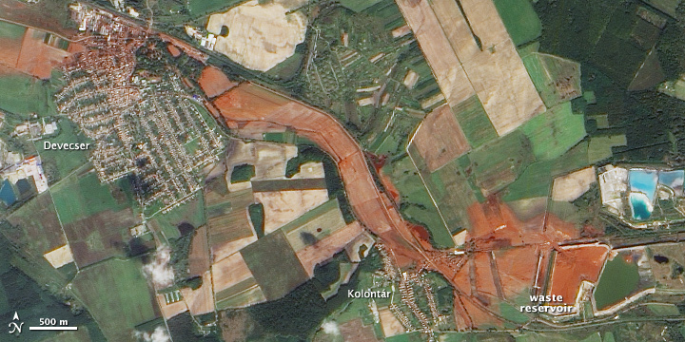
Kolontar: Major disaster resulting from a hydrometallurgical process
9 killed, 122 injured
1-3 meter wave of pH 13 solution (1 million m³)
extinguished all life in the Marcal river, immediately affected ca. 15 sq. mi. of land
"toxic red sludge" alkaline medium in the Bayer process for aluminium refinement - virtually unchanged since 1887.

Slide 12
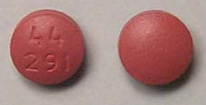
The Bayer process
aqueous OH⁻
(as in NaOH)
Al₂O₃ + Fe₂O₃
Fe₂O₃(s) + Al(OH)₄⁻
solid mixture
solid
dissolved
Safe?
all chemistry is done in water
chemicals are all food grade or approved for use in food industry

Slide 13
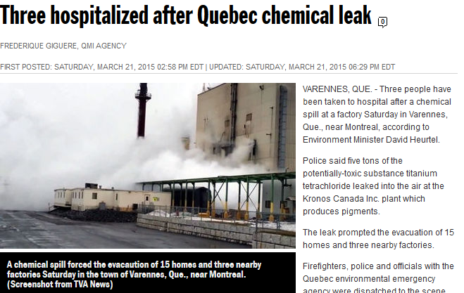
Chlorides and other common salts are a huge risk in chemical manufacturing

Slide 14
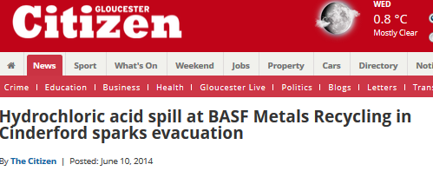
It would not be difficult to identify an industrial leak or an accident for every week of the year

Slide 15
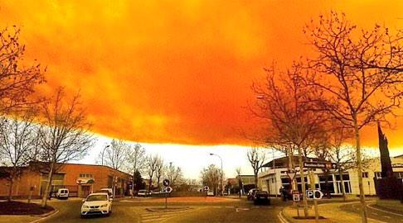
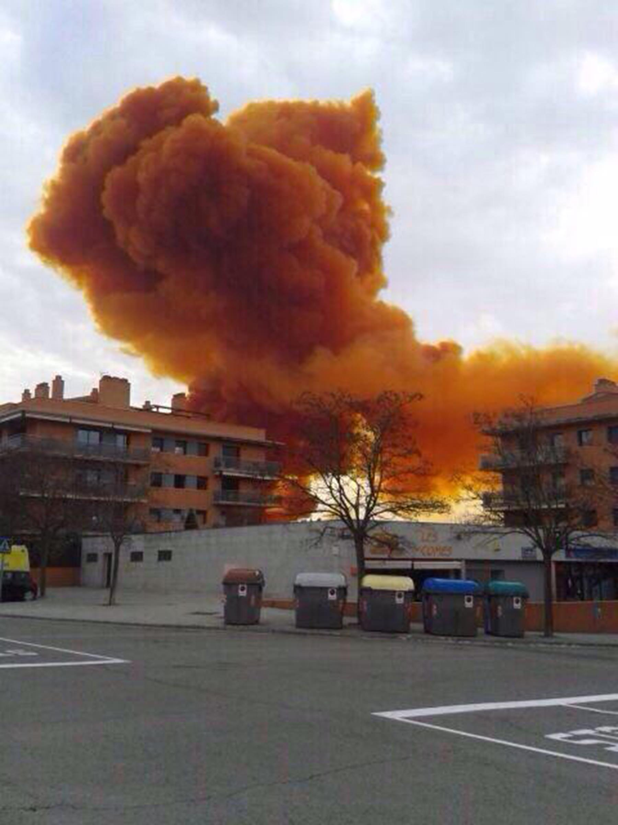
(Igualada, Spain, February 2015)
Source: Daily Mail

Slide 16
Top Five Chemicals Involved in Accidents with Injuries (2008)
Carbon monoxide (2,364 accidents): This colorless and odorless gas lurks silently and cause minor symptoms, such as headache and dizziness, or even sudden death. Many of the accidents in the CDC study involving CO happened at private homes. Of the five listed chemicals, CO had the highest rate of fatalities.
Ammonia (1,153): Ammonia can also cause sudden death. More that half of the accidents involving this colorless gas happened in agriculture, where it is applied directly on soil, and in food manufacturing plants, where it is used as a refrigerant.
Chlorine (783): Chlorine is a vital industrial chemical used to produce a wide range of products, including vinyl chlorine, plastics, aerosols, silicone, and foam. Most of the recorded injuries happened at paper and printing manufacturing facilities and at swimming pools.
Hydrochloric acid (326): Used to manufacture fertilizers, dyes and rubber, hydrochloric acid is highly corrosive to human skin. Most of the reports involving hydrochloric acid happened in warehousing and transportation.
Sulfuric acid (318): Another corrosive substance, sulfuric acid is used to make explosives, glue, other acids, and used to purify petroleum and in the picking of metal. A high percentage of recorded incidents with sulfuric acid involved equipment failure.
https://www.chem.info/article/2016/06/top-5-chemicals-involved-injury-causing-accidents

Slide 17
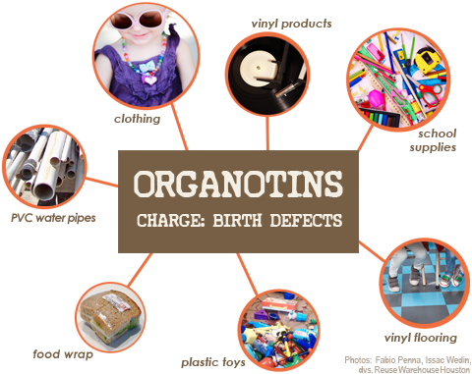
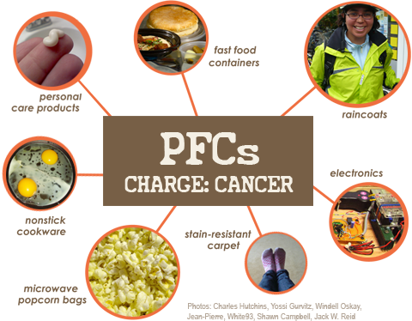
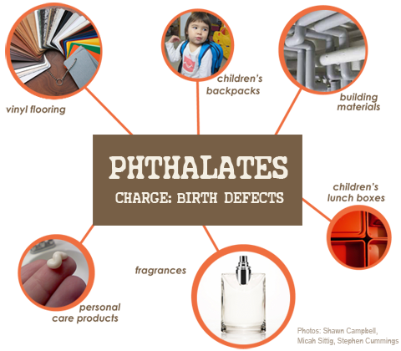
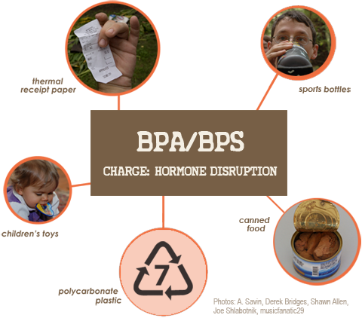
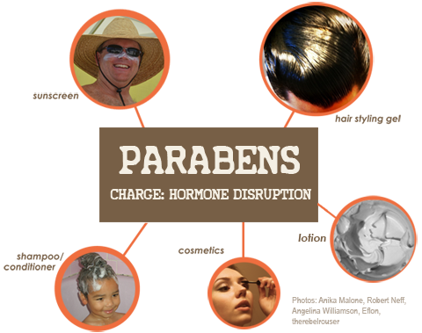

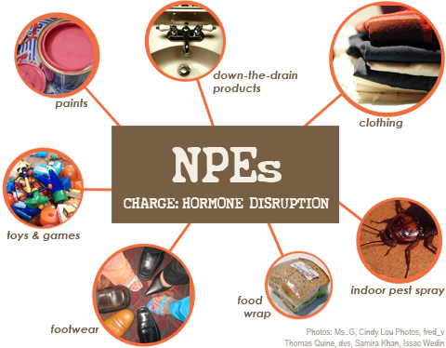
Consumer Products
Notes:
Organotin biocides, pesticides, PVC, obesity, immune damage: birth defects
Nonylphenol ethoxylates: household cleaners, drain cleaners, paints; ED, repro, birth defects, extreme aq tox
Triclosan: removed by FDA as a result of association with ED
Pesticides: kill bees, associated with Alziemers
Flame retardants: endocrine disruption
Preservatives in personal care products
Tricolosan: pesticide is found in products like toothpaste and cosmetics; endocrine disruption, learning disabilities, infertility
PFCs: stain-resistance, water-resistance; cancer, kidney disease
We can't escape them: even chemicals that are no longer manufactured are out there for good (eg PCBs) These chemicals migrate through the ecosystem through air/water and via global supply chains à 95% of Americans have synthetic chemicals used to make plastics and cosmetics in their blood (CDC).

Slide 18
Unintended Consequences – Industrial Era
Steffen et al. The trajectory of the Anthropocene: The Great Acceleration (Anthropocene Review) 16 January 2015. Design: Globaia

Slide 19
Unintended Consequences – Industrial Era
With an increasing population, the need for resources is even greater – which negatively impacts the environment.
Steffen et al. The trajectory of the Anthropocene: The Great Acceleration (Anthropocene Review) 16 January 2015. Design: Globaia

Slide 20
We’ve tried to fix some of these problems, but ended up doing the right thing in the wrong way.

Slide 21
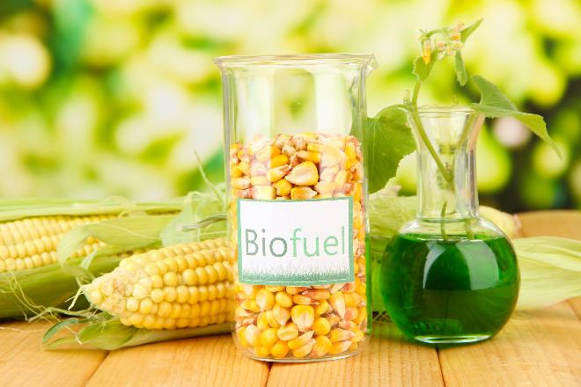
More Unintended Consequences
Biofuels made from corn that compete with food, livestock feed, and land use.
Image source: Adobe Stock
Notes:
Biofuels, specifically made from corn, an abundant vegetable, seems like a great idea. But when the corn needs land, fertilizers, water, and infrastructure for harvesting, then production of biofuel becomes unintended consequence.

Slide 22
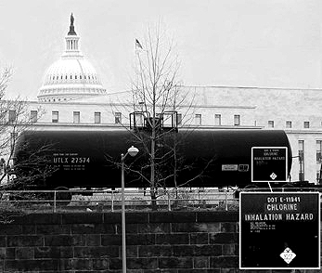
More Unintended Consequences
Purifying water with acutely lethal substances.
Chlorine transported in Washington D.C.
Image Source: http://jimdougherty.net/misc/
Notes:
Everyone should have an access to clean water. What if to get purified water, acutely lethal substances like chlorine are used?

Slide 23

More Unintended Consequences
Renewable energy through the use of precious, rare, toxic metals in photovoltaics.
Solar panel installed on the roof of the building.
Image source: Wikipedia
Notes:
Energy which does not rely on petroleum but rather on solar can be a good thing. But what if the solar panel technology relies on rare earth and precious metals?

Slide 24

Why do Green Chemistry?
“It’s not my job…”
Image source: Pixnio, Author: Amanda Mills, USCDCP

Slide 25

Chefs
The meals I make are delicious!
Sure, they’re poisonous.
But there are other chefs working on “non-lethal cooking”.
Image source: Wikipedia, Author: MMS

Slide 26
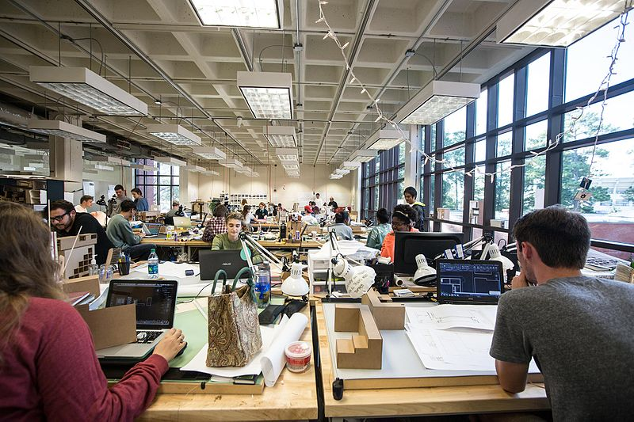
Architects
The homes I’ve built are luxurious and attractive.
Sure, they collapse and kill people on a regular basis.
But there are other builders who are working on “safe housing.”
Image source: Wikimedia Commons, Author: Auburn University College of Architecture, Design and Construction

Slide 27

Car Designers
I build the fastest and most beautiful cars in the world.
Sure, they often fall apart and explode unexpectedly.
But there are other car designers working on “sustainable cars.”
Image source: Flickr, Author: Thomas Bersy

Slide 28
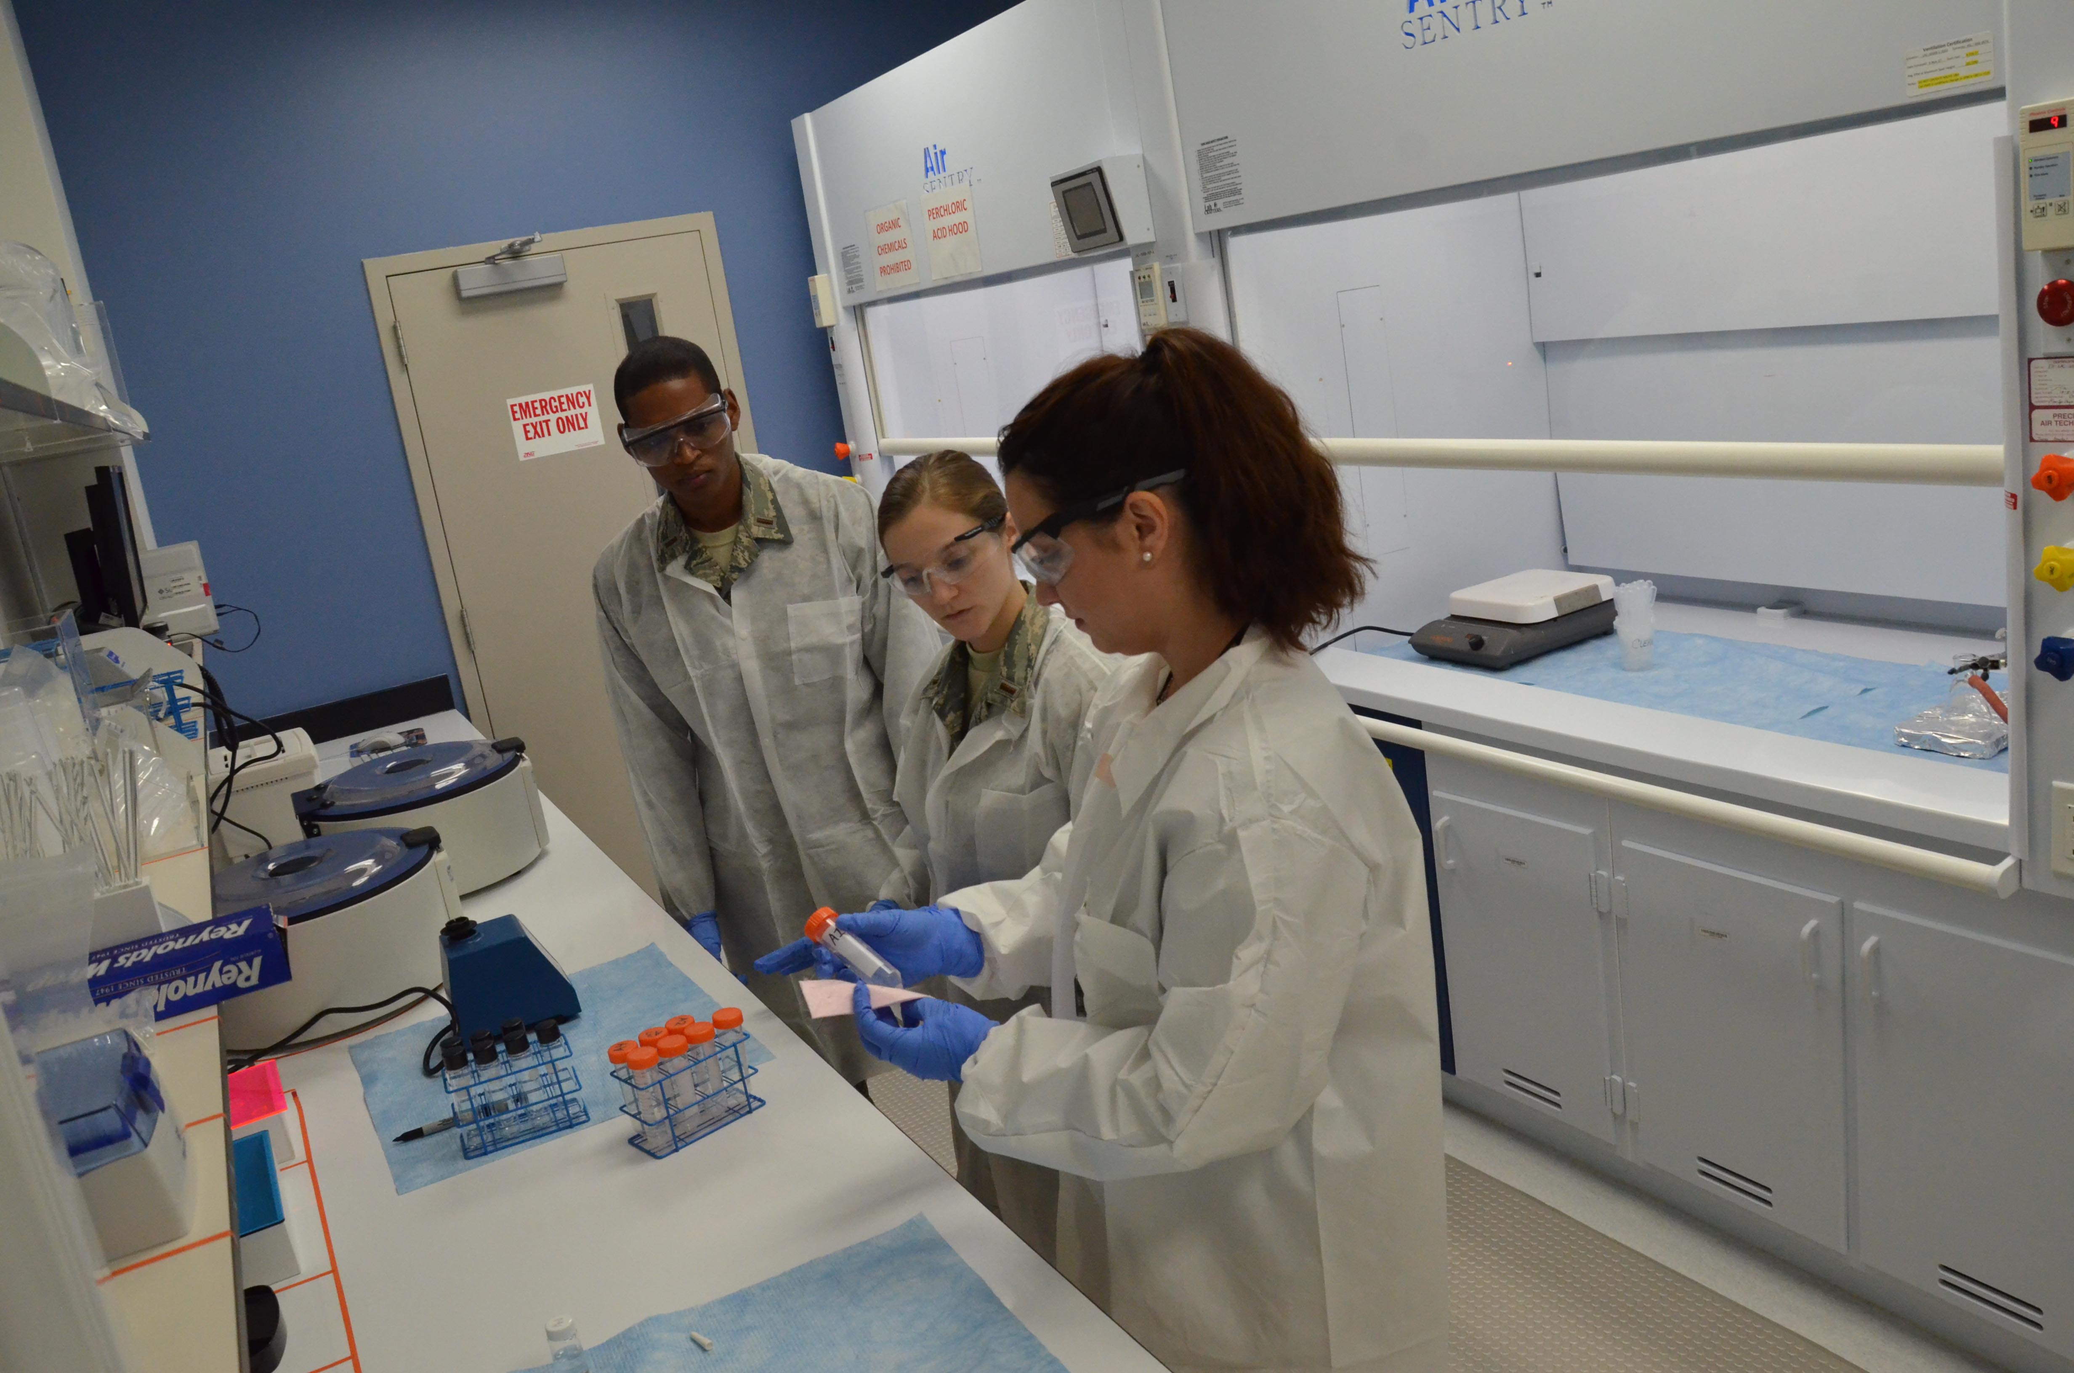
Chemists
I’ve developed some of the best methodologies and processes for making hundreds of target molecules.
Sure, they harm humans and the environment.
But there are other chemists working on “green chemistry”.
Image source: U.S. Air Force photo by Susan A. Romano

Slide 29
It’s Time for a New Perspective
We need to remember that fundamentally green chemistry is about redesigning the tools of our trade - the molecules, and the transformations, and the processes themselves.
The fact that even today the vast majority of chemists and chemical engineers are generally and fundamentally unaware of the inherent nature and the consequences of the molecules we use or make is an important condemnation of our chemistry community and an important challenge to us to ensure that it is changed.

Slide 30
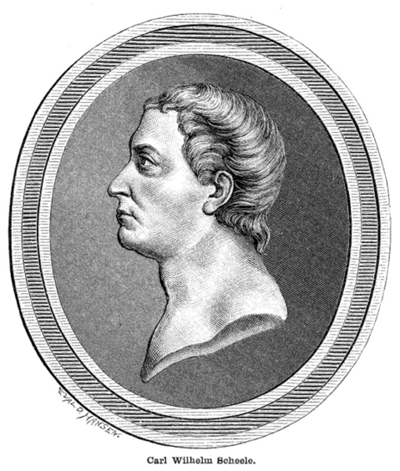
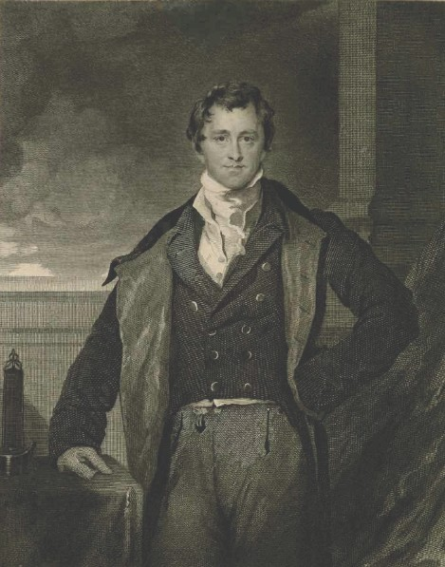
Carl Scheele and Humphry Davy
Carl Scheele - discoverer of fluorine, chlorine (credited to Humphrey Davy), manganese, barium, nitrogen and oxygen (credited to Priestly) - died from exposure to hydrocyanic acid.
Humphry Davy discovered a fifth of the elements known at the time. He died of overexposure to nitrous oxide.
Image source: Wikimedia Commons, Authors Unknown

Slide 31
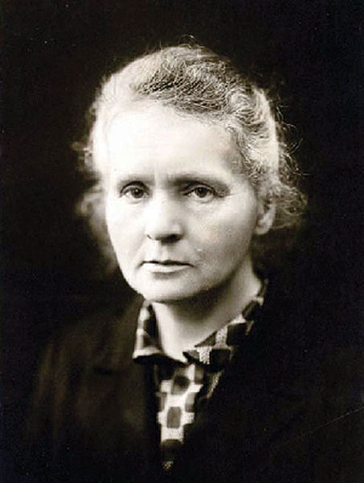
Madame Curie
Marie Curie, died of radiation induced leukemia a few years after receiving her Nobel Prize. Her lab notebooks from the 1890’s are still kept in lead-lined boxes and people must wear protective clothing in order to view them.
It wasn’t until 1938 (less than 100 years ago) that radioactive consumer products such as toothpaste and laxatives were banned from the market.
Image source: Wikimedia Commons, Author Unknown

Slide 32
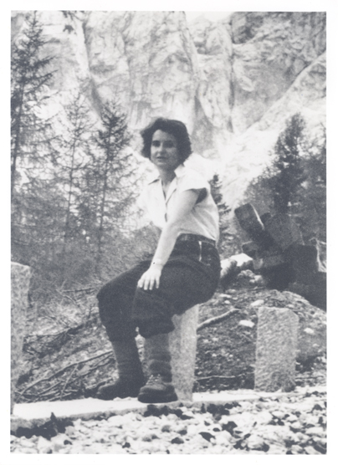
Rosalind Franklin
Rosalind Franklin - co-discoverer of the structure of DNA - died due to the tools of her research at the age of 37, four years before she could receive her Nobel Prize along with Watson and Crick.
Image source: The National Library of Medicine's Profiles in Science, Author Unknown, From the personal collection of Jenifer Glynn

Slide 33
These luminaries were not careless, thoughtless, or stupid.
They were just working in the context and perspectives of their time.
There didn’t yet exist an understanding of the molecular basis of hazard.

Slide 34
Impediments to Innovation
We would like to believe that innovation and change is the hallmark of scientific advance – it is also true that change can come much more slowly than anyone might expect.
Simply stated, people don't like to do things differently from the way they have done them before.
New ideas and new perspectives often face harsh opposition.

Slide 35
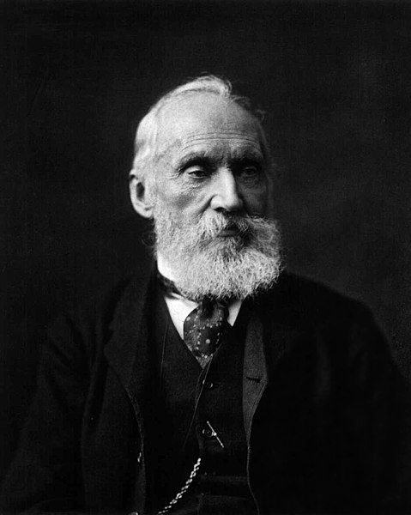
Lord Kelvin
Lord Kelvin - discoverer of the temperature scale named for him - insisted that his calculations that the Earth was only 24 million years old long after Rutherford had demonstrated this to be false by using radio isotope dating.
Image source: Wikimedia Commons, Author: Photo by Messrs. Dickinson, London, New Bond Street

Slide 36
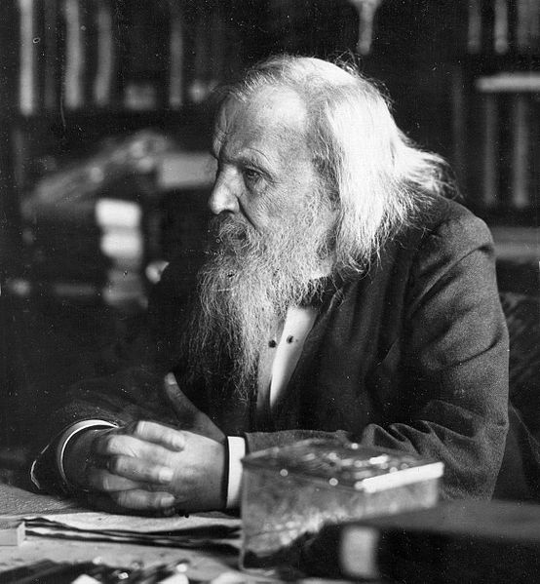
Dmitri Mendeleev
Mendeleev, inventor of the periodic table, refused to acknowledge the existence of radiation - or even of the electron.
Image source: Wikimedia Commons, Author Unknown

Slide 37
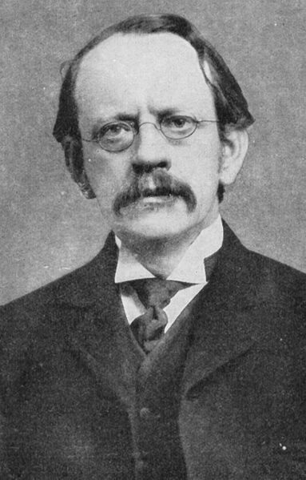
J.J. Thompson
J.J. Thompson is quoted famously in defense of "ether" as “it is as essential to our lives as the air we breathe”
(long after it was disproven)
Image source: Wikimedia Commons, Author Unknown

Slide 38
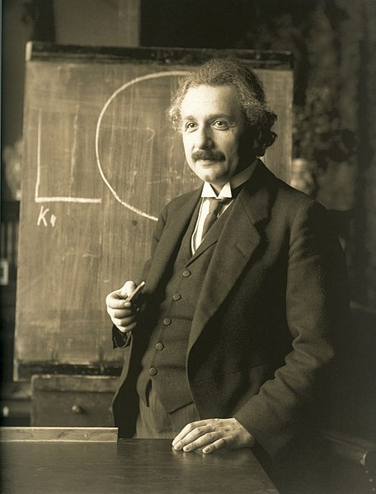
Albert Einstein
Einstein’s suspicion of quantum mechanics (“God does not play dice with the universe”) is legendary.
Image source: Wikimedia Commons, Author: Ferdinand Schmutzer

Slide 39
Leadership
These cases are not meant to ridicule or demean the great scientists of the past. Exactly to the contrary. Many of them were geniuses and all of them dramatically moved science forward.
The point is that leaders in scientific thought - even those who have had great breakthroughs - do not necessarily recognize the next generation of new and innovative ideas.

Slide 40

Because it leads to CHANGE
Why is Working Toward Green Chemistry Important?
Image source: https://earthobservatory.nasa.gov/Features/OrbitsCatalog/page2.php

Slide 41
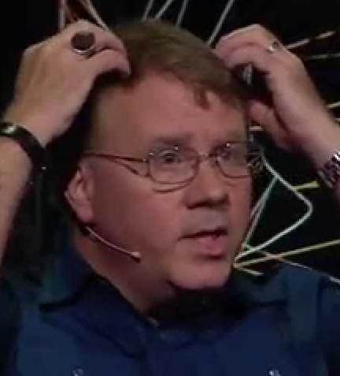
What is Green Chemistry?
John Warner
“Green Chemistry is a revolutionary approach to the way that products are made; it is a science that aims to reduce or eliminate the use and/or generation of hazardous substances in the design phase of materials development”
– John Warner, Co-Founder of Green Chemistry

Slide 42
How Do We Proceed From Here?
With brilliance and optimism
Science and technology have risen to the challenge and we have the creativity and capability to do it again.

Slide 43
How Do We Proceed From Here?
Responsibly
With power comes responsibility. With all the knowledge, perspective, and training you acquire, you also have acquired the ability to impact others – to impact the world. Once you have the power to impact the world, you have the responsibility to impact it for the better.

Slide 44
How Do We Proceed From Here?
With conviction, courage, and commitment
  Green Chemistry and Green Engineering
  Because we can.
  Because we must.

Slide 45
Topics Covered
Chemical and Industrial Accidents
  Union Carbide, 1984
  Cuyahoga River, 1969
  Port of Tianjin, 2015
  Kolontar 2010
Unintended Consequences
Green Chemistry is Everybody’s Job
Perspective and Context
Green Chemistry – Where do we go from here?

Slide 46
Sponsored by Yale-UNIDO Initiative
QUESTIONS?
CENTER for GREEN CHEMISTRY
and GREEN ENGINEERING at YALE

