Slide 1
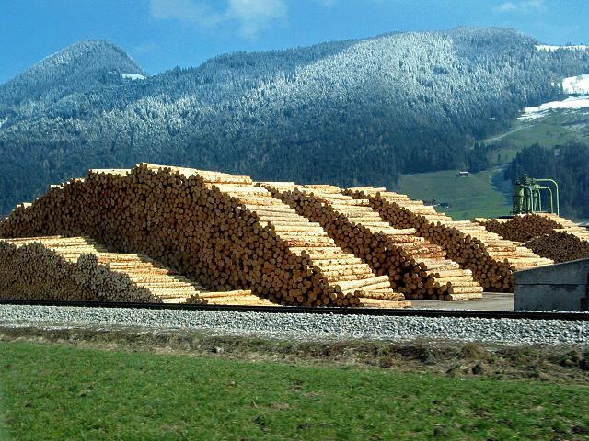

Yale-UNIDO Train-the-Facilitator Workshop in Green Chemistry
Renewable Feedstocks for energy
CENTER for GREEN CHEMISTRY
and GREEN ENGINEERING at YALE
Image: Wikimedia Commons, Author: R. Möhler

Slide 2

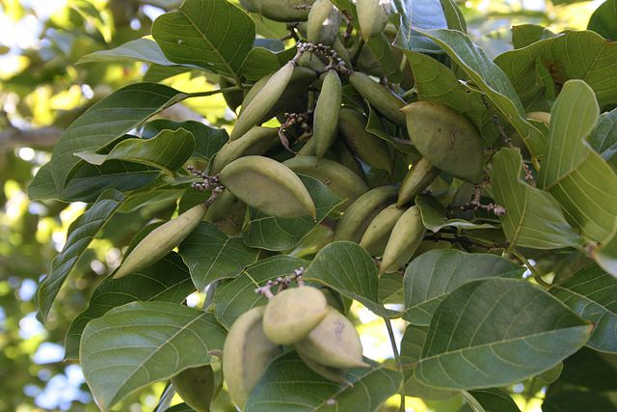
Use of Renewable Feedstocks
A raw material or feedstock should be renewable rather than depleting whenever technically and economically practical.
Image: Wikipedia, Pongamia Pinnata Seeds

Slide 3
Topics To Be Covered
Where does things come from
Fossil carbon
  Gas
  Oil
  Coal
First, Second, and Third Generation Feedstocks
  Bioethanol
  Ethanol from cellulose
  Biodiesel
  Biofuel from algea
The Advantages and Drawbacks of Biofuel

Slide 4

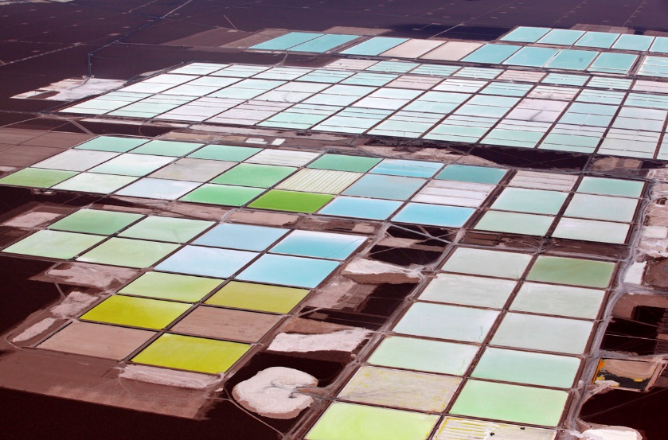

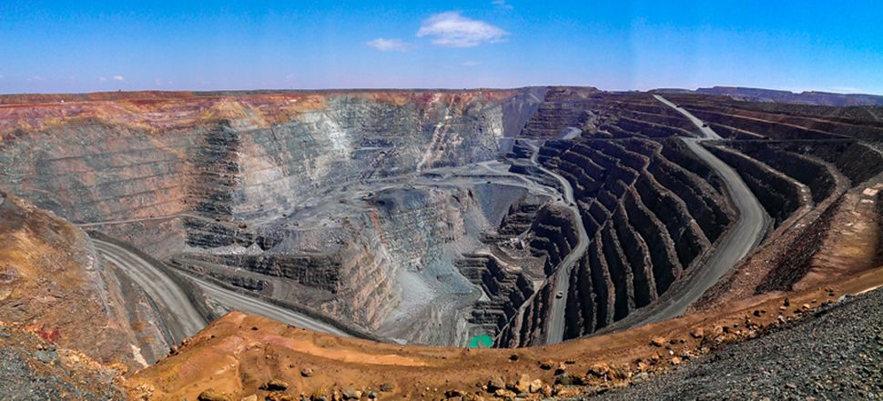
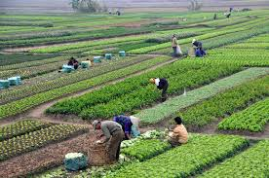
Where does stuff come?
CHEM 512: Heterogeneous catalysis
Brine pools (Lithium mine, Soquimich, Atacama, Chile)
vs
Biomass
Mined materials
Fimiston Open Pit (Gold mine, Australia)

Slide 5
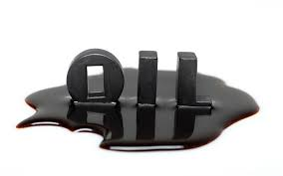
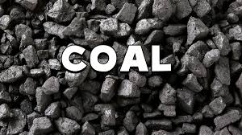

Where does stuff come?
CHEM 512: Heterogeneous catalysis
C
For carbon
vs
Biomass
Mined materials

Slide 6

Renewable vs. Fossil Feedstocks
Feedstock:
A raw material to supply or fuel or industrial process.
Renewable or Depleting is a question of time:
A renewable resource is determined to be renewable if it can be replenished in a relevant amount of time.
Fossil fuels are depleting because they cannot be replenished in a practical timeframe from vegetation.
Image: Wikimedia Commons, Author: Johnlacrosse

Slide 7
Fossil carbon timeline
Fossil carbon is formed over 300 million years ago
    CO₂
Absorption
Decomposition 99,99%
Death
Millions of years
Sequestration 0.01%
Fossil fuel: gas, oil, char…
Source: DOE

Slide 8
How is petroleum generated and used?
Biomaterials [Carbohydrates, Proteins, Lipids]
Highly Functionalized Molecules
1. High temperature, and pressure; natural process of oil creation
2. Oil extraction and processing
Over millennia
Petroleum Products [Hydrocarbons – highly reduced state]
3. Separation and oxidation, high energy input
Functionalized Compounds [Olefins, Alkylchlorides]
4. Further functionalization, replacing reactive groups with functional groups of interest
Highly Functionalized Molecules

Slide 9
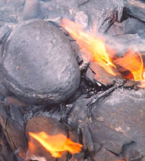
Fossil carbon
      Oil shale containing kerogen
Formation of fossil fuels: what happens during sequestration?
  Transformation under high temperature and pressure of cellulose, lignin, lipids, chitin, proteins…
    into kerogen and bitumen (high molecular weigh, viscous material). Kerogen from an oil shale deposit of western USA: C₂₁₅H₃₃₀O₁₂N₅S
    Then cracking of this material into lower molecular weight material: crude oil and natural gas.
    Reforming can also afford coal
Image: Wikimedia Commons

Slide 10
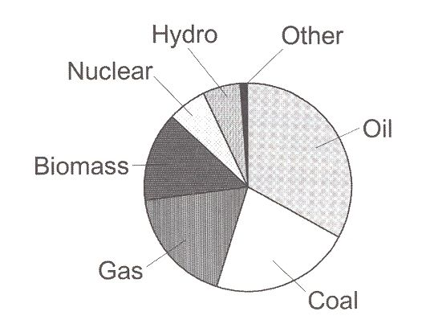
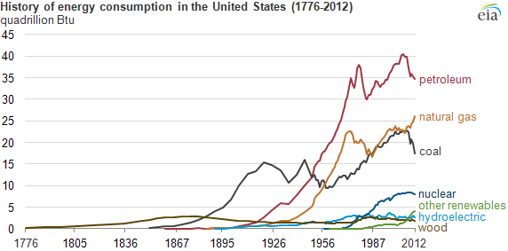
Where does energy come from?
Fossil fuels provide a significant part of our energy supply (almost three quarter):
  oil + coal + gas
    Sources of world energy
Increasing world energy consumption since 1990.
http://www.eia.gov/todayinenergy/detail.cfm?id=11951
The graph includes a prediction for year 2035, where the projected energy consumption will reach 770 quadrillion British Thermal Unit [BTU].
Source: U.S. Energy Information Administration [U.S. EIA].

Slide 11

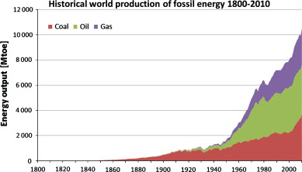
Carbon peak?
The oil peak may actually not happen soon… or at all
M. King Hubbert, was an oil geologist of developed the theory of the ‘ultimately recoverable reserve’. He predicted that oil production in the USA would peak at about 1970
A peak in resource science is defined as a moment when production peaks before it drops continuously.
“The peak concept is not valid for modelling mineral resource depletion”
Critical Metals Handbook, First Edition. Edited by Gus Gunn, 2014 John Wiley & Sons,

Slide 12
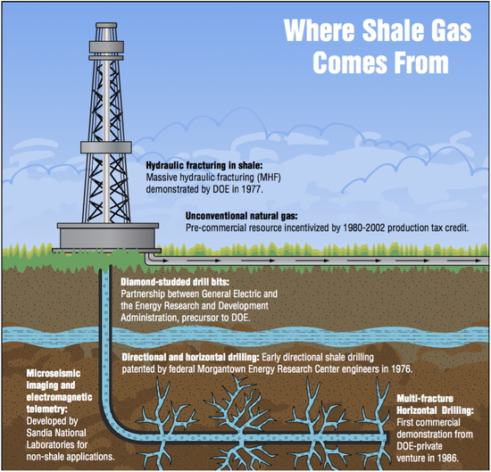
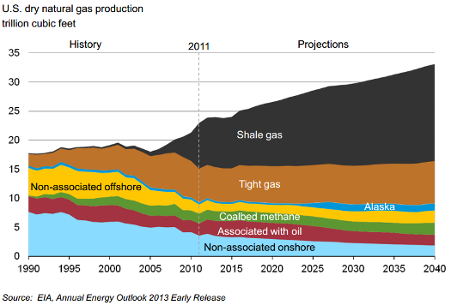
Gas from fracking
Gas production by fracking has exploded over the past 10 years
Zhiltsov, S. S.; Semenov, A. V. In Shale Gas: Ecology, Politics, Economy; Springer International Publishing, 2016; pp 9–16.

Slide 13
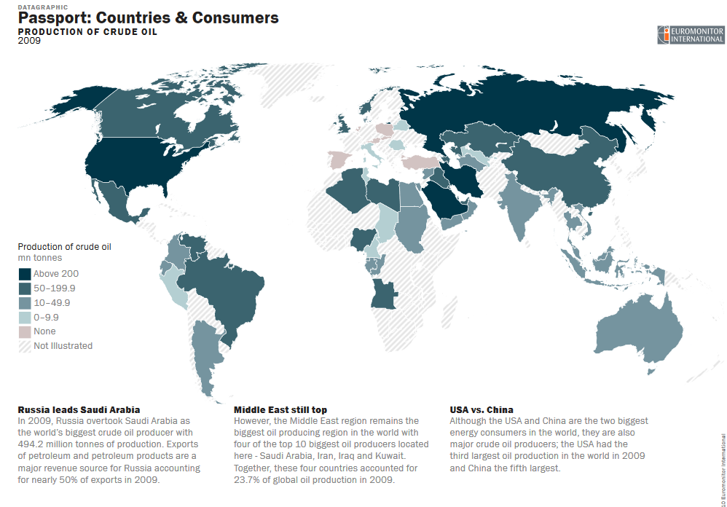
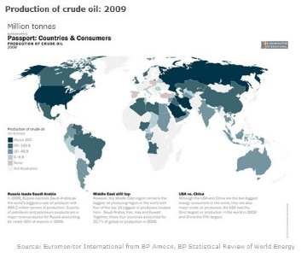
Crude oil in the world
CHEM 512: Heterogeneous catalysis

Slide 14
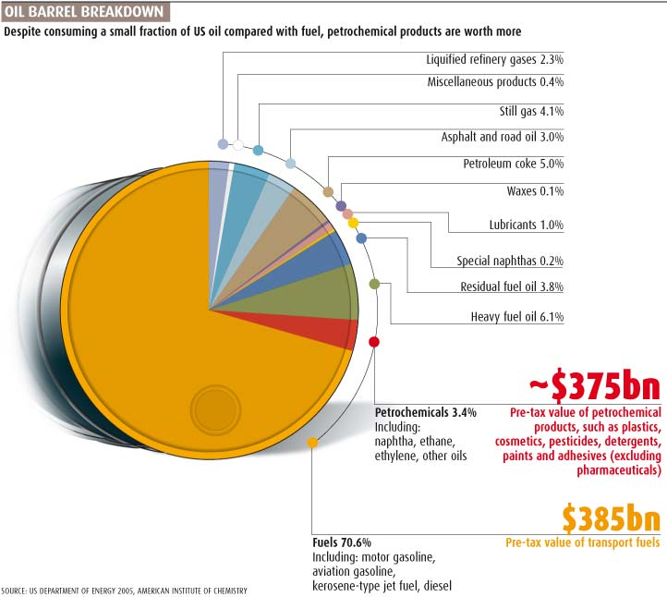
CHEM 512: Heterogeneous catalysis
Use & Cost of Crude Oil (USA)
• only ~ 3.5 % of all crude oil processed ends up in petrochemicals
• the rest is called the paraffins
• 70 % is used as fuel
• 25% is asphalt, coke, bitumen, wax, etc.
• chemicals are worth as much as the fuel!
Sources: New Scientist 2007; www.fas.org

Slide 15
How are petroleum products made?
• by using a fractionation column.
• by oxidation (typically by a powerful oxidizing agent like chlorine) and numerous additives.

Slide 16
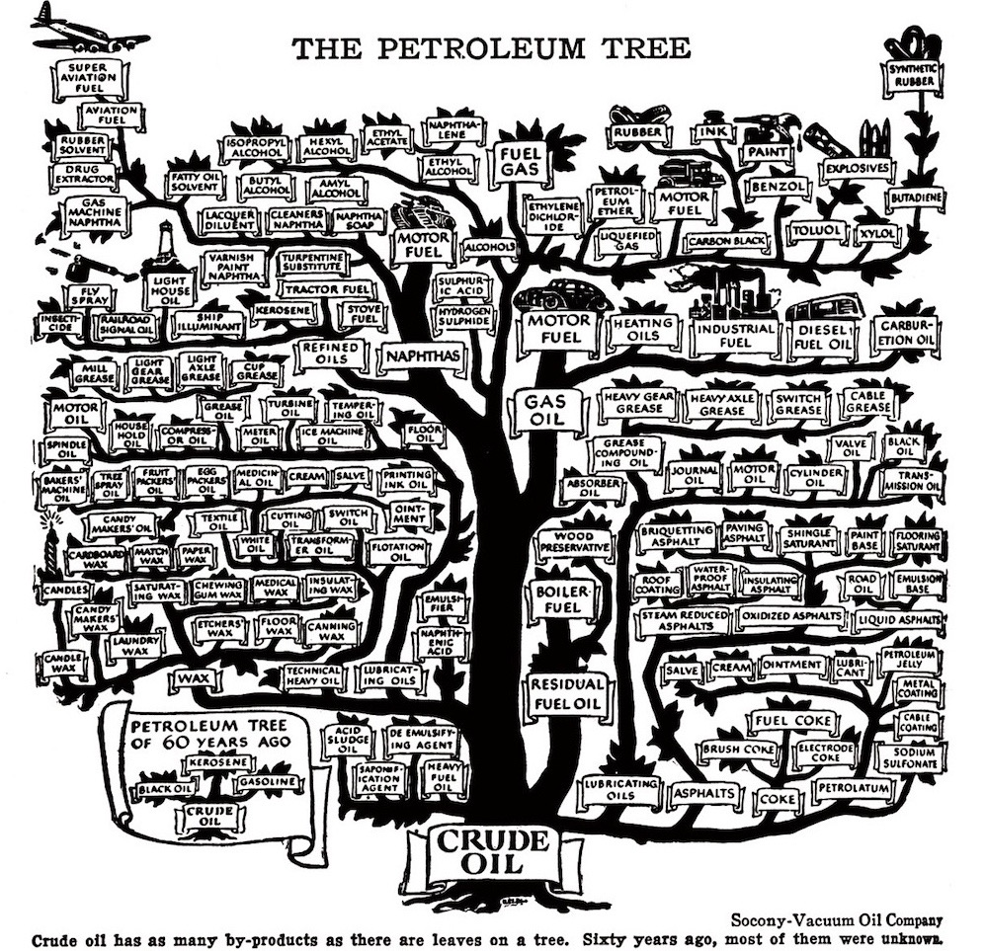
What is petroleum used for?

Slide 17

What about energy from renewable resources?
Source: Adobe Stock

Slide 18
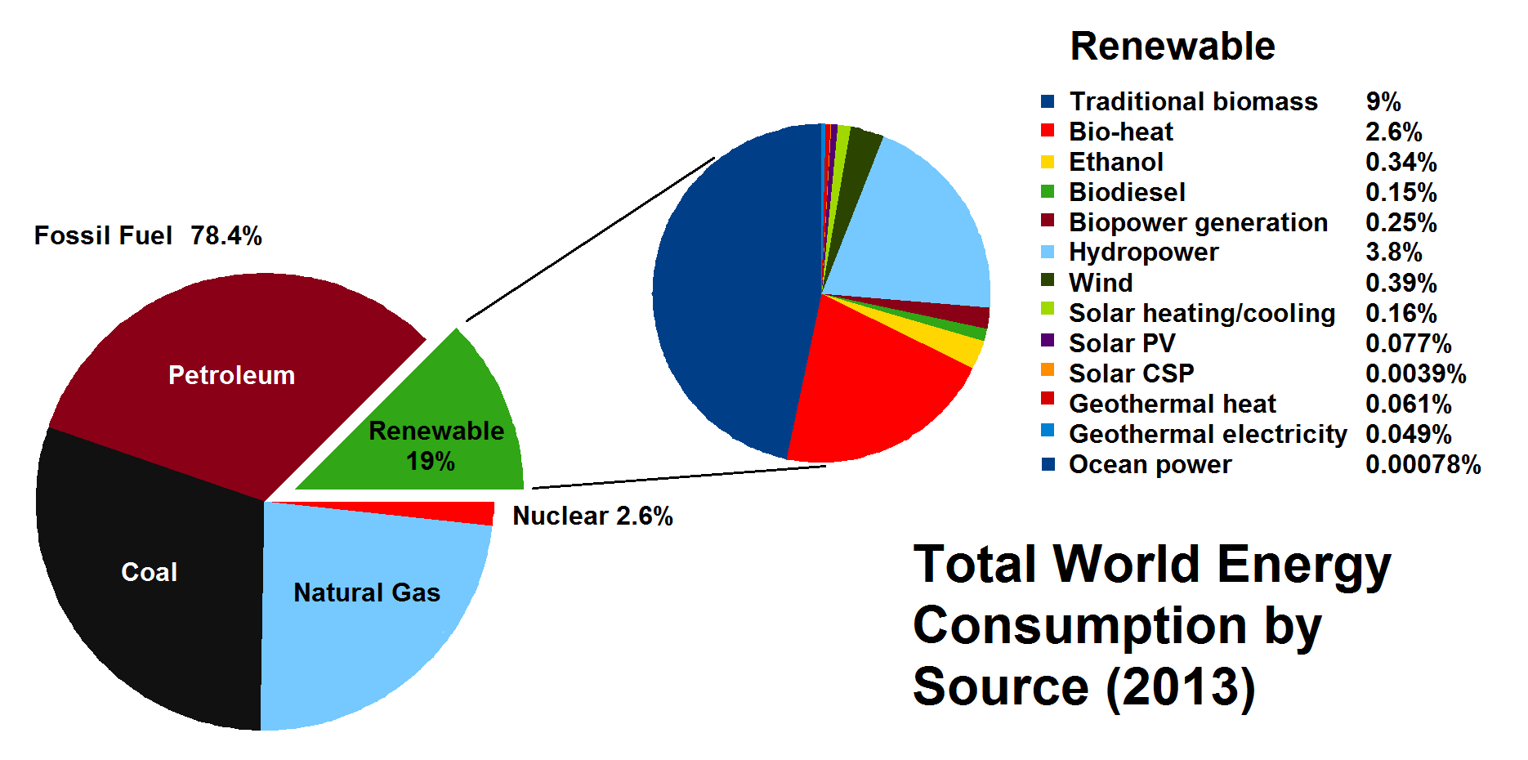
Energy Feedstocks Sources
• World energy consumption by source as reported in 2013.
• While the use of fossil fuels is still predominant, by 2013 there was an increase in the use of renewable sources of energy.
• Most renewable energy comes from biomass.
Source: REN21 Renewables 2014 Global Status Report.

Slide 19
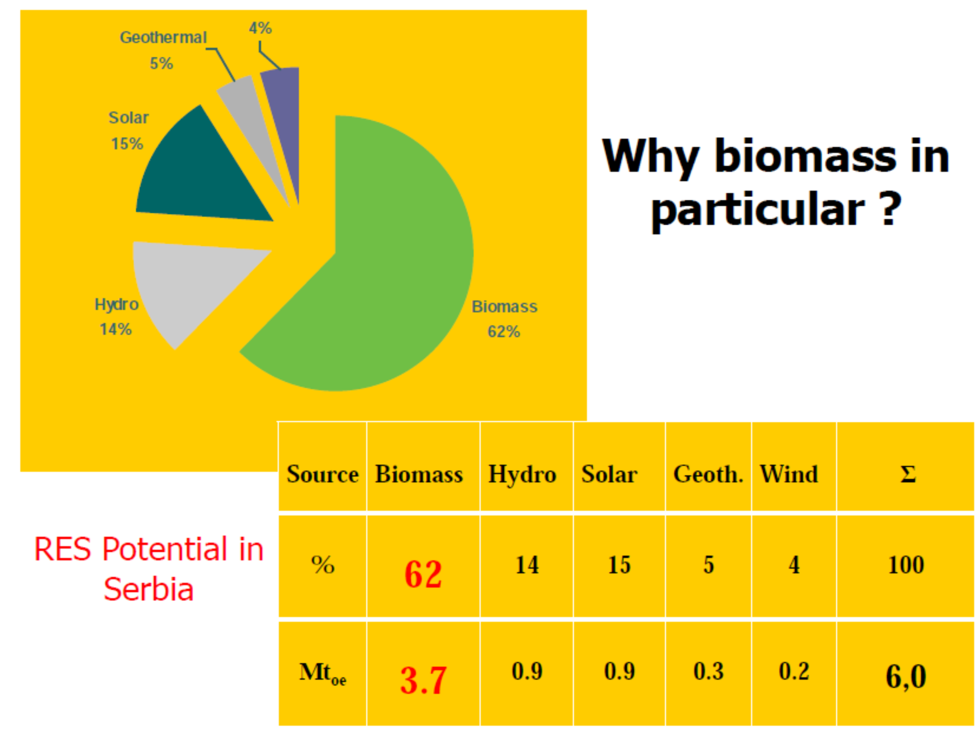
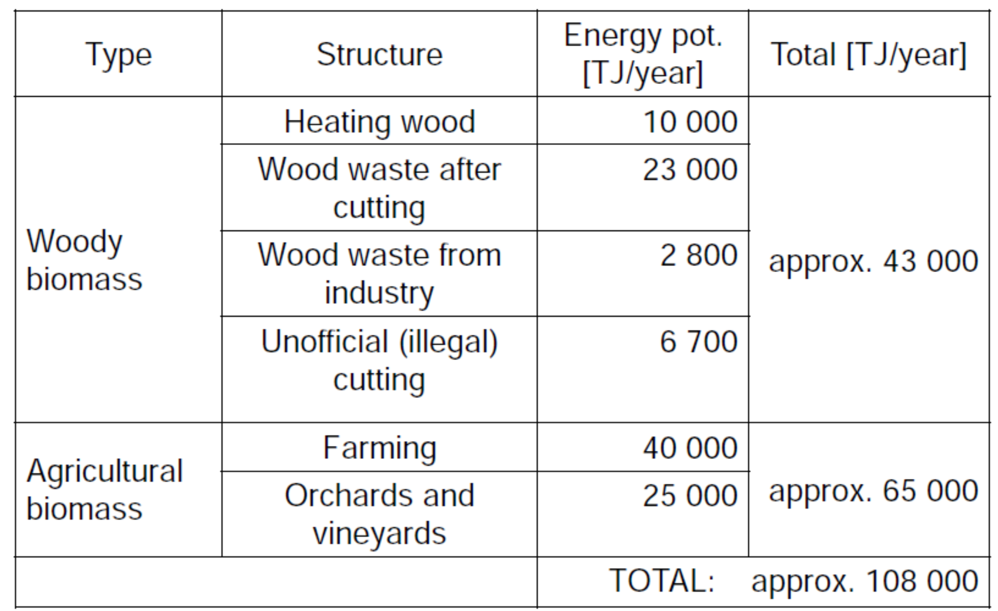
The Serbian Context
CHEM 512: Heterogeneous catalysis
Natural gas |  | Oil |  | Hydro | Coal |  | Geothermal | Biomass | Total
domestic | import | domestic | import | domestic | domestic | import | domestic | domestic
0.45 | 1.66 | 1.11 | 3.10 | 0.8 | 7.82 | 0.93 | 0.001 | 0.31 | 15.75
Source:
Dakić, Martinov,˝Status of Bioenergy in Serbia˝, Workshop on International Cooperation in the Field of Bioenergy (2013)

Slide 20
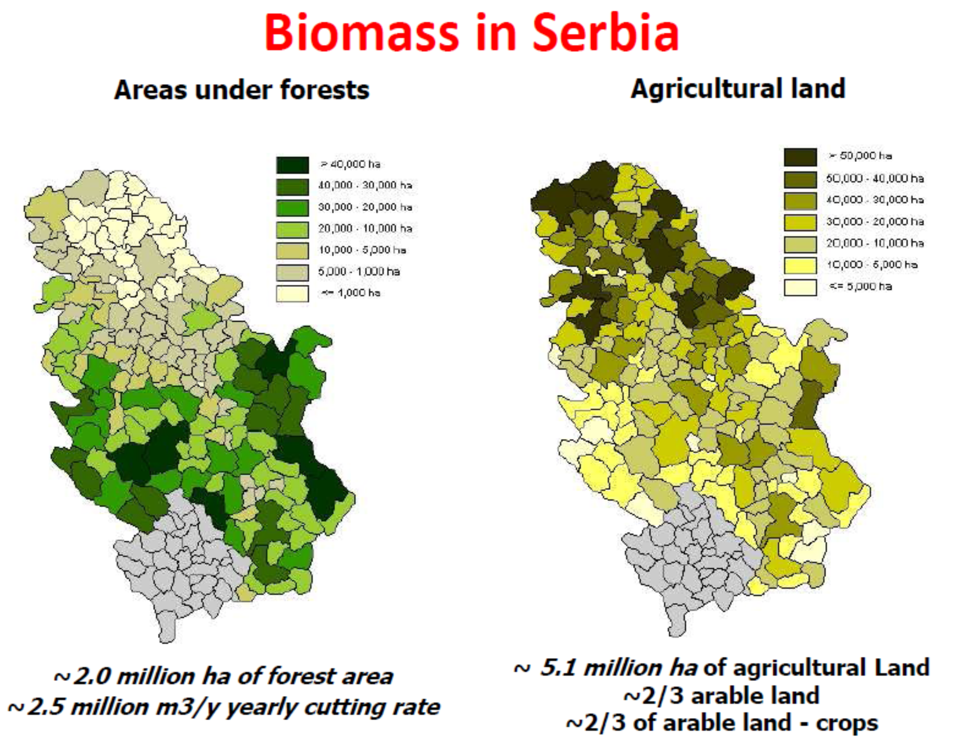
The Serbian Context
CHEM 512: Heterogeneous catalysis
Source:
Dakić, Martinov,˝Status of Bioenergy in Serbia˝, Workshop on International Cooperation in the Firld of Bioenergy (2013)

Slide 21
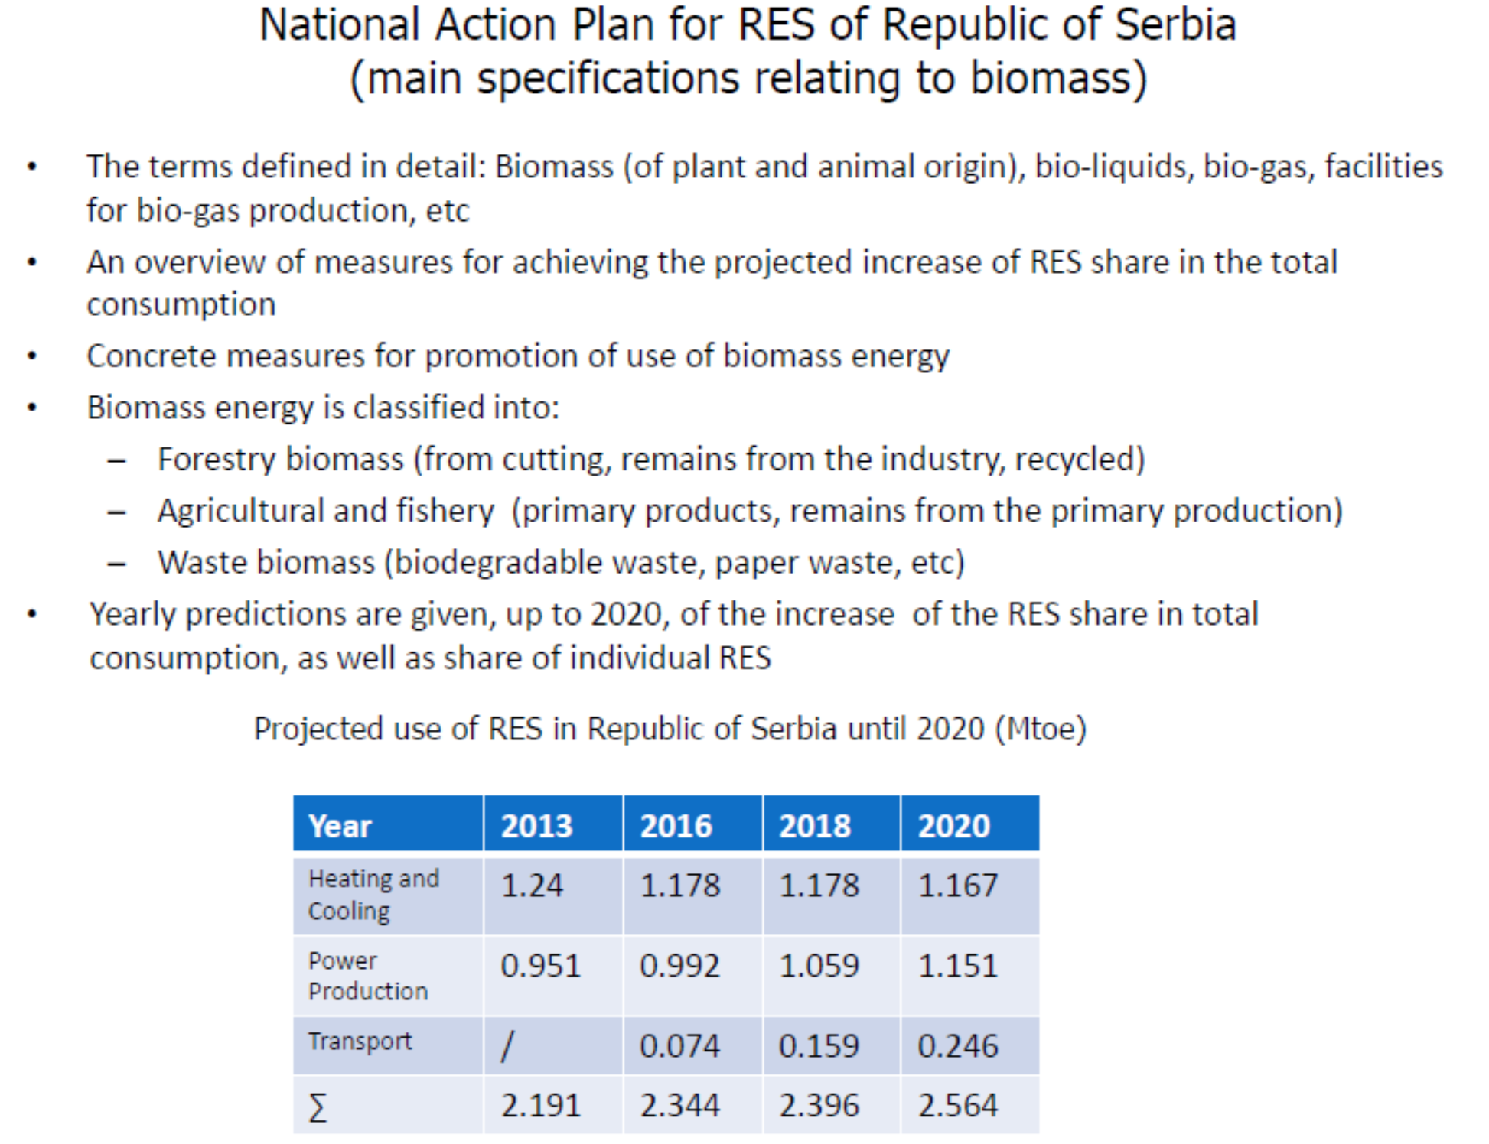
What are The Numbers for Serbia?
CHEM 512: Heterogeneous catalysis
In 2008, Serbia had bioenergy resources available as municipal solid waste (2.8 million tonnes), wood (1.0 million tonnes), forestry and wood processing material (0.36 million tonnes), agricultural residues and crops (56 200 TJ), orchard materials (14 100 TJ), and vineyard materials (6 100 TJ).
Direct combustion energy produced from wood (6 000 TJ) and forestry and wood processing material (1 800 TJ). The biodiesel production capacity from the agricultural crops and residues was 4 TJ/yr, with a yield of 40 GJ/tonne and a total biodiesel production of 2 400 TJ.

Slide 22
Renewable feedstocks
Renewable feedstocks include the following materials:
• Biomass (algae, corn, switchgrass, poplar, willow, sorghum, and bamboo)
• Agricultural waste (ex. manure)
• Urban waste (garbage, sewage)
• CO₂
• Estimated generation of > 100 billion tons per year
Source: Adobe Stock

Slide 23
Environmental Issues
Bioenergy can have positive impacts:
• Green house gas reduction (through fossil-fuel substitution).
• More agrobiodiversity, soil carbon increase, less erosion.
But these impacts can also be negative:
• Green house gas from cultivation, soil carbon, life-cycle, direct and indirect land-use changes.
• Loss of biodiversity from land-use changes, water use, agrochemicals, erosion.
Competition with food

Slide 24
Types of Biofuel
First Generation Biofuels
Oils for diesel
Grains are used to produce ethanol
Food versus fuel
Second Generation Biofuels
Using agricultural wastes ←→ lignocellulosics
Lignocellulosics from agrowaste
Grasses
These crops were not domesticated for use as biofuels
Third Generation Biofuels (looking to the future)
Algae

Slide 25
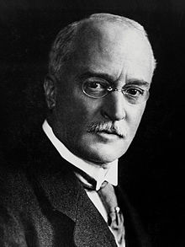
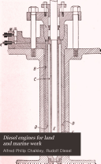
Biodiesel
The first Diesel engine was exhibited to function with vegetable oil
In 1900 a small Diesel engine was exhibited by the Otto company which, on the suggestion of the French Government, was run on peanut oil, and operated so well that very few people were aware of the fact. The motor was built for ordinary oils, and without any modification was run on vegetable oil.
Rudolf Diesel
Chalkley, A. P., “Diesel engines for land and marine work” (2nd Ed.), New York, Van Nostrand, p. 3 (1912)

Slide 26
Biodiesel
Biodiesel refers to vegetable oil or animal fat-based diesel fuel consisting of long-chain esters. The main component of vegetable oil is triglycerides, which require transesterification prior to usage as a fuel.
Transesterification is essential to get a good fuel.
BIODIESEL

Slide 27
Advantages of Biodiesel
40% reduction in global warming potential compared to conventional diesel
8% reduction in sulfur oxides. The release of sulfur oxides can lead to acid rain.
3% reduction in methane.
32% reduction in particulate matter (PM10 68%).
83.6% reduction in particulate matter soot.
79% reduction in wastewater.
96% reduction in hazardous waste, but double the non-hazardous waste.
By using spent oil, diesel can be turned from a first to second generation fuel
Compared to conventional diesel processing, biodiesel requires additional processing and has a lower overall energy return. Energy return is one of the important parameters that enables engineers to evaluate the efficiency and viability of a process. Energy return describes the amount one can gain from the product vs energy input need for production. Biodiesel lags far behind conventional diesel processing in this regard.
Source: National Biodiesel Board,” Lifecycle Summary,” available at http://www.nbb.org/pdf_files/fuelfactsheets/LifeCycle_Summary.PDF
Notes:
Source: National Biodiesel Board,” Lifecycle Summary,” available at http://www.nbb.org/pdf_files/fuelfactsheets/LifeCycle_Summary.PDF

Slide 28
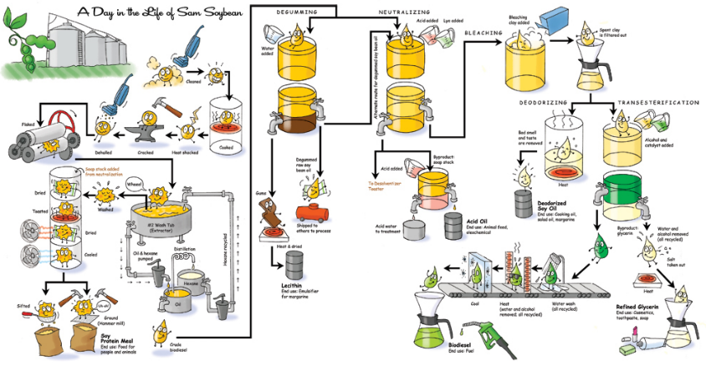
Steps Required to Produce Biofuel from Soybeans
Retrieved: nancymeyersdesign.com

Slide 29
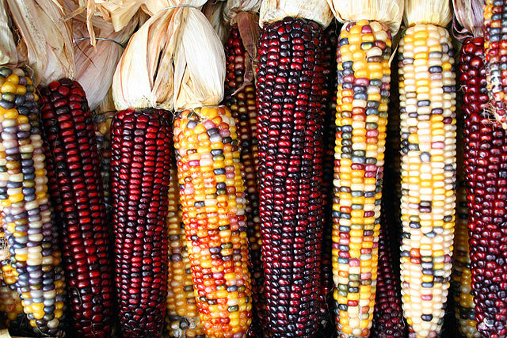
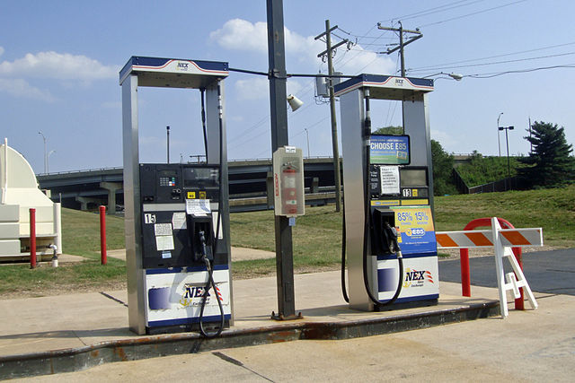
First Generation bioethanol
Grind up the feedstock so it can be easily and quickly processed.
Sugar is dissolved out of the material.
The sugar is fed to microbes that use it for food, producing ethanol and carbon dioxide in the process.
Purify the ethanol to desired concentration.
Images: Wikipedia Commons, Corncobs, Author: Sam Fentress; Wikimedia Commons, Biofuel Pumps, Author: Mario Roberto Duran Ortiz
Notes:
Source: Department of Energy, Alternative Fuels Data Center, “How is Ethanol Made?”, available at http://www.eere.energy.gov/afdc/altfuel/eth_made.html

Slide 30
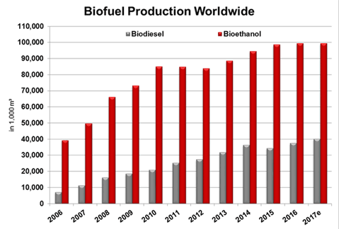
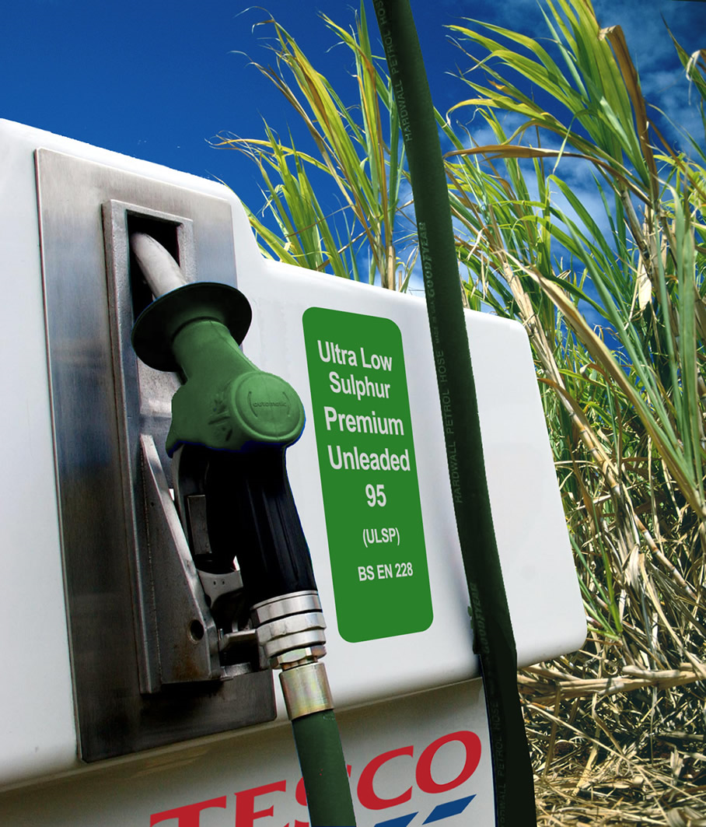
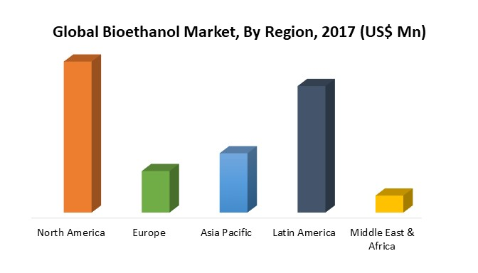
First Generation bioethanol
This type of biofuel can be generated from:
  • sugar cane sugar
  • corn starch
  • lignocellulosic materials (waste or grasses) cellulose
via
via
via
http://www.cropenergies.com/en/Bioethanol/Markt/Dynamisches_Wachstum/
https://marketresearch.biz/report/bioethanol-market/

Slide 31
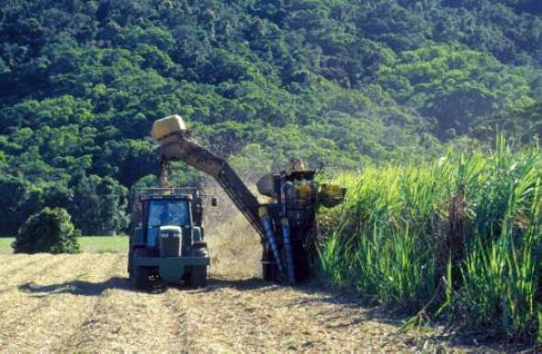
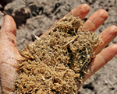
Bioethanol: the Brazilian case – from sugar
  • Canes are crushed, yielding sugar juice
  • for ethanol manufacture, sugar juice is diluted into a 20% solution, fermented with yeast for hours, producing a 6-10% ethanol solution.
  • the yeast is removed and either recycled or dried and used as animal feed.
  • the fibrous material left from the crusher is then used and burnt to provide electricity.
  • from aqueous solution, 95-100% ethanol can be obtained by distillation/membrane filtration
  • for sugar production. the syrup can be filtered, condensed and sugar is recrystallized.
Fibrous remains of processed sugarcane, called bagasse, are burned in Brazil to generate electricity

Slide 32
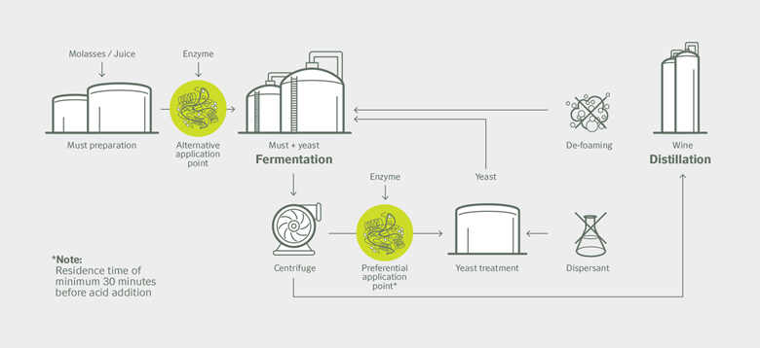
Bioethanol: the Brazilian case – from sugar
  Fermentation process
  • In 2016, Novozyme introduced a new enzyme able to prevent foaming (avoids surfactant use)
https://www.novozymes.com/en/news/news-archive/2016/11/launch-of-worlds-first-biological-foam-control-for-sugarcane-ethanol

Slide 33


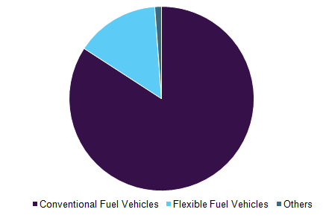
Bioethanol: the Brazilian case – from sugar
Ethanol can be used directly as a liquid fuel:
  Either mixed with normal gasoline: a blend can have up to 25% of ethanol (US)
  Another strategy is to use 100% ethanol: it requires a special engine: 12.6% of transportation energy is made up with ethanol in Brazil (flex fuel technology)
Global fuel ethanol market volume by application, 2016 (%)
Petrobras gas station at São Paulo with dual fuel service, marked A for alcohol (ethanol) and G for gasoline
Source: Wikipedia, Ethanol fuel in Brazil - Fuel Ethanol Market Analysis 2018 – 2025, Grand view research 2017.

Slide 34
Bioethanol: the Brazilian case – from sugar
Ethanol can be used directly as a liquid fuel:
  Either mixed with normal gasoline: a blend can have up to 25% of ethanol (US)
  Another strategy is to use 100% ethanol: it requires a special engine: 12.6% of transportation energy is made up with ethanol in Brazil (flex fuel technology)
  The country has reduced CO₂ emissions by more than 350 million tons since the introduction of flex-fuel vehicles that can run on any combination of ethanol and gasoline. There are more than 26 million such vehicles in Brazil.
Source: Novozyme

Slide 35
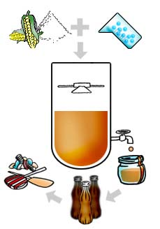
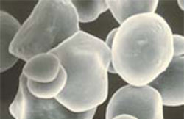
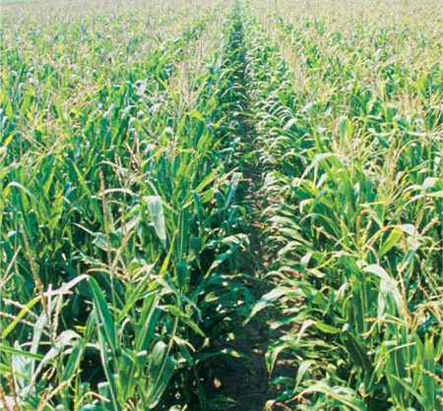
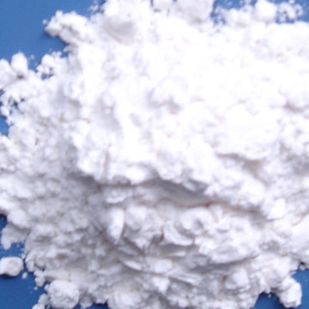
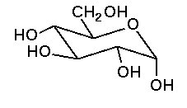
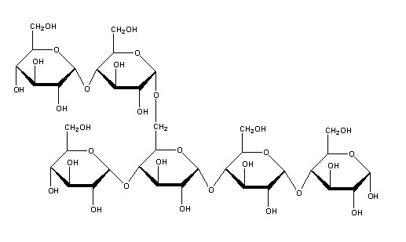
Bioethanol: the US case – from starch
  Ethanol is produced from cornstarch
  Cornstarch need to be converted into glucose by enzymes: the process is less efficient
From Novozyme
Sugar
Cornstarch
Ethanol

Slide 36
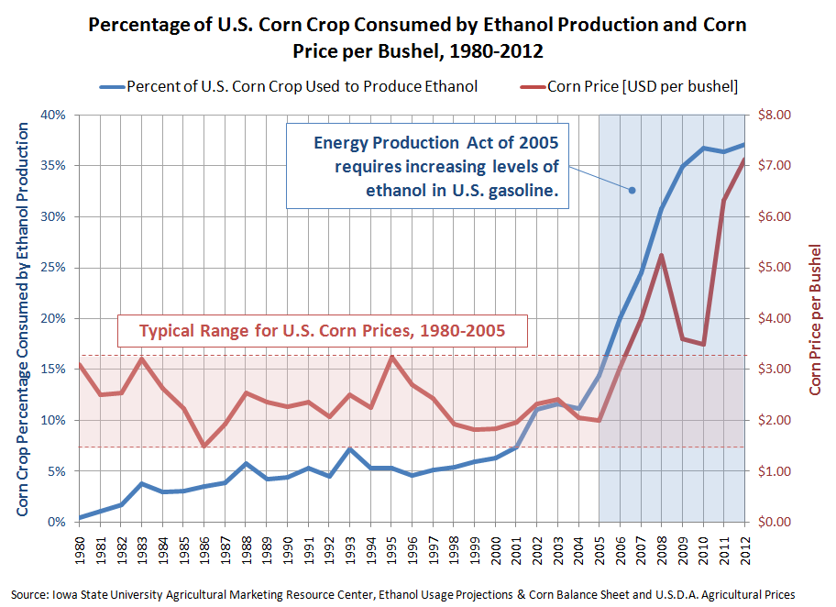
Bioethanol: the US case – from starch
  To provide energy for the USA society, the surface necessary to plant with corn is… the whole surface of the USA.
  Bioethanol from corn is controversial: scientists (Pimentel and others) claim that bioethanol from corn costs more energy to produce than the energy it delivers… Is it really worth then?
  Since 2004/5, George Bush has launched a program dedicated to bioethanol from corn.

Slide 37
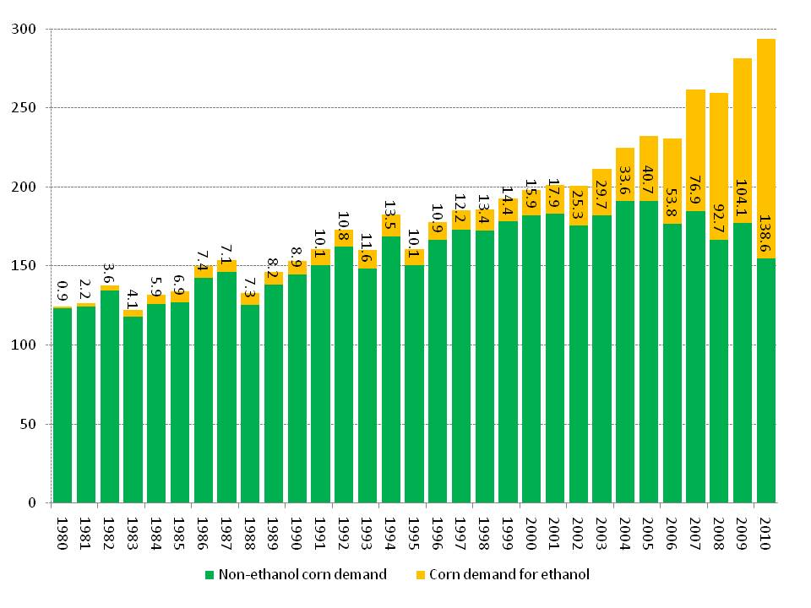
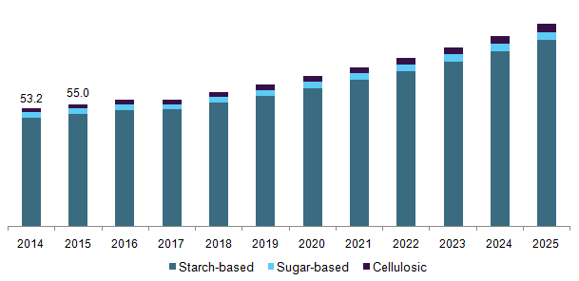
Bioethanol: the US case – from starch
Bioethanol pushed the demand for U.S. corn
Million tonnes/year
Fuel Ethanol Market Analysis 2018 – 2025, Grand view research 2017.

Slide 38
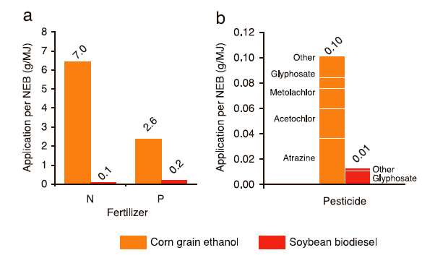
Environmental Consequences per Unit Energy
Comparing corn bioethanol and biodiesel
Greenhouse Gas Emissions per Unit Energy
Soybean biodiesel needs less fertilizer and pesticide than corn ethanol.
Soybean biodiesel produces significantly less green house gas.
Data of Lee et al. and Muir et al, collated in Gressel“Genetic Glass Ceilings, Hopkins, 2007

Slide 39
Food verses Biofuel: The Math
To fill up an average 25 gallon SUV gas tank with ethanol requires the same amount of grain as it takes to feed 1 person for 1 year.
Every driver in the U.S. uses 500 gallons of gasoline per year.
That means that each year, every person in the U.S. would use enough gasoline to feed 20 people for one year.
There are 300 million people in the U.S. – if each person was using enough food to feed 20 people to run their cars, that alone would require enough grain to feed 6 billion people.
Notes:
Source: Sharon Astyk, “Ethics of Biofuels” Energy Bulletin (Dec. 28 2006), available at http://www.energybulletin.net/24169.html

Slide 40
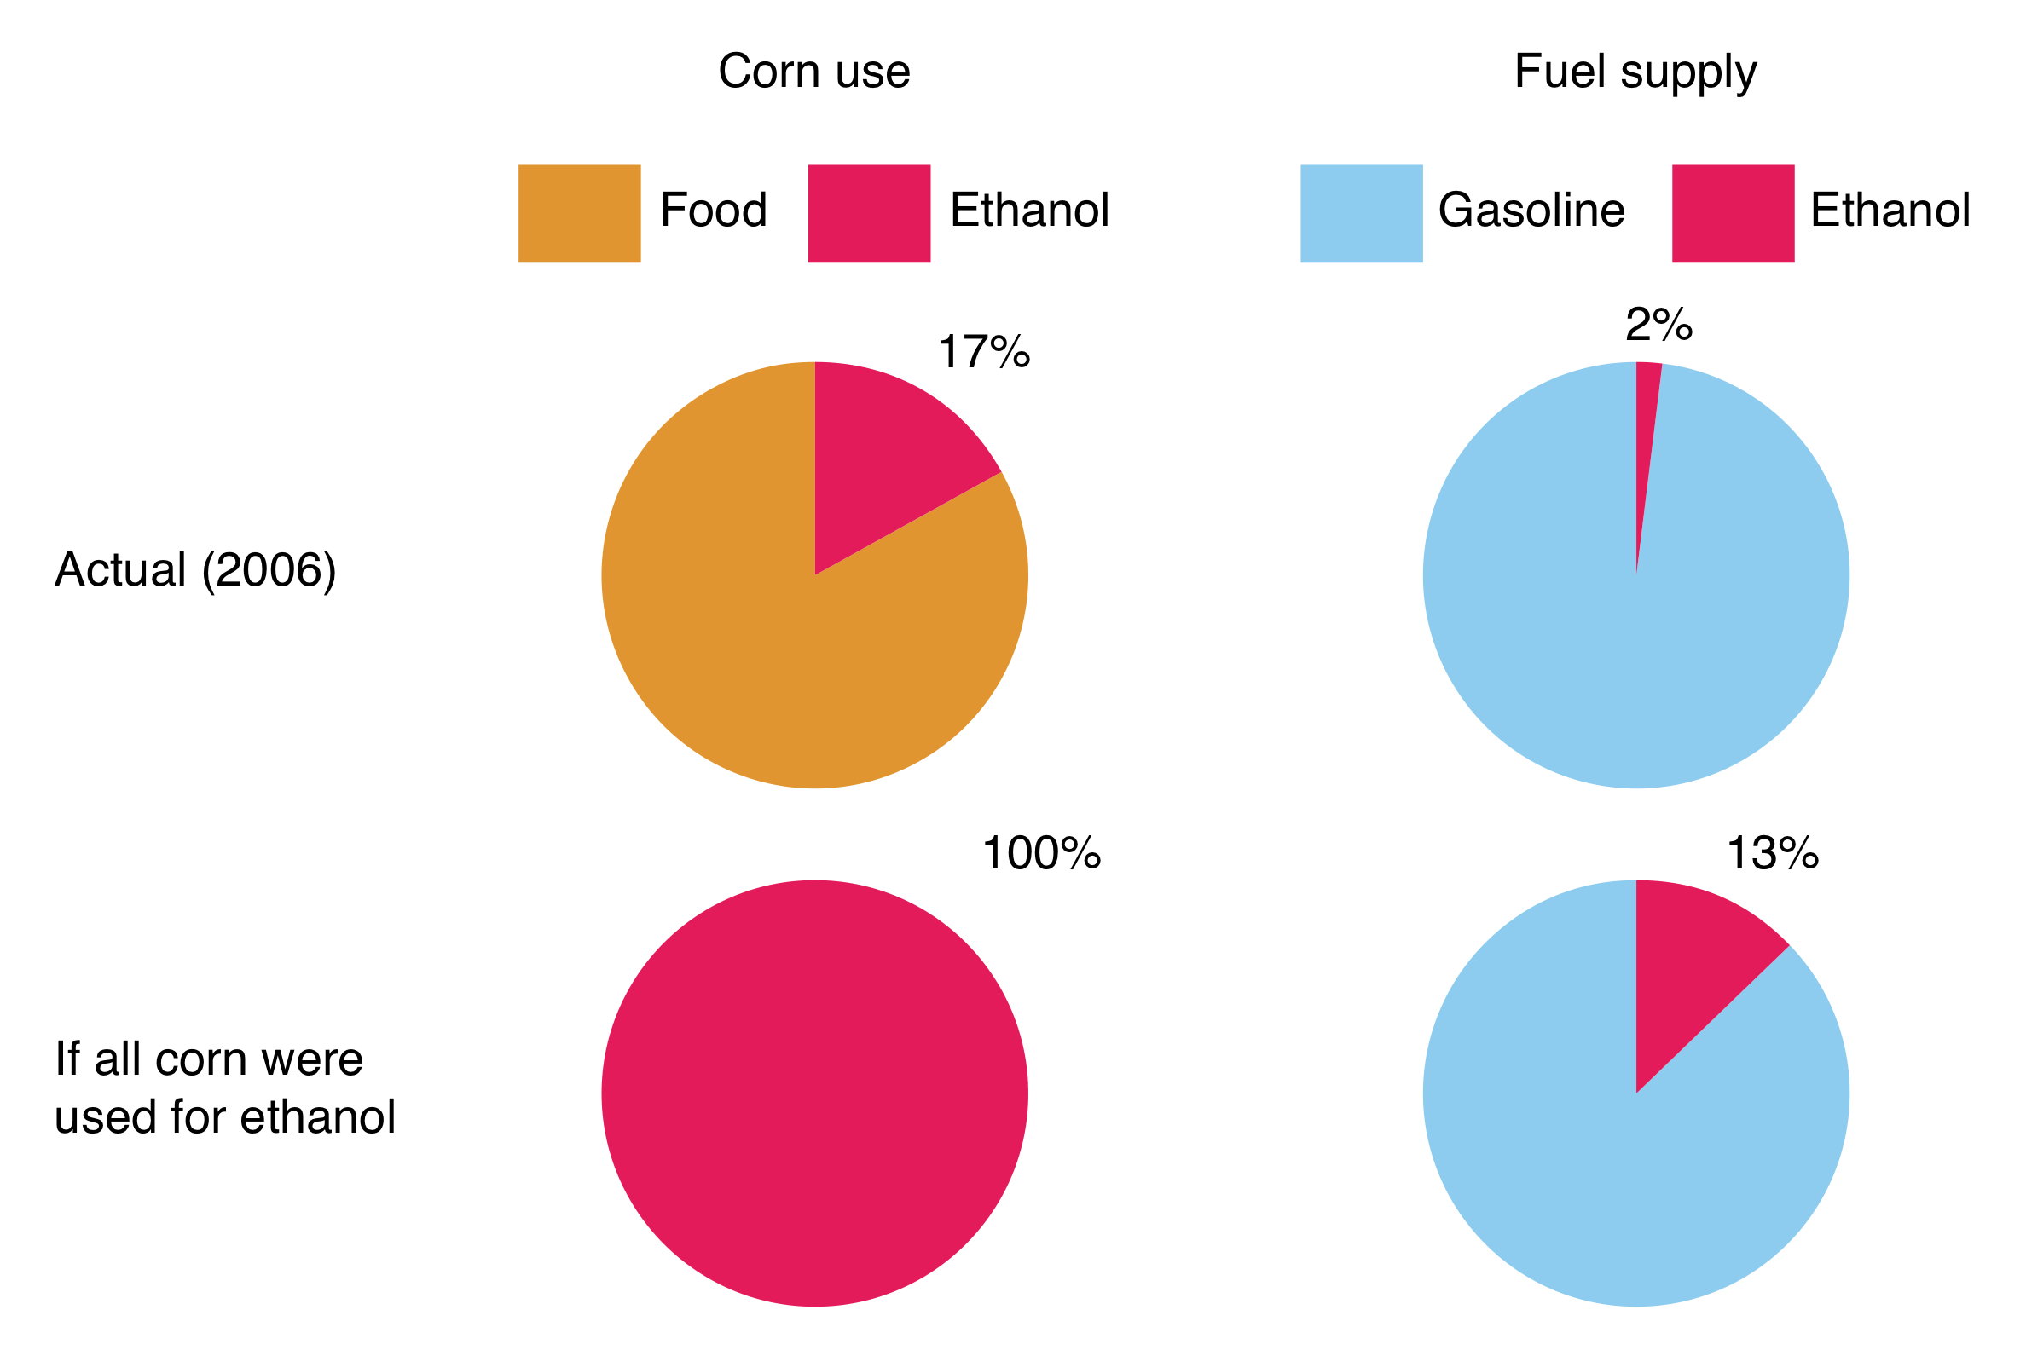
Ethanol Supply: The Effect on Corn Supply and on Gasoline Supply

Slide 41
Types of Biofuel
First Generation Biofuels
Oils for diesel
Grains are used to produce ethanol
Food versus fuel
Second Generation Biofuels
Using agricultural wastes ←→ lignocellulosics
Lignocellulosics from agrowaste
Grasses
These crops were not domesticated for use as biofuels
Third Generation Biofuels (looking to the future)
Algae

Slide 42
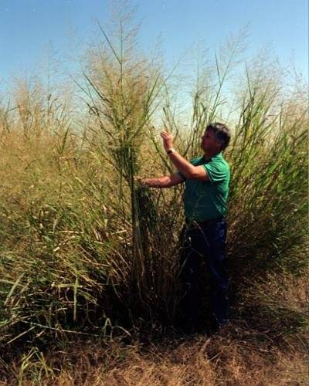
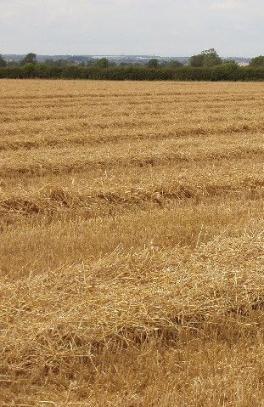
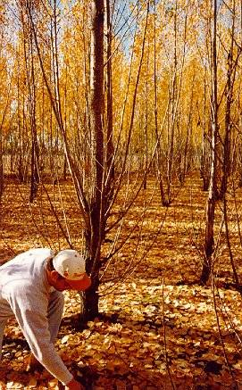
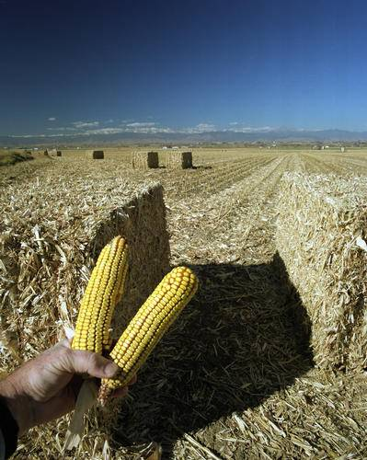
Second Generation Biofuels: Cellulosic Feedstock
Switchgrass
Wheat Straw
Hybrid Poplar
Corn Stalks
Image, Wikimedia Commons, Author: David Hawgood

Slide 43
Second Generation Biofuels
  To qualify as second generation, a feedstock must not be suitable for human consumption and meet the following criteria:
    Should grow on marginal (non-agricultural) land.
    Should not require large amounts of water or fertilizer.
    Certain food products can become second generation fuels when they are no longer useful for consumption:
        Waste vegetable oil (2nd generation feedstock).
        Virgin vegetable oil (1st generation feedstock).

Slide 44
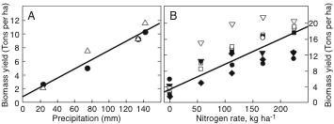
Switchgrass as a Feedstock
Switchgrass still needs water and fertilizer to grow.
Nutrients needed:
corn versus switchgrass.
Water
Nitrogen fertilizer
kg ha⁻¹ yr⁻¹ | Corn | Switchgrass
N | 148 | 0
P | 23 | 4
K | 50 | 6
Data of Lee et al. and Muir et al, collated in Gressel,
“Genetic Glass Ceilings, Hopkins, 2007

Slide 45
Types of Biofuel
First Generation Biofuels
Oils for diesel
Grains are used to produce ethanol
Food versus fuel
Second Generation Biofuels
Using agricultural wastes ←→ lignocellulosics
Lignocellulosics from agrowaste
Grasses
These crops were not domesticated for use as biofuels
Third Generation Biofuels (looking to the future)
Algae

Slide 46

Third Generation Biofuels: Algae Feedstock
Source: wikipedia

Slide 47

Biodiesel from algae
“It has more oil per pound than corn and soybeans, does not divert crops from the food supply and can potentially be grown in sewage water and seawater without impacting the freshwater supply.” J. Zimmerman
http://www.csa.com/discoveryguides/biofuel/review7.php

Slide 48

Biodiesel from algae
Adaptable to large scale
  On a larger scale, Solix has built a pilot-scale demonstration facility with three-quarters of an acre of photosynthetic area forecasted to generate 1,500–2,000 gallons/year of biocrude, or an estimated several tons of biomass per year if the solids are included (2011)
  Note: Solix today seems focused on the specialty nutrition products from algea
“The ideal location is in a dry, sunny, flat desert, with a carbon dioxide source such as a coal-fired power plant and a significant wastewater source"Bryan McCarty, Solix Biofuels' vice president of engineering
https://www.asme.org/engineering-topics/articles/bioengineering/scaling-algae-growth-for-biofuels

Slide 49

Is Algae “Green Gold”?
Currently being developed.
30 times more oil per acre than current crops that are being used.
No sulfur.
Non-toxic
Highly biodegradable,
Not subject to a commodity risk like crude oil, corn, and soybeans are.
Notes:
Source: EcoFriend Article, “Algae BioFuels: PetroSun’s Subsidiary to Develop Bio-diesel Form Algae” India (2006), available at http://www.ecofriend.org/entry/algae-biofuels-petrosuns-subsidiary-to-develop-bio-diesel-form-algae/

Slide 50
Pros
Algae: The Pros and Cons
Cons
Versatility in growth methods
Versatility in uses
Speed of production
Potential for huge production levels
CO₂ reduction
Energy intensive
Not competitive against foreign oil (yet)
Needs funding
Technology not ready (yet)

Slide 51
How to Overcome the Technical Roadblocks to Low-Cost Advanced Biofuel Production
Make all of the components of biomass available for biofuel and co-product production:
Use the appropriate parts of specific plants.
Improve the efficiency of biomass to biofuel conversion:
Do it faster, cheaper, and sustainably.
Minimize the cost of biomass transportation.
Move more for less.

Slide 52
Biofuels as an Alternative
Biofuels are not THE answer to sustainable energy, but biofuels may be part of the answer.
Biofuels may offer environmental and economic advantages over fossil fuels, but the magnitude of these advantages depends on how a biofuel crop is grown and converted into a usable fuel.

Slide 53
Topics To Be Covered
Where does things come from
Fossil carbon
  Gas
  Oil
  Coal
First, Second, and Third Generation Feedstocks
  Bioethanol
  Ethanol from cellulose
  Biodiesel
  Biofuel from algae
The Advantages and Drawbacks of Biofuel

Slide 54
Sponsored by Yale-UNIDO Initiative
QUESTIONS?
CENTER for GREEN CHEMISTRY
and GREEN ENGINEERING at YALE

