Slide 1
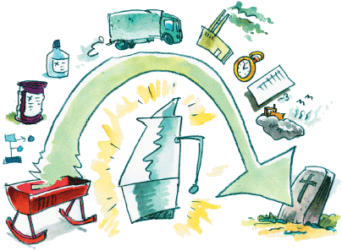
Reporting and Metrics
“Cradle-to-Grave”
“Cradle-to-Shelf”
Comprehensive Evaluation of Impact
Source: Wikipedia

Slide 2
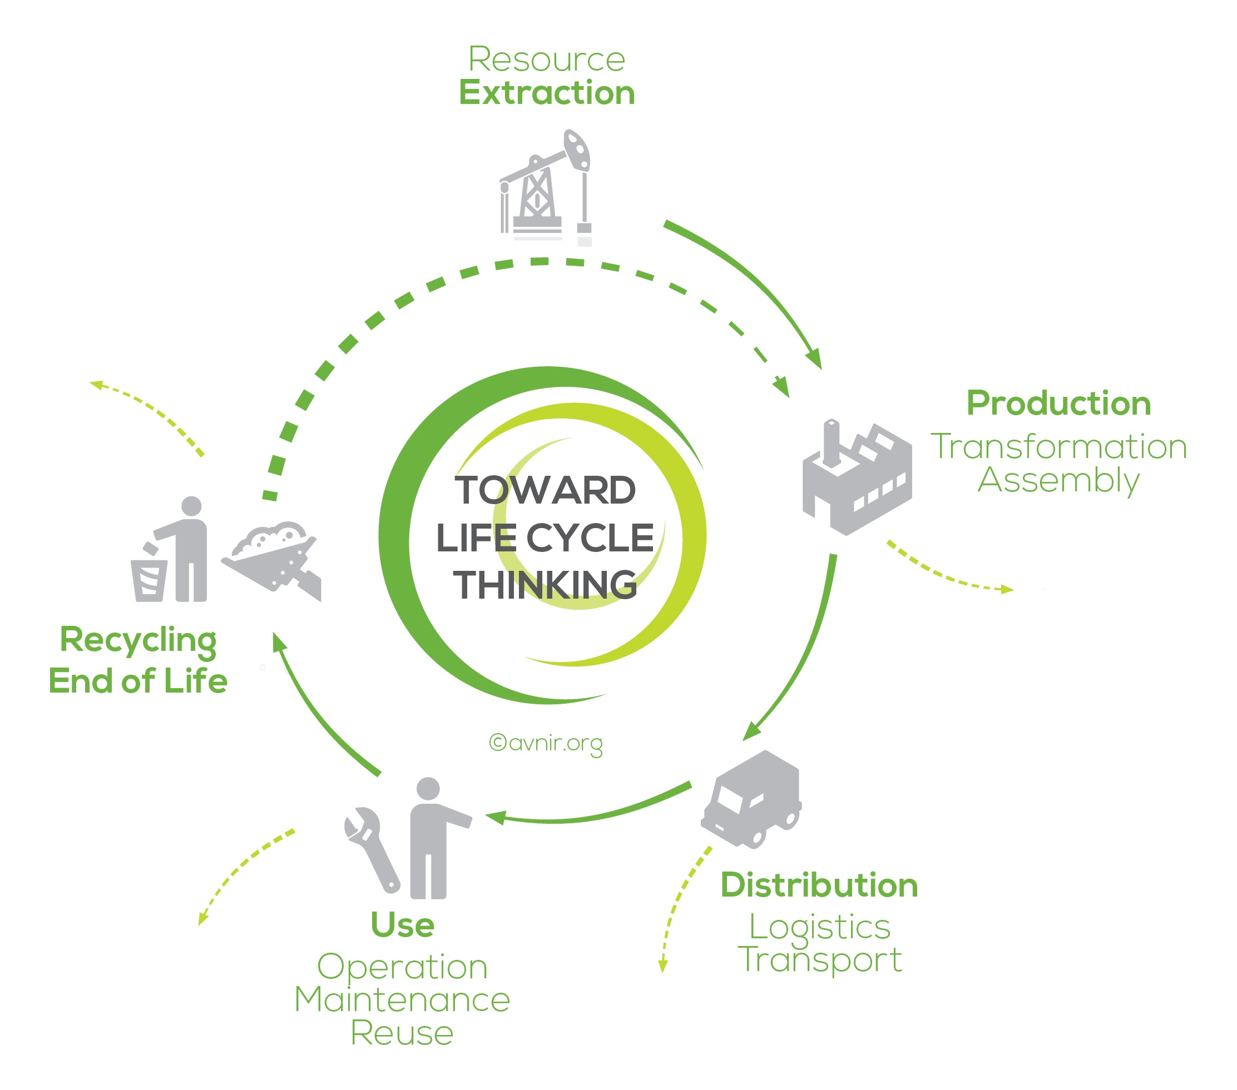
Life-Cycle Assessment
A life-cycle assessment (LCA, also known as life-cycle analysis, ecobalance, and cradle-to-grave analysis) is a technique to assess environmental impacts associated with all the stages of a product's life from-cradle-to-grave.
(i.e., from raw material extraction through materials processing, manufacture, distribution, use, repair and maintenance, and disposal or recycling)
Check out: http://www.avnir.org/EN/
- potential impacts, to be analyzed by LCA

Slide 3
Life-Cycle Assessment
Two attributes make LCA distinct and useful as an analytical tool:
  Whole system consideration of the total product life-cycle.
  Presentation of tradeoffs among multiple environmental issues.
LCA is quantitative (within limits)

Slide 4
The Four Steps of an LCA
Goal and Scope Definition (ISO 14040)
The Life-Cycle Analysis (ISO 14041) - What are the energy, raw materials, emissions, and wastes? What data is needed?
Life-Cycle Impact Assessment (ISO 14042) - Assess environmental impacts identified in the life-cycle inventory.
Life-Cycle Improvement - (ISO 14043) Identify opportunities to reduce the environmental impacts by modification of the life-cycle inventory.
ISO1400 link provided for reference only.
Phases
  Portions of LCA procedure
Goal and Scope
Interpretation
Inventory Analysis
Impact Assessment
https://www.iso.org/standard/37456.html

Slide 5
What is ISO?
ISO is an independent, non-governmental international organization with a membership of 162 national standards bodies.
It is an organization setting international standards.
ISO also publishes technical reports, technical specifications, publicly available specifications and guides.

Slide 6
Life-Cycle Inventory
Each process is subdivided into the unit processes/steps, where a detailed input/output analysis is conducted.
Process materials,
reagents, solvents, &
catalysts (including
reuse & recycle
from another stage).
Energy
Raw Material Inputs
Reuse/Recycle
Unit Process
Primary Product
Includes reuse
and recycle of
materials from
another stage.
Useful Co-Product
Waste
Fugitive &
Untreated Waste
Treatment &
Disposal

Slide 7
Scope of ISO 14040
ISO 14040 contains general information on:
  Goal and scope of LCA
  LCI phase
  LCIA phase
  Interpretation phase
  Reporting and critical review
  Limitations
  Relationship between phases
  Conditions for use of value choices and optional elements
Normative references: Need to use 14044 to apply 14040
Phases of a LCA

Slide 8
An input/output analysis is required for each process.
Life-Cycle Inventory
Data Needs Input/Output Analysis
Inputs
Outputs
Raw Material Acquisition
Water
Effluent
Airborne
Emissions
Solid Wastes
Other
Environmental
Releases
Useable
Products
Manufacturing, Processing, & Formulation
Energy
Distribution & Transportation
Use/Re-Use/Maintenance
Raw Materials
Recycle
Waste Management
System Boundary

Slide 9
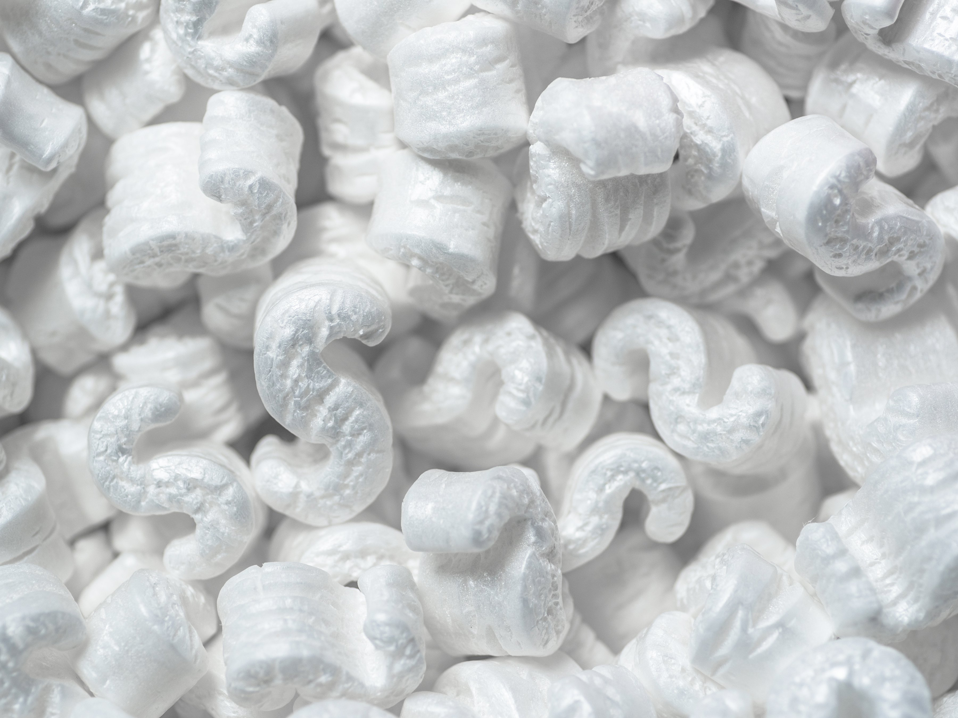

Life-Cycle Inventory
A theoretical case study: Styrofoam vs Popcorn
Which has the least environmental impact for packaging purposes?
Renewable source
Jolliet, O., Cotting, K., Drexler, C., & Farago, S.Agriculture, ecosystems & environment 49.3 (1994): 253-266.
https://www.readersdigest.ca/home-garden/tips/5-things-do-styrofoam/

Slide 10
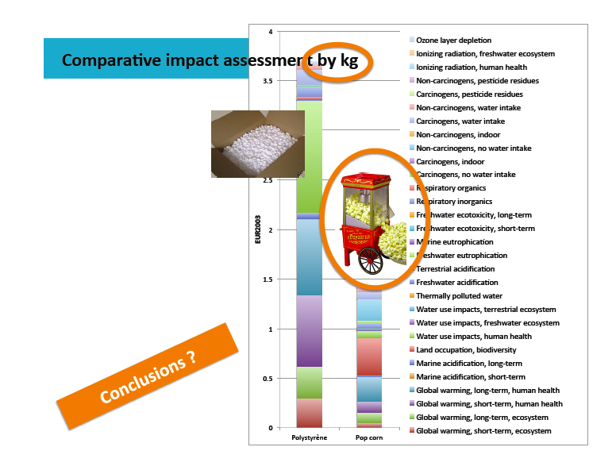
From Cecile Bulle @CIRAIG

Slide 11
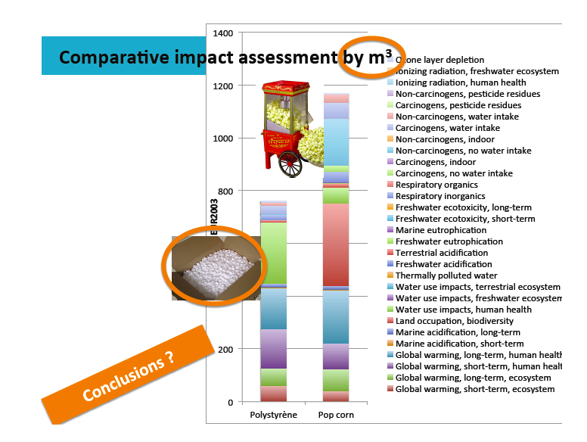
The relevant function unit here is the volume!
It’s essential to define well the functional unit for validity of conclusions!
From Cecile Bulle @CIRAIG

Slide 12
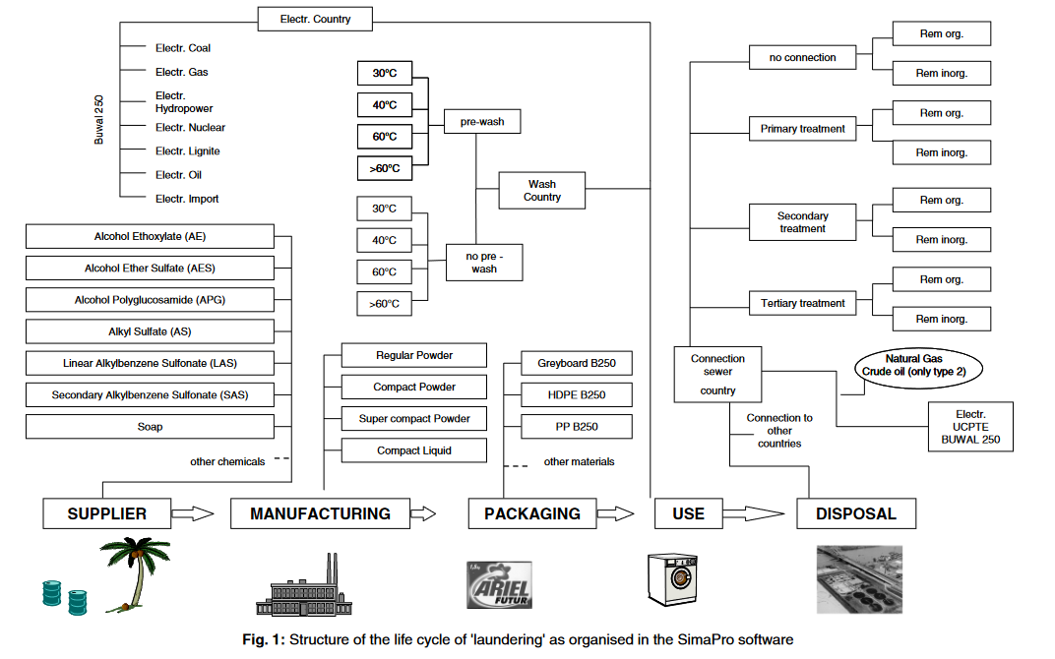

Life-Cycle Inventory
In the 1990s Procter & Gamble launched a project to perform the LCA of laundry
Note: study done using Belgium in model
E. Saouter, G. Van Hoof. The International Journal of Life Cycle Assessment 7.2 (2002): 103-114.

Slide 13
Life-Cycle Inventory
In the 1990s Procter & Gamble launched a project to perform the LCA of laundry
So what do you think is costing the most in terms of GHG emissions?
Note: study done using Belgium in model
E. Saouter, G. Van Hoof. The International Journal of Life Cycle Assessment 7.2 (2002): 103-114.

Slide 14
Life-Cycle Inventory
In the 1990s Procter & Gamble launched a project to perform the LCA of laundry
Analysis showed that:
  more than 80% of the energy consumption occurs during the consumer use stage (mainly for heating of the water).
  Air and solid waste follow the same pattern, most of these being associated with the energy generation for the use stage.
  More than 98% of the biological oxygen demand, however, is associated with the disposal stage even after accounting for removal during treatment.
Note: study done using Belgium in model
E. Saouter, G. Van Hoof. The International Journal of Life Cycle Assessment 7.2 (2002): 103-114.

Slide 15
Life-Cycle Inventory
In the 1990s Procter & Gamble launched a project to perform the LCA of laundry
Analysis showed that:
  more than 80% of the energy consumption occurs during the consumer use stage (mainly for heating of the water).
  Air and solid waste follow the same pattern, most of these being associated with the energy generation for the use stage.
  More than 98% of the biological oxygen demand, however, is associated with the disposal stage even after accounting for removal during treatment.
Note: study done using Belgium in model
E. Saouter, G. Van Hoof. The International Journal of Life Cycle Assessment 7.2 (2002): 103-114.

Slide 16

Life-Cycle Inventory
In the 1990s Procter & Gamble launched a project to perform the LCA of laundry
Analysis showed that:
  more than 80% of the energy consumption occurs during the consumer use stage (mainly for heating of the water).
  Air and solid waste follow the same pattern, most of these being associated with the energy generation for the use stage.
  More than 98% of the biological oxygen demand, however, is associated with the disposal stage even after accounting for removal during treatment.
Note: study done using Belgium in model
E. Saouter, G. Van Hoof. The International Journal of Life Cycle Assessment 7.2 (2002): 103-114.

Slide 17
Phase 1: Goal and Scope
Goal
Goal statement is the first component of an LCA and guides much of the subsequent analysis
Goal must state:
Intended use
Reasons for study
Audience
Whether comparative and disclosed to public
Scope
Scope provides background information, details methodological choices, and lays out report format
Scope includes:
Product system
Functions of systems
Functional unit
System boundary
Allocation procedures
Impact categories, assessment
method and interpretation type
Scope follows the goal and provides background information, details methodological choices, and tells how the report will be formatted.
  Data requirements
  Assumptions
  Limitations
  Initial data quality requirements
  Type of critical review, if any
  Type and format of report

Slide 18
Phases 2 and 3: LCI and LCIA
Life Cycle Inventory (LCI) Phase
  Data collection
  As much input and output data as possible is collected
  Can be presented in report or kept private, if confidentiality agreements warrant
  Useful for other researchers that could use that data
Life Cycle Impact Assessment (LCIA) Phase
  Conversion of inventory data into environmental impact potentials
  Impact categories, indication, and characterization models are chosen
  Data are grouped based on potential to cause certain environmental impacts (classification)
  Input and output quantities converted to potential impacts based on characterization factors (characterization)
  Optional steps: Normalization, grouping, weighting

Slide 19
Phase 4: Interpretation
Continually ongoing during assessment to help guide other phases.
Discussion of inventory analysis and impact assessment results in LCA study.
Can be modeled as conclusions and recommendations to the decision maker.
Should be consistent with and based on goal and scope of the study.
Should reflect the various uncertainties inherent in LCA including:
  LCA is based on a relative approach using a functional unit.
  Impacts are “potential”.

Slide 20
Example of an LCA
Possible Goal: Is an electric car greener than a combustion engine vehicle?
Possible Scope:
  Do analysis on environmental damage and human toxicity.
Output:
  Global warming (GWP),
  terrestrial acidification (TAP)
  particulate matter formation (PMFP)
  photochemical oxidation formation (POFP)
  human toxicity (HTP)
  freshwater eco‐toxicity (FETP)
  terrestrial eco‐toxicity (TETP)
  freshwater eutrophication (FEP)
  mineral resource depletion (MDP)
  fossil resource depletion (FDP).

Slide 21
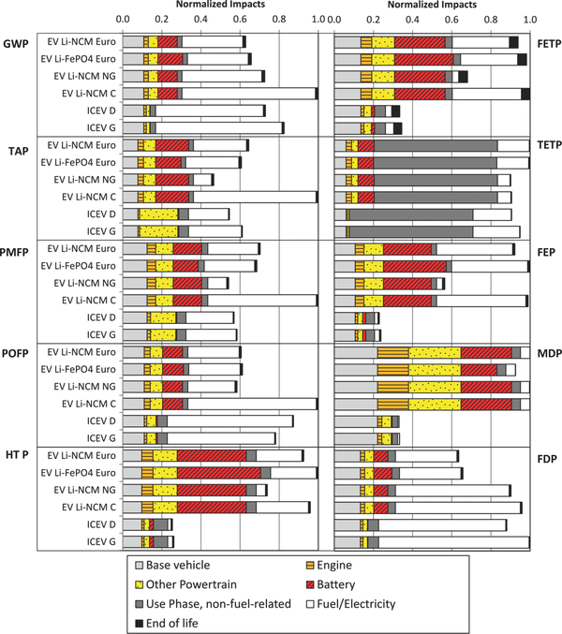
Comparative LCA of Conventional and Electric Vehicles
The study compares 4 electric cars (with different batteries) and 2 conventional cars in terms of environmental impact
ICEV = internal combustion engine vehicle
EV = electric vehicle
LiNCM = lithium nickel cobalt manganese
LiFePO₄ = lithium iron phosphate
PbA = lead acid
  GWP: global warming potential,
  TAP: terrestrial acidification (TAP)
  PMFP: particulate matter formation (PMFP)
  POFP: photochemical oxidation formation (POFP)
  HTTP: human toxicity (HTP)
  FETP: freshwater eco‐toxicity (FETP)
  TETP: terrestrial eco‐toxicity (TETP)
  FEP: freshwater eutrophication (FEP)
  MDP: mineral resource depletion (MDP)
  FDP: fossil resource depletion (FDP).
Journal of Industrial Ecology
Volume 17, Issue 1, pages 53-64, 4 OCT 2012 DOI: 10.1111/j.1530-9290.2012.00532.x
http://onlinelibrary.wiley.com/doi/10.1111/j.1530-9290.2012.00532.x/full#jiec532-fig-0001
Notes:
Normalized impacts of vehicle production. Results for each impact category have been normalized to the largest total impact. Global warming (GWP), terrestrial acidification (TAP), particulate matter formation (PMFP), photochemical oxidation formation (POFP), human toxicity (HTP), freshwater eco‐toxicity (FETP), terrestrial eco‐toxicity (TETP), freshwater eutrophication (FEP), mineral resource depletion (MDP), fossil resource depletion (FDP), internal combustion engine vehicle (ICEV), electric vehicle (EV), lithium iron phosphate (LiFePO₄), lithium nickel cobalt manganese (LiNCM), coal (C), natural gas (NG), European electricity mix (Euro).
IF THIS IMAGE HAS BEEN PROVIDED BY OR IS OWNED BY A THIRD PARTY, AS INDICATED IN THE CAPTION LINE, THEN FURTHER PERMISSION MAY BE NEEDED BEFORE ANY FURTHER USE. PLEASE CONTACT WILEY'S PERMISSIONS DEPARTMENT ON PERMISSIONS@WILEY.COM OR USE THE RIGHTSLINK SERVICE BY CLICKING ON THE 'REQUEST PERMISSIONS' LINK ACCOMPANYING THIS ARTICLE. WILEY OR AUTHOR OWNED IMAGES MAY BE USED FOR NON-COMMERCIAL PURPOSES, SUBJECT TO PROPER CITATION OF THE ARTICLE, AUTHOR, AND PUBLISHER.

Slide 22
Example results from LCA study
Electric cars powered by the present European electricity mix offer a 10% to 24% decrease in global warming potential relative to conventional diesel/gasoline vehicles
Electric cars exhibit potential for significant increases in human toxicity, freshwater eco‐toxicity, freshwater eutrophication, and metal depletion impacts, largely emanating from the vehicle supply chain (energy consumption, battery replacement)
Recommendation:
Improving the environmental profile of electric cars requires engagement around reducing vehicle production supply chain impacts and promoting clean electricity sources in decision-making regarding electricity infrastructure.

Slide 23
Powers and limitations of LCA
Powers
Limitations
• LCA functions by building and sharing databases: if you know the LCA for the production of for instance styrene, you can use this analysis for the reaction of styrene oxidation, styrene polymerization, etc…
• Allows for true comparison by using concepts such as function unit
• Allows to point at important shortcomings and opportunities in green technologies
• Open to updates based on new science and developing techniques
• Iterative process with continual interpretation.
Some environmental/health issues may be missing: yet more are developed
LCA is an approximation because of difficulty to capture all aspects of the process, account for variability, etc.
LCA data collected contains uncertainty.
• LCA depends on geographical location, which prevents generalization

Slide 24

Critical Review
Necessary component for comparative studies disclosed to the public.
Verifies process and consistency with principles.
  Not an endorsement
  Does not verify or validate goals
Can improve credibility of study.
Critical review process is defined in the goal and scope.
Requires external independent chair person and at least
two other members.
Image: shenandoahchiropractic.com

Slide 25
In-Class Exercise: LCA and Input-Output
Use the Input-Output (Embodied Energy & Operating Energy) Quick tool to estimate energy resulting from production of product.
  Use economic activity to derive estimates of materials and energy resources required for that activity, as well as the resulting environmental emissions.
  Online Tool : http://www.eiolca.net
  Task: Estimate Embodied energy and emissions associated with manufacturing of an automobile verses a bicycle.
    Use the database – look into energy use for 2002.
      Total energy TJ/1million $ (scale for 1 car worth $35000).
      Look at greenhouse gas emissions.
      Compare automobile and a bicycle.

Slide 26
Questions:
How are the inputs similar, how are they different? (consider total energy and categories).
Discuss the assumptions for the car and bicycle.
Does the result change based on the product lifetime?

Slide 27
Topics Covered
Sustainability – Myths and Facts
Society, Economy, and the Environment
Business and Sustainability
  Applying Green Chemistry to Management
Different Models of Sustainability
Case Study: The Interface Company
Green Washing
Life-Cycle Assessment

Slide 28

Sponsored by Yale-UNIDO Initiative
QUESTIONS?
CENTER for GREEN CHEMISTRY
and GREEN ENGINEERING at YALE

