Slide 1
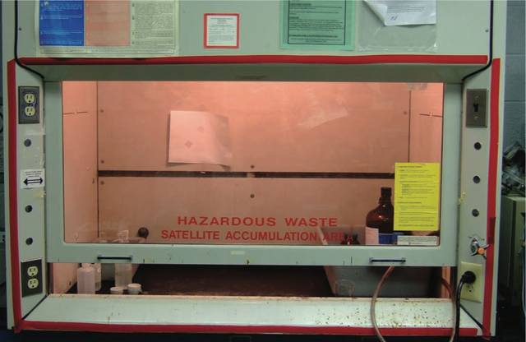

Yale-UNIDO Train-the-Facilitator Workshop in Green Chemistry
Designing for Reduced Hazard
CENTER for GREEN CHEMISTRY
and GREEN ENGINEERING at YALE
Image: Wikimedia Commons, Fume Hood , Author: U.S. National Institute for Occupational Safety and Health

Slide 2
Topics To Be Covered
Hazard and Risk – Past and Present
Toxicology
Assessing Hazards and Exposure
  What Happens When You’re Exposed?
Hazard Minimization Through Molecular Design
QSAR - Quantitative Structure Activity Relationship
Molecular Design Research Network (MoDRN)

Slide 3
The Challenge of Environmental Risk
There are over 100,000 chemicals in global circulation.
> 700 chemicals are introduced to the US market each year.
85% of these chemicals lack experimental data on environmental risk.
There has been unintended biological activity which has led to increased hazard as well as toxic endpoints for humans and the environment.
Source: Wikimedia Commons

Slide 4
Hazard
The ability cause adverse consequence.
What types of chemical hazards are there?
  Global Hazards (global warming, acid rain, security threat, ozone depletion)
  Physicochemical Hazards (explosivity, corrosivity, oxidizers/reducers)
  Toxicological
    Environmental (aquatic toxicity, avian toxicity, mammalian toxicity)
    Human (e.g., carcinogenicity, neurotoxicity, hepatotoxicity, dermal toxicity)

Slide 5
The Risk Equation
risk = f (hazard, exposure)
Risk to the environment stems from exposure to a potential environmental hazard
Two routes to reduce risk:
If hazard , exposure needs to be reduced to 0
If hazard = 0, exposure can be
conventional strategy: wear PPE!
aim of Green Chemistry
Ultimate goal is to use BENIGN materials = no hazard!
• Exposure becomes irrelevant
• Less dependence on systems which can fail or be sabotaged
• Competitive advantage – reduces costs associated with toxic materials

Slide 6
Historical Approach to Hazard Problems
Dealing with waste: treatment, control, disposal; pollutant monitoring; hazardous waste site cleanup.
Development of standards for emissions to air, releases to water, and disposal by land, as well as regulation of these standards.
“Command and Control”
Compensating injured employees
Investment in protective equipments

Slide 7
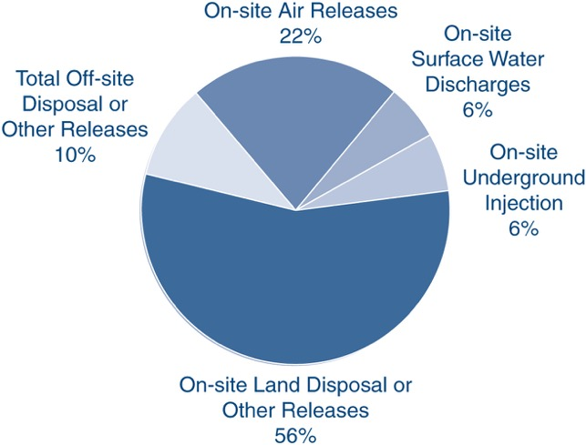

Chemicals in the Environment
In 2011, in USA only, 1.78 × 10⁶ tons of toxic chemicals were released directly to air, water and land
Only 650 toxic chemicals/chemical categories (out of 100,000 in commerce) are tracked by Toxic Release Inventory
...meanwhile in the EU...
REACH is a 2007 regulation of the European Union
Registration, Evaluation, Authorisation & Restriction of Chemicals
Goals:
  • to improve the protection of human health and the environment from the risks that can be posed by chemicals.
  • to promote alternative methods for the hazard assessment of substances in order to reduce the number of tests on animals.
Companies need to register their substances - to do this they need to work together with other companies who are registering the same substance.
Mihelcic & Zimmerman, Environmental engineering: Fundamentals, sustainability, design. Wiley Global Education (2014).

Slide 8
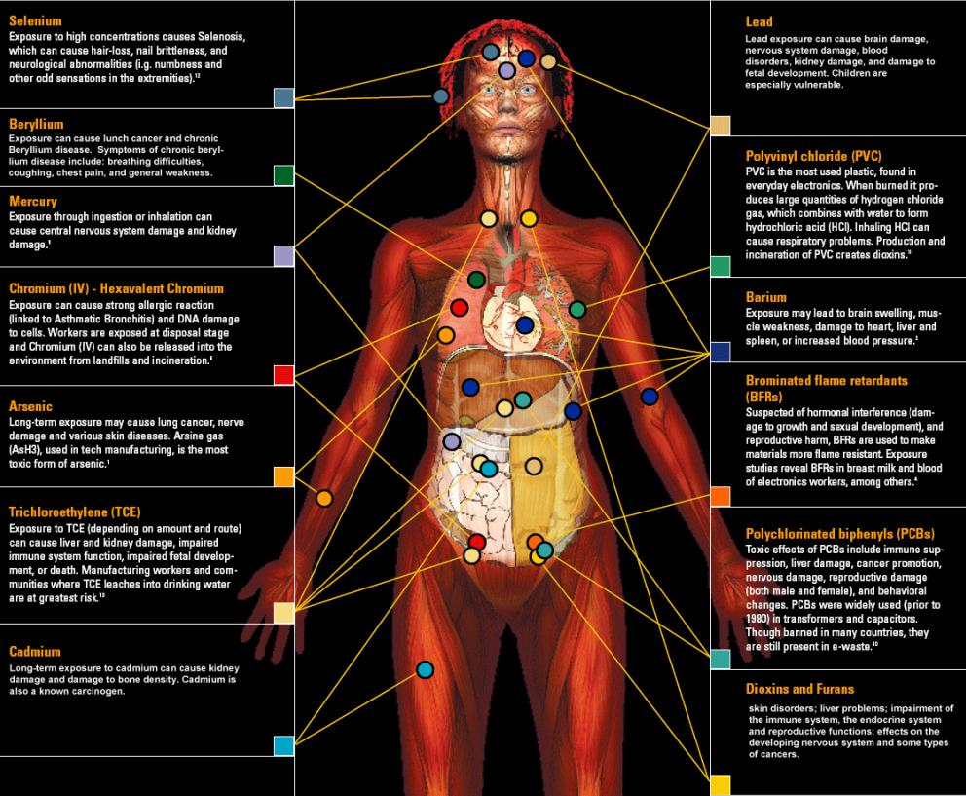
Why is This Relevant?
148 xenobiotics in the body
Xenobiotic: synthetic chemical, that is foreign to the body or to an ecological system.
Of the chemicals found:
  76 cause cancer in humans or animals,
  94 are toxic to the brain and nervous system, and
  79 cause birth defects or abnormal development.
The dangers of exposure to these chemicals in combination has never been studied.
One of Green Chemistry’s greatest strengths is the ability to design for reduced hazard.
Image Source: http://svtc.org/our-work/e-waste/

Slide 9
What is Toxicology?
The traditional definition of toxicology is "the science of poisons."
A more descriptive definition of toxicology is
"the study of the adverse effects of chemicals or physical agents on living organisms".

Slide 10
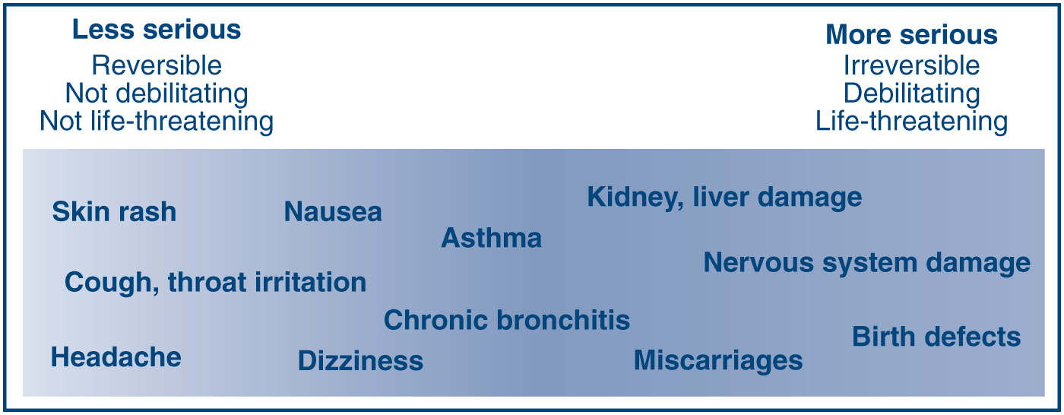
What Counts as Toxic
A toxic agent is anything that can produce an adverse biological effect;
it may be chemical, physical, or biological in form.
chemical (such as cyanide),
physical (such as radiation), and
biological (such as snake venom)
Mihelcic & Zimmerman, Environmental engineering: Fundamentals, sustainability, design. Wiley Global Education (2014).

Slide 11
Relating Toxic Endpoints to Molecular Features & Properties
Acute toxicity | Carcinogenicity | Bioconcentration
Subchronic & chronic toxicity | Neurotoxicity | Degradation & transport
Reproductive toxicity | Immunotoxicity | Aquatic toxicity
Developmental toxicity | Genotoxicity | Terrestrial organism toxicity
Relationships
Molecular weight | Molecular volume | Dipole moment
Hydrophilic surface area | Hydrophobic surface area | Rotatable bonds
Hydrogen bonds | Ionization potential | Electron affinity
Partition coefficients | Acid/base properties | Polarizability

Slide 12
What is the most important factor in bringing about the adverse biological impact?
Dose
the amount of a substance administered at given times.
examples:
  650 mg Tylenol as a single dose
  500 mg Penicillin every 8 hours for 10 days
Source: Wikimedia Commons
An apparently nontoxic chemical can be toxic at high doses.
Too much of a good thing can hurt you!
Highly toxic chemicals can be life saving when given in appropriate doses.

Slide 13
Lethal Doses
Approximate Lethal Doses of Common Chemicals
(Calculated for a 100 kg human from data on rats)
Chemical Lethal Dose
Sugar (sucrose) 900 g
Alcohol (ethyl alcohol) 1.5 L
Salt (sodium chloride) 250 g
Herbicide (2, 4-D) 125 mL
Arsenic (arsenic acid) 1-2 teaspoons
Nicotine one half teaspoon
Food poison (botulinum toxin) microscopic
Source: Marczewski, A.E., and Kamrin, M. Toxicology for the citizen, Retrieved August 17, 2000: www.iet.msu.edu/toxconcepts/toxconcepts.htm.

Slide 14
How is toxicity testing done?

Slide 15
Dose-Response
The dose-response relationship is a fundamental and essential concept in toxicology. It correlates exposures and the spectrum of induced effects.
The dose-response relationship is based on observed data from
• experimental animal studies
• human in vitro cell studies
• human clinical studies (but for drugs only!)
Dose-response assessment is a step in the risk assessment process
(Image Source: ORAU, ©)

Slide 16
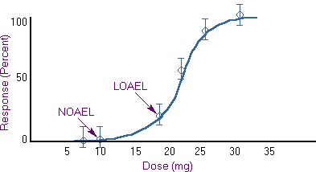
Dose-Response
Knowledge of the dose-response relationship:
• establishes causality between dose exposure and the observed effects
• establishes the lowest dose where an induced effect occurs - the threshold effect
• determines the rate at which injury builds up - the slope for the dose response.
LD 50
Relevant Metrics
LD 50- estimate for acute toxicity is the Lethal Dose Response 50%; a statistically derived dose at which 50% of the individuals will be expected to die.
NOAEL - No Observed Adverse Effect Level
Highest observed data point with no adverse effect
LOAEL - Low Observed Adverse Effect Level
Lowest data point with an adverse effect
RfD – estimate of a daily oral exposure to the human population, that’s likely to be without risk of an effect.
UF = Uncertainty factor (usually 10-1000)
UF is bigger when larger uncertainty on experiment

Slide 17
In-Class Discussion- Which Solvent Would You Use?
Solvent 99-2
100
90
Solvent 99-7
80
70
60
% Mortality
50
40
30
20
10
0
0 50 100 150 200 250 300 350
Inhaled Dose (ppm)
Plotted here are two theoretical curves for the toxicity of solvents used in the cleaning of silicon compounds. Both solvent 99-2 and 99-7 performed equally well against a variety of manufactured silicon compounds. The task at hand for you is to determine which solvent would you pick to be “safer” for use. As you can see from the accompanying data both compounds have an equivalent Lethal dose 50 value (LD50). These are based on average values during a 6 hour exposure period.

Slide 18
In-Class Discussion- Which Solvent Would You Use?
Solvent 99-2
100
90
Solvent 99-7
80
70
60
% Mortality
50
40
30
20
10
0
0 50 100 150 200 250 300 350
Inhaled Dose (ppm)
Solvent 99-7 causes lethality at much lower levels than 99-2 (20ppm versus 100ppm respectively), and the response is much more predictable (i.e. less population heterogeneity). Solvent 99-2 because higher levels can be inhaled before any harmful effects should begin.

Slide 19
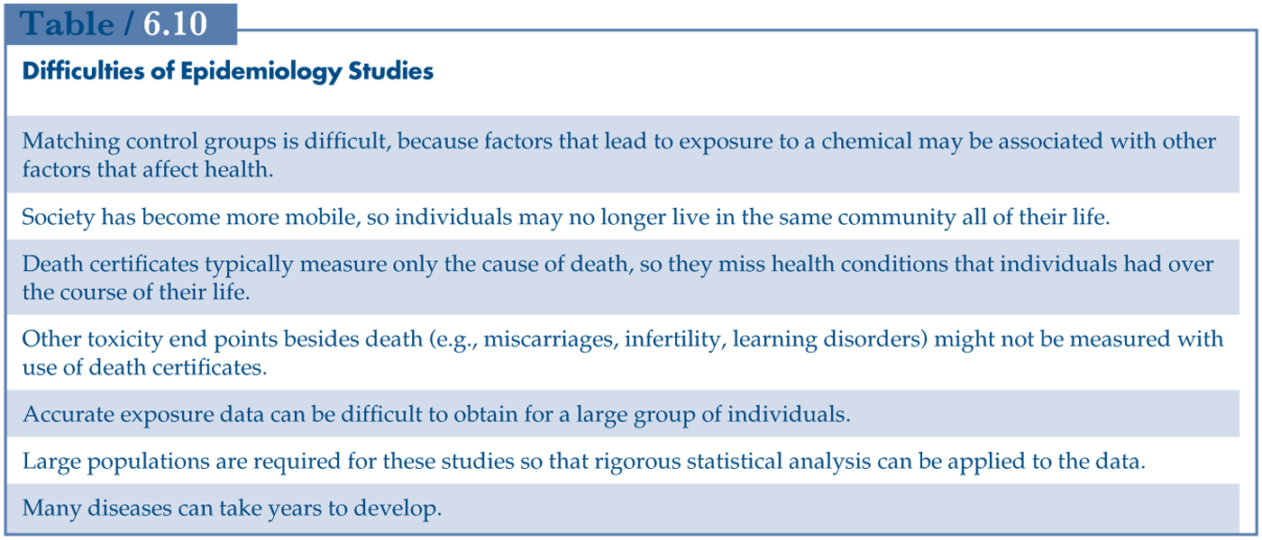
Hazard Assessment
risk = f (hazard, exposure)
Review and analysis of toxicology data and assessing if the substance causes toxic effects
Sources include animal and human studies and computational data
These studies have difficulty with showing causation (if a risk factor lead to disease)
Mihelcic & Zimmerman, Environmental engineering: Fundamentals, sustainability, design. Wiley Global Education (2014).

Slide 20
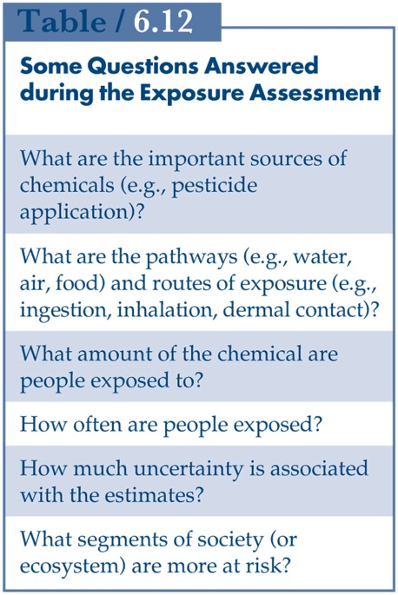
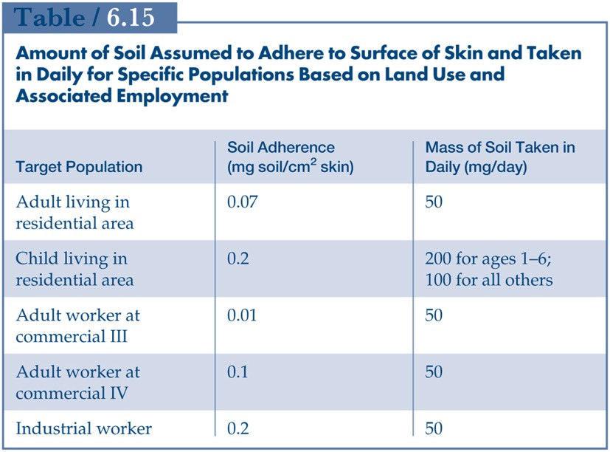

Exposure Assessment
risk = f (hazard, exposure)
Determines the extent and frequency of human exposure to target chemicals.
Guidelines for residential, industrial and commercial sites
For engineers, the knowledge of hazard and exposure provides information whether the site needs to be remediated.
Example of exposure evaluation: workers touching soil
Mihelcic & Zimmerman, Environmental engineering: Fundamentals, sustainability, design. Wiley Global Education (2014).

Slide 21
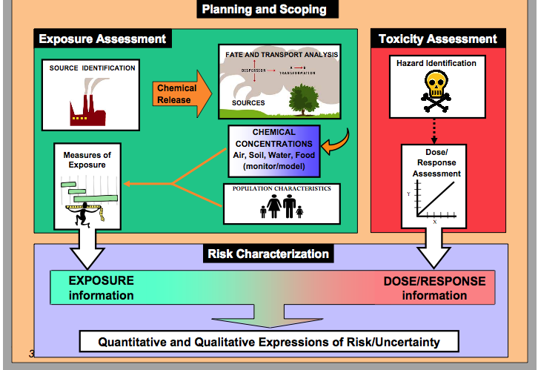
Hazard assessment, dose-response & exposure assessment
Risk Characterization

Slide 22
Tools For Hazard Characterization
ChemHAT - easy way to access summarized information on chemical hazards in the workplace
ChemSpider
Protox
Safer Choice - for consumers, businesses, and purchasers to find products that perform and are safer for human health and the environment.
toxicity assessment based on experimental or predicted LD₅₀
Notes:
Show tools

Slide 23
What happens once you are exposed to a toxicant?

Slide 24
ADME
ABSORBTION
DISTRIBUTION
METABOLISM
EXCRETION
Chemical Processes in ADME
Place where the drug (or chemical) can take effect
From: Wang and Skolnik, Chemistry and Biodiversity (2009)
http://blog.gyrosproteintechnologies.com/spinblog/adme-of-therapeutic-proteins

Slide 25
Absorption
Dermal
Respiratory
Digestive
Skin is the first barrier to absorption for the chemical. The skin can keep chemicals out of the body, or it can let them in, depending on the physical and chemical properties of the chemical. Absorption of a chemical will result in the chemical circulating inside the body and perhaps causing adverse effects.
As chemicals are inhaled, they may reach the lungs. The lung surface is a poor barrier against the entry of many chemicals into the body, which means that absorption of chemicals into the lung can be rapid and efficient.
If chemicals are swallowed, either intentionally or unintentionally, they enter the gastrointestinal tract (GI). From there, they may either pass through the body or be absorbed into the body.

Slide 26
Absorption
Dermal
Respiratory
Digestive
Parameter | Preferred | Not Preferred
Physical state | solid | liquid
LogP | Under 0 or greater than 5 | Between 0 and 5
Molecular weight | Over 400 Da | Below 400 Da
Parameter | Preferred | Not Preferred
Particle size | Over 5 nm | Under 5 nm
LogP | Less than 0 or greater than 5 | Between 0 and 5
M_{w} | Over 400 Da | Under 400 Da
p_{vapor} [mmHg] | Under 0.001 | Over 0.001
Parameter | Preferred | Not Preferred
Particle size | Over 100 nm | Under 100 nm
LogP | Under 0 or above 5 | Between 0-5
Phase | solid | liquid
M_{W} | Over 500 Da | Under 400 Da

Slide 27
Distribution
Distribution is the movement of a chemical throughout the bloodstream and into other organs, such as the brain and the bones. Pharmaceuticals such as antibiotics and painkillers are designed to have high distribution rates so they can reach their target organs and have therapeutic effects. For chemicals such as detergents, distribution should be limited.
Distribution depends on many factors such as log P, polar surface area, acidic/basic properties, and molecular weight.
Distribution as opposed to absorption is more difficult to control.
Courtesy of Molecular Design Research Network and Dr. Karolina Mellor

Slide 28
Metabolism
As a chemical is distributed through the body, it will most likely undergo metabolism. Metabolism is the body’s way of transform the molecules into metabolites in the liver. This facilitates their excretion (removal) through the kidneys. The rate at which a chemical is metabolized is usually dependent on its accessibility to enzymes.
Metabolism is unpredictable. Metabolism can lead to detoxification or toxification of the organism.
Courtesy of Molecular Design Research Network and Dr. Karolina Mellor

Slide 29
Elimination
After the chemical is absorbed, the body can eliminate it by a process called excretion which can occur through the kidneys, the skin, the GI tract, and the lungs. If the chemical is not eliminated from the body, it can accumulate, or stay in the blood, which can lead to disease. Bioaccumulation is favored for lipophilic molecules in fatty tissues.
Excretion as opposed to absorption is more difficult to control.
Courtesy of Molecular Design Research Network and Dr. Karolina Mellor

Slide 30
In-Class Exercise
Go to chemspider.com and search for acetone
Using discussed parameters, predict respiratory, dermal and digestive absorption of compounds.
What is a likely route for an acetone exposure?

Slide 31
DERMAL
 | acetone
LogP
Molecular weight [g/mol]
Phase
RESPIRATORY
 | acetone
LogP
Molecular weight [g/mol]
Vapor pressure [mmHg]
DIGESTIVE
 | acetone
LogP
Molecular weight [g/mol]
Phase

Slide 32
DERMAL
 | acetone
LogP | -0.24
Molecular weight [Da] | 58
Phase | liquid
RESPIRATORY
 | acetone
LogP | -0.24
Molecular weight [Da] | 58
Vapor pressure [mmHg] | 348.4±0.1
DIGESTIVE
 | acetone
LogP | -0.24
Molecular weight [Da] | 58
Phase | liquid

Slide 33
Conclusions
Acetone is volatile–it will absorb through the respiratory system.
It’s not likely to absorb through membranes.
Since it is a liquid, it will absorb easier than solid.

Slide 34
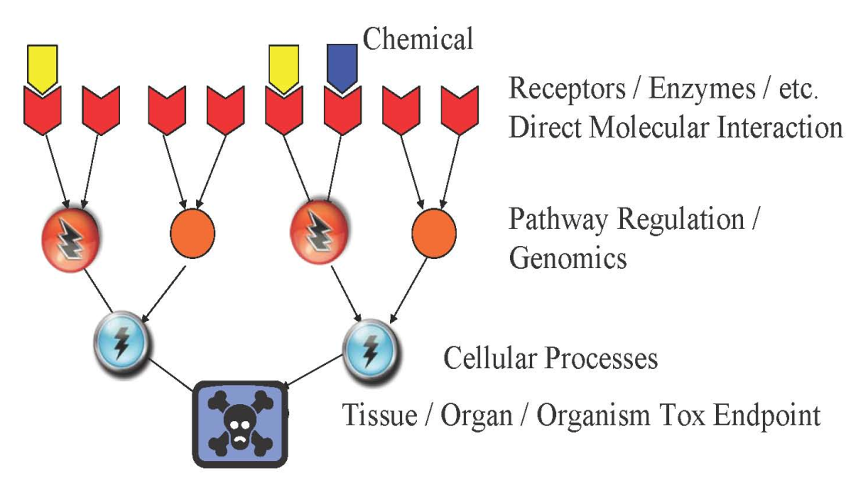
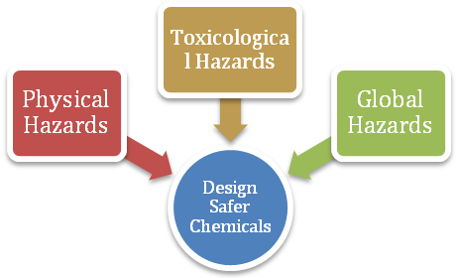
Understanding Physicochemical Properties Associated with Reduced Hazard
DESIGN
DESIGN
Chemical and Physical Properties
pKa chain branching log P molecular refractivity mol. wt. hydrolyzable groups
E_{HOMO} E_{LUMO} electronegativity hardness dipole log D_{7.4} # H-bond accep/donor
Flammability
Radioactivity
Risk of Explosion
Chemical Reactivity
Pollution
Persistence
Depletion of resources

Slide 35
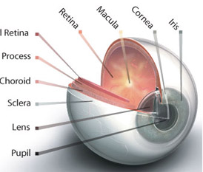
Property-Based Guidelines for Bioavailability
Acidic substance
Chemical
Basic substance
pKa<7
pKa>7
Absorption organs
GI tract
Skin
Lungs
Eyes
Unionized at pH>pKa
Lipid soluble
Un-ionized at pH>pKa
Absorbed across intestine membrane intoblood
Notes:
Different absorption mechanisms - GI tract has largest SA, resp has largets blood flow & thinnest membrane, skin has variable thicknes; different requirements for water sol

Slide 36
Property-Based Guidelines for Bioavailability
• molecular size < 500 Da
• log P_{ow} 0 - 5
• Non-ionization at GI pH
• water solubility molecular size
• vapor pressure < 0.001 mmHg
Absorption organs
GI tract
Skin
Lungs
Eyes
• molecular size < 400 Da
• log P_{ow} 0 - 6
• presence of solvents
• ionization (polar, ionized)
• particle size < 5um
• molecular size < 400 Da
• vapor pressure < 0.001 mmHg
Voutchkova et al., Chem. Rev. 2010, 110, 5845.

Slide 37
For Additional Practice: Safer Chemical Design Game
Educational game based on ADME and scientific data for surfactants to make connection between physico-chemical properties and health.
http://gwiz.yale.edu
Courtesy of Molecular Design Research Network and Dr. Karolina Mellor

Slide 38
Approaches to Hazard Minimization through Molecular Design

Slide 39
Green Chemistry Molecular Design Pyramid
Not well understood and relatively complex
Toxicodynamics
Receptor
binding
Key events
Bioaccumulation/
Persistence
Bioavailability Structure/Shape Activity Mechanism of Action
Shape/
Molar Volume
Reactive
Functional
Groups
That’s what we want to target
Solubility
Electronic
Charge
Chemists can control quite well
Molecular
Weight
Volatility
Particle
size
Toxicokinetics

Slide 40
Approaches to Hazard Minimization Through Molecular Design
Elimination of the molecular initiating event that activates pathway
Changing reactive functional groups
Reducing or eliminating bioavailability
Reduction of need for associated hazardous substances
Design for End-of-Use product life

Slide 41
Elimination of the molecular initiating event that activates pathway
Where the mechanistic pathway of action is known, molecular structures can be designed such that the necessary reactions are either impossible or highly disfavored: resulting in significant toxicity reduction.
Molecular
Cellular
Tissue
Organ
Organ System
Individual
Population
Ecosystem
Macro-Molecular
Interactions
Cellular
Responses
Organ
Responses
Organism
Responses
Population
Responses
Toxicant
Chemical
Properties
Receptor/Ligand
Interaction
DNA Binding
Protein Oxidation
Gene activation
Protein production
Altered signaling
Altered physiology
Disrupted homeostasis
Altered tissue development/ function
Lethality
Impaired
Development
Impaired
Reproduction
Structure
Recruitment
Extinction
Ankley et al. 2010 ET&C; Source: Gary Ankley & Dan Villeneuve, EPA

Slide 42
B. Changing Reactive Functional Groups
In the absence of specific mechanistic information, chemists can modify structure such that certain reactive functional groups, e.g., cyano, electrophilic, etc., can be minimized or eliminated from the chemical structure where feasible.

Slide 43
C. Reducing or Eliminating Bioavailability
In order for a chemical to manifest its intrinsic hazard, it must be able to reach the toxicological target, human, animal, environmental or global. Through structural molecular design, properties such as solubility, log Kow, and volatility can adjusted to reduce hazard manifestation.

Slide 44
D. Reduction of Need for Associated Hazardous Substances
Many chemical substances, if not hazardous themselves, require the use of other hazardous substances e.g., paints with VOCs, surfaces requiring specific cleaners, plastics with various additives.
Through molecular design, these associated substances can be eliminated by making the desired properties integral to the product

Slide 45
E. Design for End-of-Useful Product Life
Persistence of chemical in the environment is a problem that can be designed out of molecular structure.
By creating products that degrade to innocuous by-products under designed conditions, e.g., heat, light, time one a can reduce or eliminate this hazard.
Design for utilization of waste as a feedstock is an important goal.

Slide 46
By Changing the Molecular Charge: Cephalosporins
Cephalosporins: Antibiotic molecules used for gram+ bacteria
Clinical nephrotoxicity was recognized early – damage to proximal tubular epithelia.
Rapidly transported across basolateral membrane via the organic anion transporter, OAT1. Transport out of cell into lumen is less well characterized (involves other OAT, OAT4).
Cephalosporin has a very low affinity for OAT4 due to its zwitterionic character, resulting in considerable intracellular accumulation
In contrast, cephalothin, an anionic analog of the original zwitterionic drug, rapidly moves across the epithelia from blood into urine
Is thus not a neurotoxin
Cephalothin
Cephaloridine
Notes:
Cephalosporins are a type of beta-lacatam antibiotic.
First generation:Cephaloridine

Slide 47
By Manipulating Sterics: Paraquat and Diquat
Diquats and Paraquats are herbicides (plant killer), primarily for weed and grass control
Diquat
Paraquat
Both: Toxic doses are life threatening. Impacts GI tract, kidney lungs, liver, heart, other organs
Paraquat is not metabolized by the liver. It has life-threatening effects on the gastrointestinal tract, kidney, liver, heart and other organs
In animal studies, diquat causes mild, reversible injury
Not registered as a restricted use pesticide
Registered as a restricted use pesticide
http://npic.orst.edu/RMPP/rmpp_ch12.pdf
Notes:
Paraquat is s non-selective contact herbicide of the diphenyl class. It was introduced in the 1960s and became used worldwide.
However it was soon recognized that paraquat also cause selective pulmonary toxicity to humans (damage to alveolar cells type I and II, causing edema, inflammation and hermorrhage, lung fibrosis).

Slide 48
Nonylphenols and Glycidyl Ethers
Polyethoxylatednonylphenols
Emulsifiers, surfactants
When n = 14-19, intense myocardial necrosis at 40 mg/kg day in dogs and guinea pigs
When n<14 or n>19, no myocardial effects
Glycidyl ethers
When n = 7-9, mutagenic, cause testicular lesions
When n = 11-13+, non-mutagenic

Slide 49
By Manipulating Electrophilicity: Acrylates
Acrylate is understood to be carcinogenic because it can readily undergo Michael addition reactions
The addition of a methyl group to form methacrylate decreases the electrophilicity of the b-carbon, and decreases tendency for Michael reactions.
While this does not reduce the commercial efficacy, but whereas acrylate causes cancer is experimental assays, methacrylate does not.
Acrylate
carcinogenic
Methacrylate
non-carcinogenic
Notes:
Electr

Slide 50
By Facilitating Detoxification: Benzene
Benzene is known to cause hematotoxicity and leukemia in humans
This is understood to be due to one of its metabolites, (E,E)-muconaldehyde.
Toluene is comparatively much less toxic, as the methyl group is oxidized more easily than the benzene ring to give benzoic acid
hematotoxicity,
leukemia
hepatic oxidation
non-toxic
[detoxification]

Slide 51
By Isosteric Substitution: Carbon with Silicon
DDT
(Toxic to insects)
Si-DDT Analog
(Non-toxic to insects)
DDT is well known to be environmentally persistent
DDT analog with Silicon above was synthesized.
While less persistent, the analog turned out to be non-toxic to insects
This is due to the more readily oxidized (metabolized) Si-H bond compared to C-H and also the larger size of the molecule

Slide 52
Designing New Molecules is Not a Trivial Task
Even if chemists design one chemical, it has to undergo tests

Slide 53
QSAR-Quantitative Structure Activity Relationship
QSAR = classification models used in the chemical and biological sciences and engineering
QSAR established relationship
Known data sets
"predictor" variables
QSAR
potency of the response variable
Biological activity: toxicology and eco-toxicology
[like LC50 or oxidative stress]
Structure, physico-chemical properties, chemical functionalities
QSAR predicted potency of the response variable
New molecules
"predictor" variables
QSAR
QSAR uses the learnt rules to predict biology
Wikipedia

Slide 54
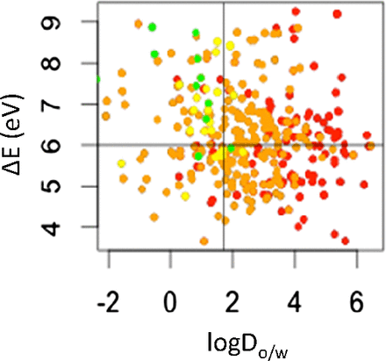
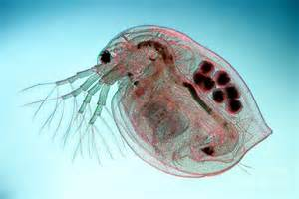
A simple QSAR example with 2 parameters
Safe region
In this example a correlation between two parameters: energy gap (ΔE) in molecule and logD_{ow} and toxicity for Daphnia is established.
energy difference between the highest occupied and lowest unoccupied frontier orbitals. ΔE (eV)
This tool can predict aquatoxicity using a parameter easy to measure (logD_{ow}) and a parameter easy to compute (ΔE)
Scatter plot colored by category of concern for acute aquatic toxicity based on a 48-h toxicity assay of Daphnia magna
octanol-water distribution coefficient at pH 7.4 (logD_{o/w})
Kostal et al. "Identifying and designing chemicals with minimal acute aquatic toxicity." Proc. Nat. Acad. Sci. 2015, 112, 6289-6294.

Slide 55
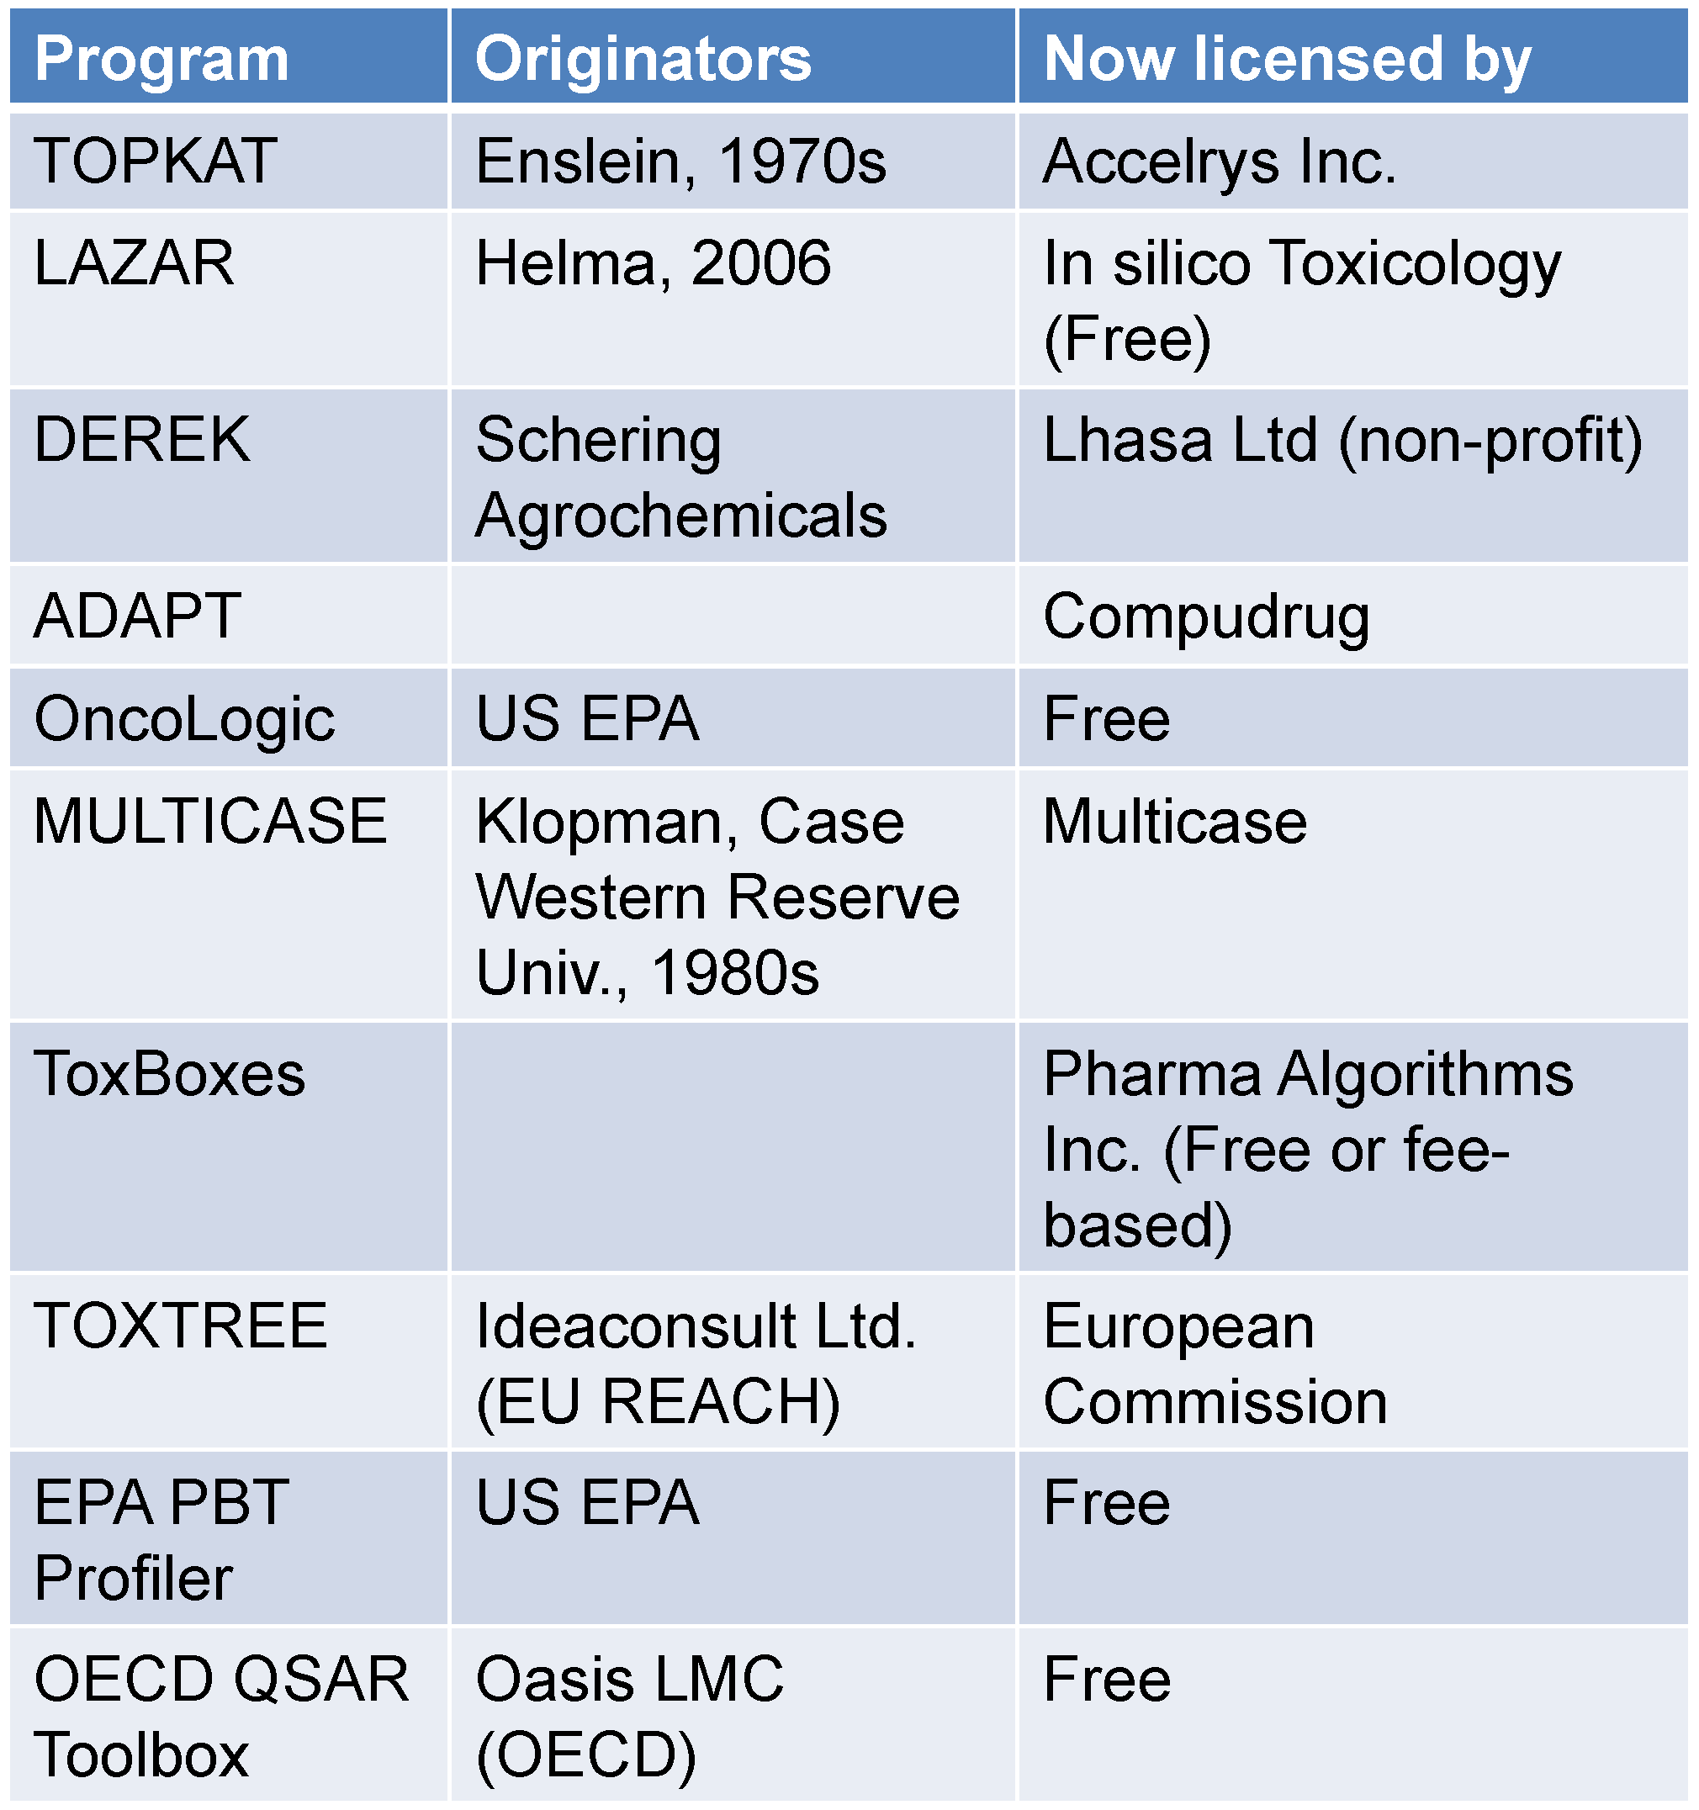
Examples of Popular Toxicity Prediction Tools
Current limitations
Prediction accuracy not higher than 65-70% for non-carcinogenic chemicals.
Lack of validation with up-to-date data
Application to a narrow range of chemical structures
Qualitative output

Slide 56
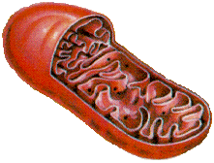
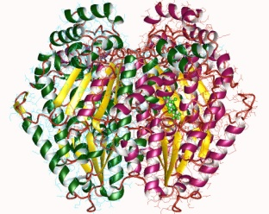
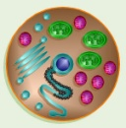
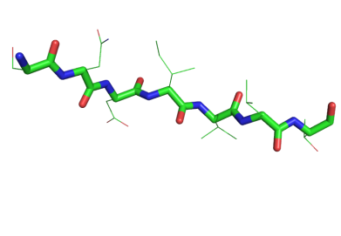
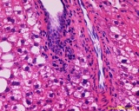
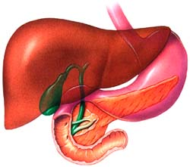
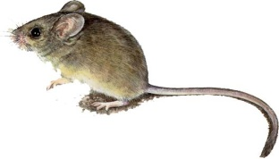
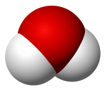
Next generation: powers of computational Chemistry
Computational chemistry
Toxicology
Organelles
Enzymes
Receptors
Genes
Cells
Tissues
Polypeptide
DNA strands
Organs
Small molecules
Whole organisms
System size
Advances in technology & science
As toxicology has increased its understanding of underlying biological processes leading to toxicity, computational chemistry can now describe the chemical transformations involved in these processes
Notes:
Jakub’s slide

Slide 57
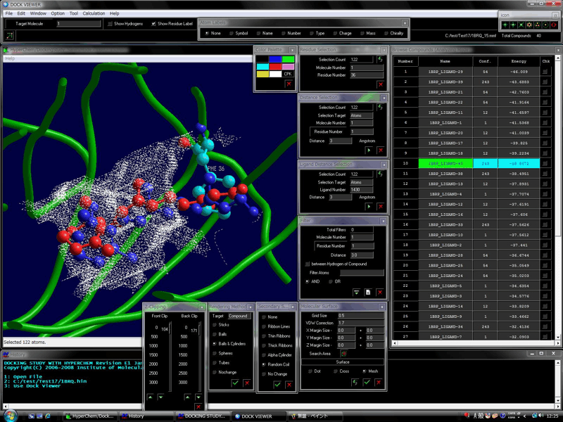
Next generation: powers of computational Chemistry
Docking software have been able to model very precisely the active site of a target enzyme (target to a drug for instance, or to a toxic).
In drug design such software are used to predict the best molecules for biological activity. Only the best performing are synthesized and tested.
Similar ideas can be used in toxicology
http://www.molfunction.com/software5.htm
Notes:
Jakub’s slide

Slide 58
Create a reliable tool for chemists which will not only predict the toxicity of existing chemicals but will allow a design of future molecules with reduced hazard

Slide 59

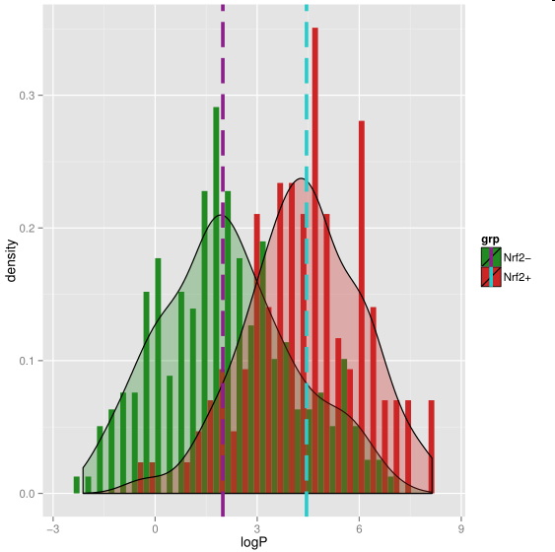
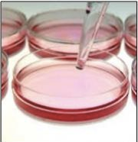


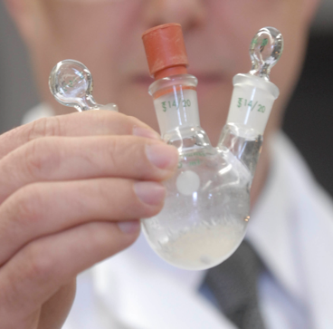





Molecular Design Research Network
Toxicology
Chemistry
Molecular Biology
Computational Chemistry
Notes:
MoDRN is the collaboration between 4 universities Baylor, GW, UWASH and Yale that uses advances in biology, toxicology, computational chemistry and engineering to develop a robust and well validated computer software that will not only predict toxicity of existing compounds but it will serve as a tool to redefine guidelines for the next generation molecules with reduced hazard. Our network will employ the newest strategies of computer modeling to build a computer software which will allow to understand what causes toxic endpoints and what can we do to avoid it. Our efforts will not only limit to research. To have the biggest possible impact we will engage educators and students on undergraduate and high school level to by including safer chemical design in students’ lesson plans and by developing interactive and hands-on teaching tools for undergraduate and high school students. Finally we plan to work with our colleagues across academia, colleagues across many industry sectors and policymakers on the government level to further inform and disseminate safe chemical concepts.

Slide 60
Where is Data Coming from?
National Center for Computational Toxicology (NCCT)
EPA ToxCast
Tox21
Network lab assays
High throughput assay
Low throughput assay

Slide 61
What is an Assay?
Assay can test almost any biological effect
In vitro assay →in cell
In vivo assay →outcome in organism
Ideal assay is:
Reproducible: same result when repeated
Reliable: same result with different people repeat it
Sensitive: won’t miss an effect
Specific: won’t say there is an effect if there is not
Predictive of outcome of interest

Slide 62
Data from ToxCast
Set | Chemicals | Assays | Endpoints | Completion | Available
ToxCast Phase I | 293 | ~600 | ~700 | 2011 | Now
ToxCast Phase II | 767 | ~600 | ~700 | 03/2013 | 10/2013
ToxCast Phase IIIa | 1001 | ~100 | ~100 | Just starting | 2014
E1K (endocrine) | 880 | ~50 | ~120 | 03/2013 | 10/2013
Tox21 | 8,193 | ~25 | ~50 | Ongoing | Ongoing
~600
Assays
0
Chemicals
~8,200
Notes:
It’s important to note that this is not just a data collection exercise. ORD has assembled the infrastructure to house, QA, and analyze the tens of thousands of data points.
AND make all of this data publically available.

Slide 63
Data from ToxCast
ToxCast phase I: primarily pesticides
ToxCast phase II: industrial chemicals
ToxCast phase III: diverse chemical space; high production

Slide 64
Data Endpoints
Chronic, developmental, acute toxicity endpoints:
Oxidative stress

Slide 65
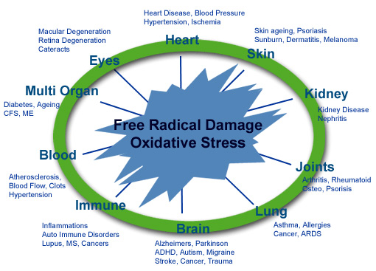
Adverse Oxidative Stress Pathways:
Diseases Associated with ROS
ROS = Reactive oxygen species

Slide 66
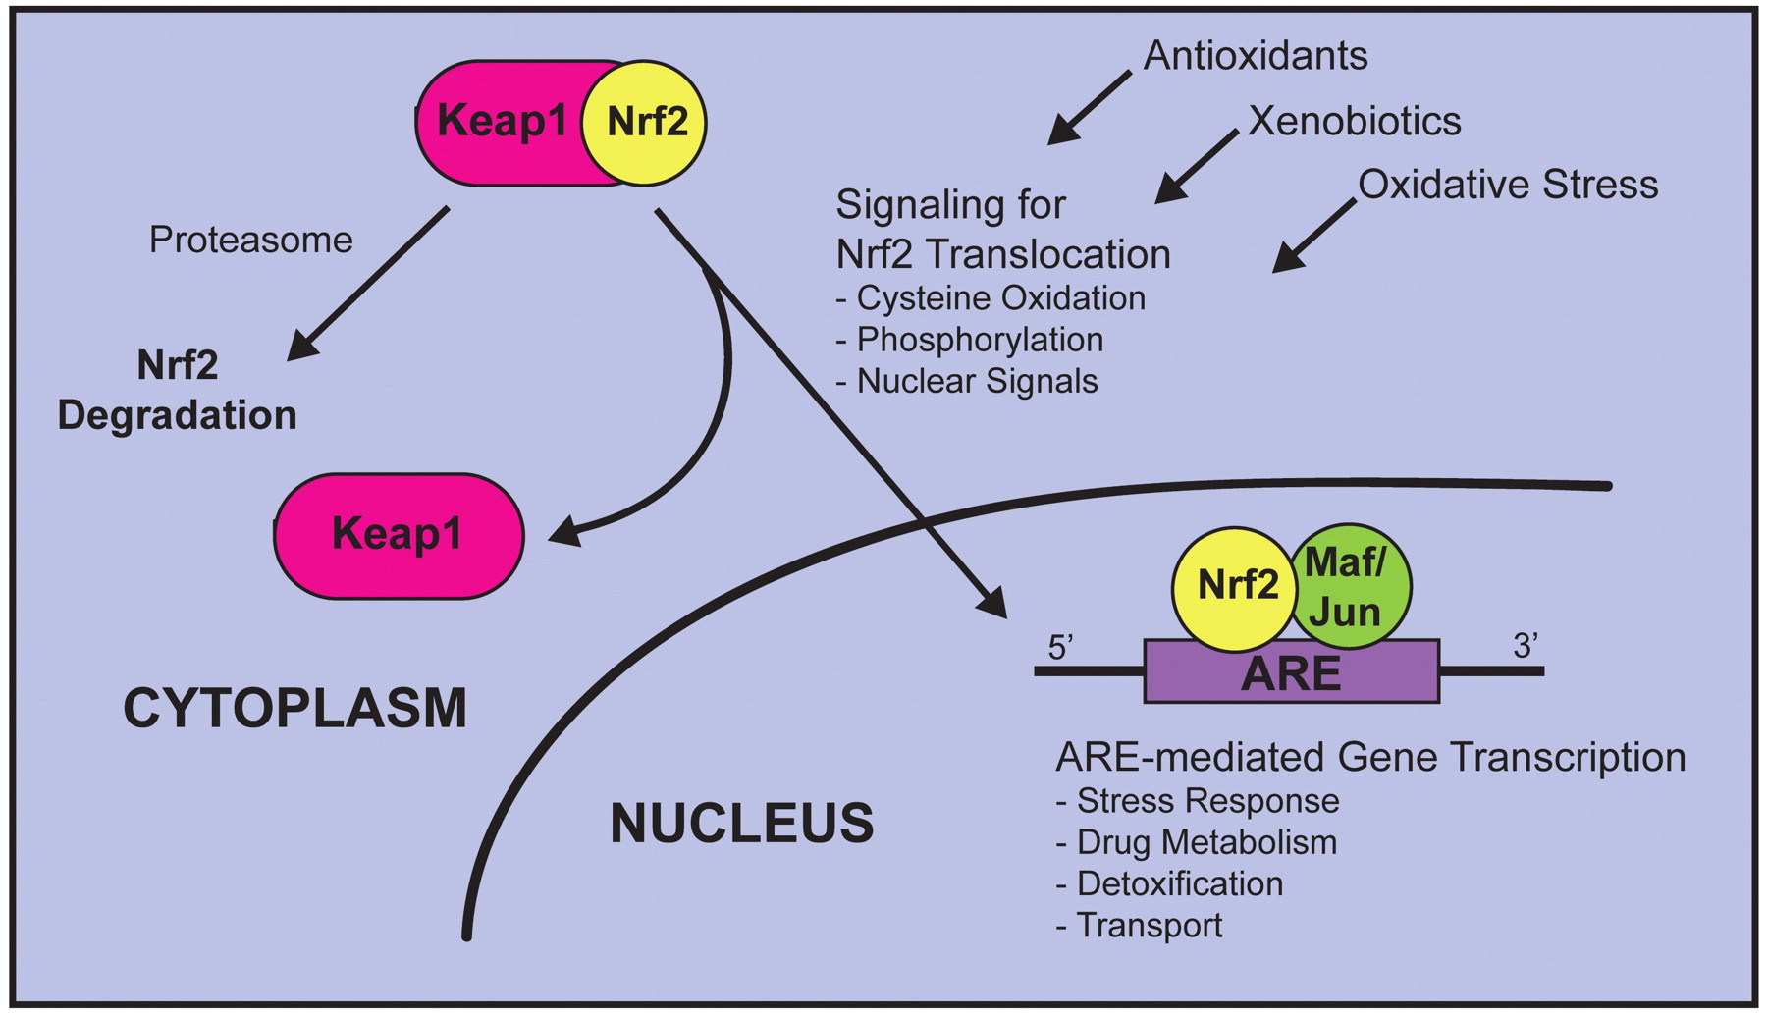
Regulation of Nrf2-mediated gene transcription
KEap1 – nucleophile interaction
Toxicologic Pathology, 2007, 35:459–473,

Slide 67
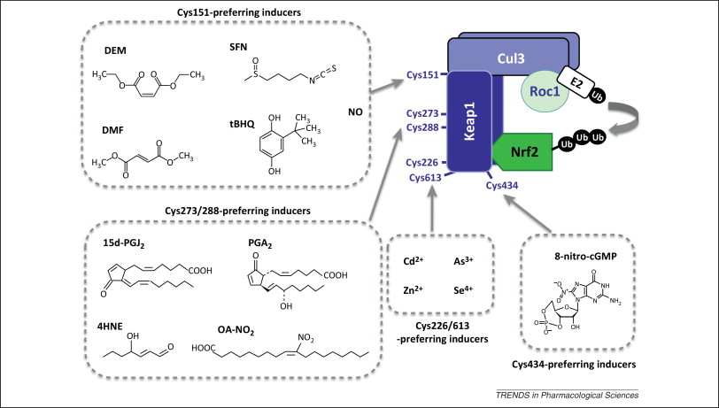
Keap1-Nrf2 Chemical inducers
Trends in Pharmacological Sciences, 2013, 34, 6, 340-346

Slide 68
Property-Based Approaches to Design Rules for Reduced Toxicity
Study the physical, chemical and electronic properties of Keap1-Nrf2 inducers
Build a statistical quantitative model that relates computational parameters to adverse outcome pathways for oxidative stress.
Notes:
Benzene diol to benzoquinone.

Slide 69
MoDRN Key Deliverables:
Guidelines or rules that will allow chemists to rationally design chemicals that are unlikely to cause oxidative stress.
In vitro and in vivo toxicity studies of chemicals that are implicated in oxidative stress, including comparative studies.

Slide 70
Topics Covered
Hazard and Risk – Past and Present
Toxicology
Assessing Hazards and Exposure
  What Happens When You’re Exposed?
Hazard Minimization Through Molecular Design
QSAR - Quantitative Structure Activity Relationship
Molecular Design Research Network (MoDRN)

Slide 71
Sponsored by Yale-UNIDO Initiative
QUESTIONS?
CENTER for GREEN CHEMISTRY
and GREEN ENGINEERING at YALE

