Slide 1
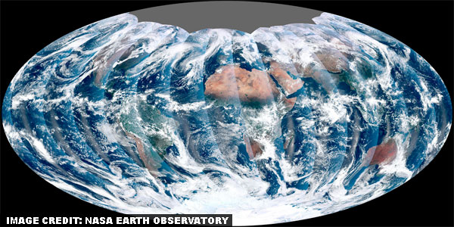

Yale-UNIDO Train-the-Facilitator Workshop in Green Chemistry
From Theory to Practice
CENTER for GREEN CHEMISTRY
and GREEN ENGINEERING at YALE
Image: NASA Earth Observatory

Slide 2
Topics To Be Covered
Implementation: Why, What, and How
Understanding Context
  Green Chemistry in the Marketplace
Identifying Opportunities
  Life Cycle and Green Chemistry Principles as a Guide to Finding Opportunity
Delivering Innovation
  Green Chemistry Strategies at All Stages
Green Chemistry Assessment Tool
How to Proceed: Moving Forward

Slide 3
What’s Next?
After several hours of listening to lectures, doing exercises, and viewing case studies, how do you go about implementation and/or dissemination of Green Chemistry?
The process can be summarized in 3 words:
Why → What → How

Slide 4
Why
Understand Context
Business/Market
What
Identify Opportunities
Product/Service
How
Deliver Innovation
Technology

Slide 5
Why
Understand Context
Business/Market
Reasons may vary:
Reduce cost
Increase margins
Increase sale
Enhance corporate competitiveness
Improve reputation
Potential roadblocks
Resource depletion
Environmental damage
Growing population
Increasing consumption
Societal attitudes
Regulatory landscape

Slide 6
Why
Understand Context
Business/Market
Understand Trends & Drivers
Political
  Social services
  Consumer protection
  Tax competition
  Knowledge competition
Environmental
  Climate change
  Extinctions
  Water
  Waste
  Resource constrains
Social
  Urbanization
  Demographics
  Population growth
  Fear
Technology
  Nano
  Molecular biology
  Statistics
  Computational science
  Green chemistry
Economic
  Globalization
  High value services
  Income

Slide 7
Why
Understand Context
Business/Market
Think of an outcome
Generate a problem statement
If only we could _________, then we could____________

Slide 8
  Identify Opportunities
    Product/Service
What
What are we delivering?
What is the “functional unit”?
New synthetic route
New catalyst
Alternative solvent
New product
Number of reaction runs
Performance (yield or atom economy)
Energy usage per period of time
Kg of parts cleaned

Slide 9
  Identify Opportunities
    Product/Service
What
Use Life Cycle and Green Chemistry Principles as a guide
Image source: Wikipedia

Slide 10
  Identify Opportunities
    Product/Service
What
Image source: Wikipedia

Slide 11
  Deliver Innovation
  Technology
How
Raw materials extraction
Production of waste and energy consumption during raw material extraction
High impact materials: rare metals, natural extracts (perfume ingredients), bricks, concrete, electronic equipment

Slide 12
  Deliver Innovation
  Technology
How
Design strategy for raw materials
Reduce the hazard for the materials used: avoid materials that are persistent, bioacummulative, have high toxicity profile
Use renewable materials like carbohydrates, lipids, biopolymers
Use recycled materials or materials from the waste stream
Reduce the number of raw materials used
Minimize transportation (locally sourced, or manufacturing shifted onsite)
Avoid materials that generate a lot of waste or are energy intensive
Avoid materials produced in environmentally damaging way
Use BIOWIN or PBT Profiler (http://www.pbtprofiler.net/default.asp) for persistence/degradation and bioconcentration
Use ChemHAT, Protox, ChemSpider for toxicity profile
EcoSAR (not discussed) for ecotoxicity

Slide 13
  Deliver Innovation
  Technology
How
Manufacturing
Possibly the greatest impact
Extensive processing that uses energy and produces a large volume of waste
Examples include consumer products and chemicals

Slide 14
  Deliver Innovation
  Technology
How
Design strategy for manufacturing
Improve energy efficiency of the process
Use technologies which minimize production of waste and emissions
Use renewable energy
Avoid hazardous process and auxiliary materials (use safer solvents)
Recycle process materials (solvents)
Choose disposal to minimize environmental impact
Use waste as a feedstock for another process
Use solvent selection guides for better solvent alternative
Identify chemicals of concern: Toxic Release Inventory (https://www.epa.gov/toxics-release-inventory-tri-program)
Use IRIS (https://www.epa.gov/iris ) to check human health effect from chemical exposure
Atom economy, E-factor for reaction performance

Slide 15
  Deliver Innovation
  Technology
How
Distribution
Products which are transported over long distances, are heavy and require a lot of packaging
  Example includes fresh out of season vegetables shipped to locations around the world

Slide 16
  Deliver Innovation
  Technology
How
Design strategy for distribution
Minimize packaging per unit of service
Use returnable packaging
Avoid PVC and use packaging from renewable feedstocks
Manufacture product at the point of use
Use a lower impact transportation

Slide 17
  Deliver Innovation
  Technology
How
Use
Products with high durability that go through many cycles are found in this category.
  Examples include cars, laser printers and dishwashers

Slide 18
  Deliver Innovation
  Technology
How
Design strategy for use
Minimize energy efficiency per unit of service
Can the product be made safer for a human and environment?
Can the amount of product be automated to avoid losses of product?
Design out waste and emissions in use or make it environmentally benign
Minimize auxiliary processes and make materials renewable and recyclable
Collect and recycle waste

Slide 19
  Deliver Innovation
  Technology
How
Disposal (End-of-Life)
Products that are toxic or persistent are hard to dispose
  Example includes batteries

Slide 20
  Deliver Innovation
  Technology
How
Design strategy for disposal
Design so that manufacturer can recover and reuse the product at end of life
Design for easy disassembly
Can the individual components be recycled at the end of life?
Avoid harmful substances that could be released at end of life
Ensure that a toxic substance can be easily extracted from the product
Design materials that are biodegradable and compostable
Consumer information on recycling streams and means.

Slide 21
Conclusions
Based on the life cycle, assess the overall improvement to the process/technology
Identify if any tradeoffs were made between green chemistry principles

Slide 22
Example pitch for a start-up?

Slide 23
What do you do if you’re not a start-up?
Involves a certain (lots!) amount of decision-making
Scenario: Established company is making a blockbuster drug. Following initial market sales and success, we need to create a safer, greener route (think Viagra).
The company will be investing $3B into this re-development, a $40B drug is at stake, which is equivalent to ca. 10,000 workplaces
Your R&D team has proposed two greener options. Which one do you choose?

Slide 24
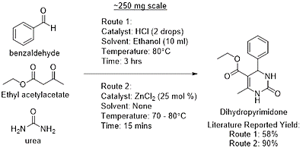
What do you do if you’re not a start-up?
Sidenote: Biginelli reaction is an example of a green reaction – one-pot, multi-component
Another example is the Ugi or Paserini reaction – 4 component!

Slide 25
How do Others Track Their Success?
International Flavors & Fragrances Inc (IFF)
International company employing ~7000 people with manufacturing facilities in 35 countries and current market of $10 billion.
In Vision 2020, they committed to embed sustainability in the company culture and develop a measurable metrics which will support triple bottom line.
As a part of this initiative they developed a Green Chemistry Assessment tool, to track their progress.

Slide 26
Green Chemistry Assessment Tool
Internal, easy to apply, uniform and standardized method of analyzing safety, health and environmental impact
Distributed and accepted by scientists and staff across the globe
Sharable with technical and non-technical experts, senior managers, customers and other stakeholders within IFF

Slide 27
Scoring
Each Green Chemistry principle has a scoring system to improve process, operations and products with the purpose of having a positive impact on TBL
Score for each principle ranges from 0 (worst) to 5 (best)
Results are presented in the radar chart
While the IFF uses the scoring system internally, their guidelines may be useful for other companies*
If process generates hazardous waste, it is assigned 0
If process has over 80% AE, then it is assigned 5
* Scoring is relative and specifically developed for IFF products. It is not shared publically.

Slide 28
Synthesis of Veridan
Fragrance aroma used in perfumery applications such as personal care and fine fragrances.
New synthesis includes:
Environmental Benefits
Improvement in mass efficiency from 25 to 85%
Chemical waste elimination up to 80%
Improved worker safety in reduction of hazardous waste
Economic benefits
94% reduction in energy cost
Greater efficiency leading to lower costs for chemical resources
Reduction for capital cost for equipment
Reduction of technical failures during scale-up
2 reaction steps

Slide 29
Improvements – STEP 1– Grignard Addition
Prevent waste (3→4)
  High, non-hazardous waste was reduced by 50 tons
Atom economy (3→4)
  Yield increased by 10%
Less hazardous synthesis (1→4)
  Elimination of safety hazards (not defined)
Design benign chemicals (3→3)
  No change in score
Benign solvents (3→3)
  No change in score: same non-hazardous solvents used
Design for energy efficiency (3→5)
  Increase from 8kg/h*m³ to 100kg/h*m³
Improvement from assigned value 3 in the traditional reaction to value 4 in the new synthesis

Slide 30
Improvements – STEP 1– Grignard Addition
7. Use of renewable feedstocks (0→0)
  The process does not use renewable feedstock
8. Reduce derivatives (5→5)
  No derivatives involved
9. Catalysis (1→1)
  No catalyst used
10. Design for biodegradation (5→5)
  No change
11. RT analysis for pollution prevention (5→5)
  Process monitoring and control present
12. Design for accident prevention (3→5)
  Process hazards eliminated

Slide 32
Improvements – STEP 2– Oxidation from alcohol to ketone
Prevent waste (3→5)
  Waste reduced by 80%, solvent recyclable between batches
Atom economy (1→5)
  Mass efficiency increased from 25-80%, yield improved by 10%
Less hazardous synthesis (3→5)
  Aluminium isopropoxide and phosphoric acid oxidation replaced by air and catalyst
Design benign chemicals (3→3)
  No change in score
Benign solvents (3→5)
  Acetone replaced by water
Design for energy efficiency (4→4)
  Reaction run at atmospheric pressure and temperature below 100C

Slide 33
Improvements – STEP 2– Oxidation from alcohol to ketone
7. Use of renewable feedstocks (0→5)
  New process uses air
8. Reduce derivatives (5→5)
  No derivatives involved
9. Catalysis (3→5)
  Use 5% reusable catalyst in place of 66% aluminum isopropoxide
10. Design for biodegradation (5→5)
  No change
11. RT analysis for pollution prevention (5→5)
  Process monitoring and control present
12. Design for accident prevention (3→5)
  New engineering controls in place

Slide 35
Is Green Chemistry Assessment Tool an absolute solution?
NO
  because metrics have uncertainties and may not apply the same way across disciplines
  They will still be a need for human decision to weight each parameters
but..
  they show greening opportunities (see LCA class)
  allows a systematic evaluation and serves as a guide
  it is a good start!

Slide 36
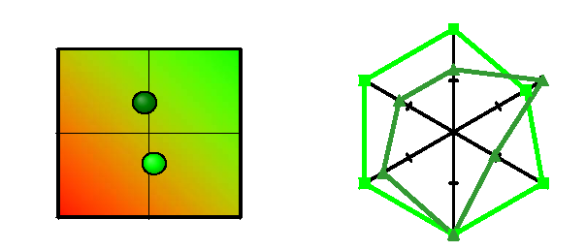

BASF Eco-Efficiency Analysis method
It is a complete suite of tools developed by BASF to be able to articulate their efforts in Green Chemistry, but also sustainability at large.
Impact & Economics

Slide 37
BASF Eco-Efficiency Analysis method
Eco-efficiency:
ratio of economic creation to ecological destruction from the perspective of the end consumer.
Six impact categories for the ecologic destruction:
  consumption of energy
  consumption of resources
  land/area use
  emissions into air, water and soil (wastes)
  toxic potential of used and released substances
  risk potential

Slide 38
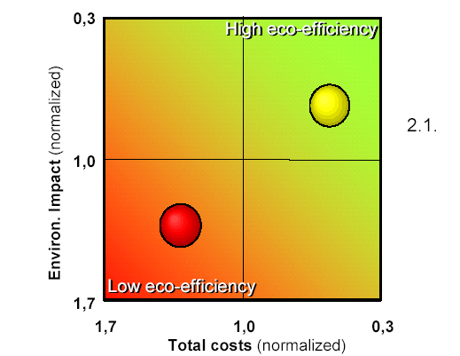
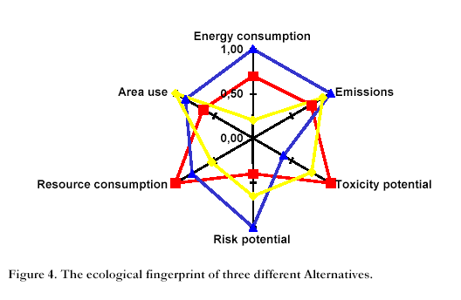
BASF Eco-Efficiency Analysis method
• impact of each of these categories is normalized with respect to one another.
• The least favorable option for each category is given the value 1 and the other alternatives are given values between 0 and 1 depending on their evaluated relative impacts.
• the ecological fingerprint is then combined into a standalone score that can be looked against cost.
Example: ecological fingerprint

Slide 39
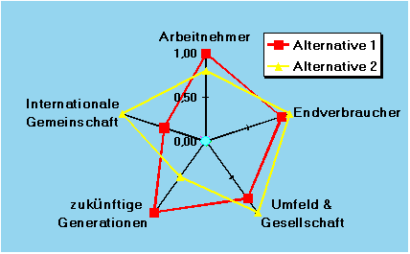
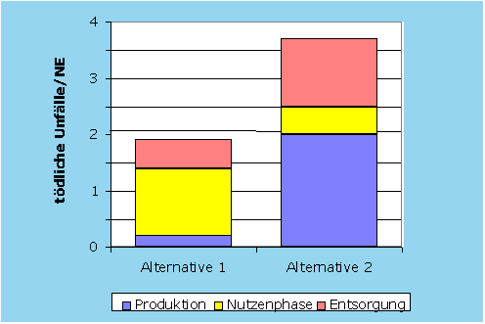
A Step Further: the SEECube®
The next optional step is integrating a Social Dimension into Eco-Efficiency Analysis
employees
workplace accidents /UB
international
community
consumers
future
generations
local & national community
SEECube®: Now cost, environmental footprint and social acceptability can be seen in one integral graph.

Slide 40
BASF Eco-Efficiency Analysis method
Benefits for the company
Strategic Decisions
Investment decisions
Technology decisions
Site decisions
Evaluate product portfolio
Marketing, Customers
Demonstration of product advantages
Improved customer relations
Product Differentiation
Better understand competitive
advantages
Research and development
Quantification of the most
important factors
Drive sustainable
products and processes
Drive production/process improvements
Stakeholder and Government Dialogue
Communication with authorities
Demonstration of Sustainability
Government “approvals”

Slide 41
Sponsored by Yale-UNIDO Initiative
QUESTIONS?
CENTER for GREEN CHEMISTRY
and GREEN ENGINEERING at YALE

